Slide 1

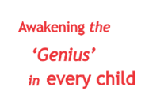


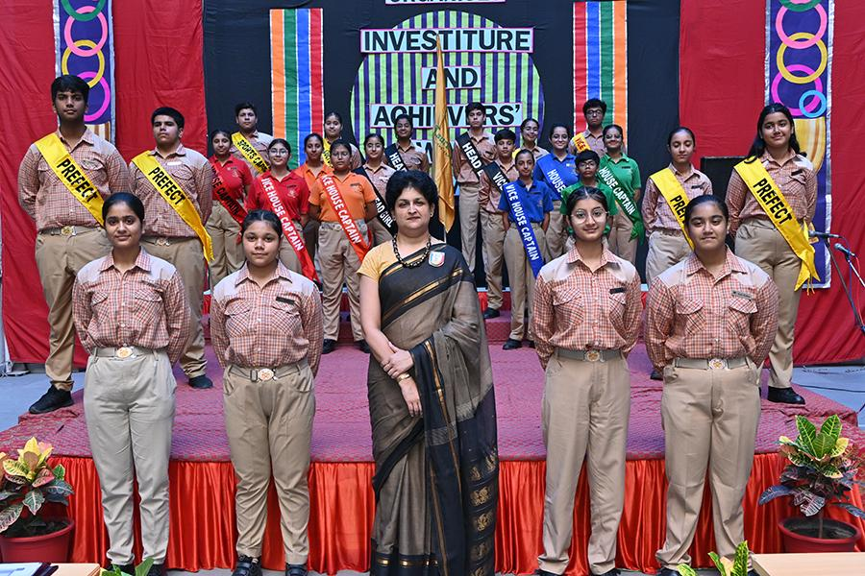
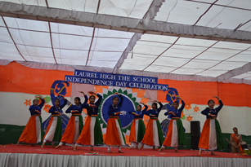
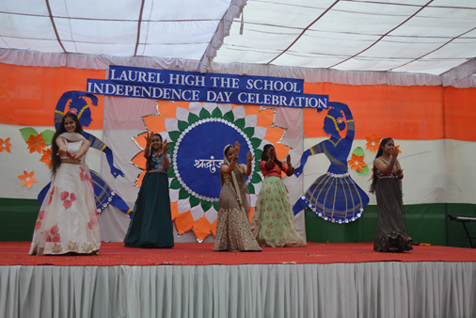
THE HORIZON
(July - August’23)
“Education is the bridge that connects imagination to reality.”

Slide 2
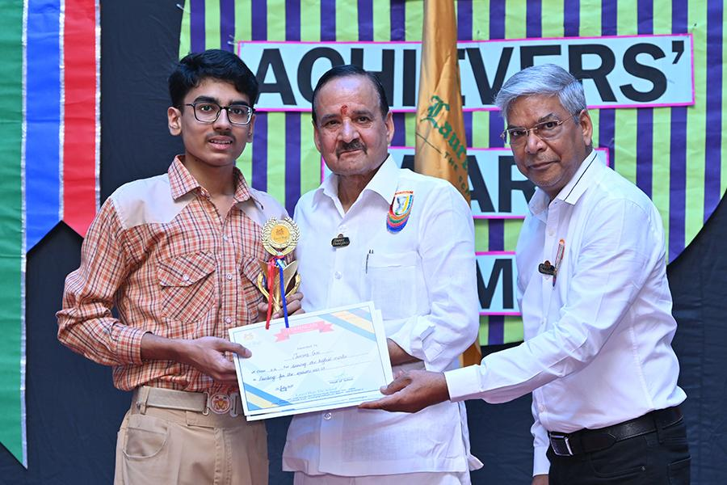
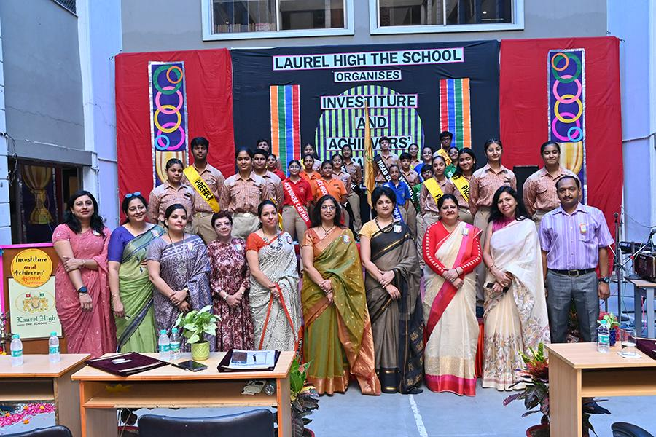
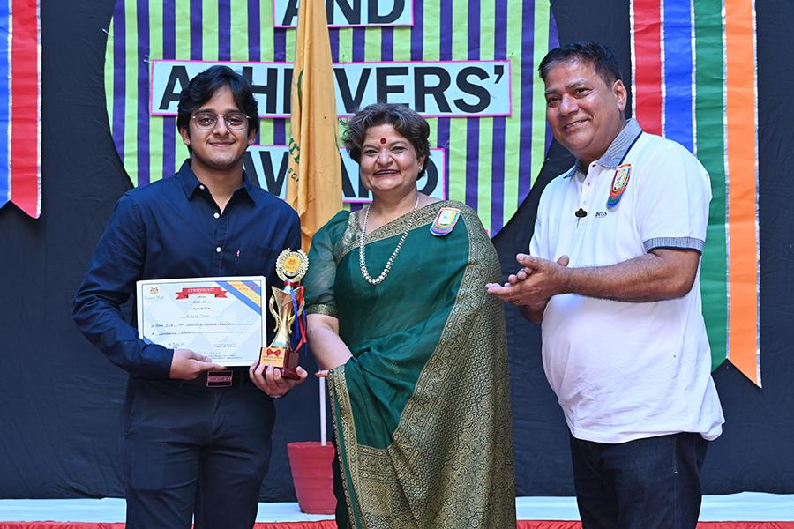
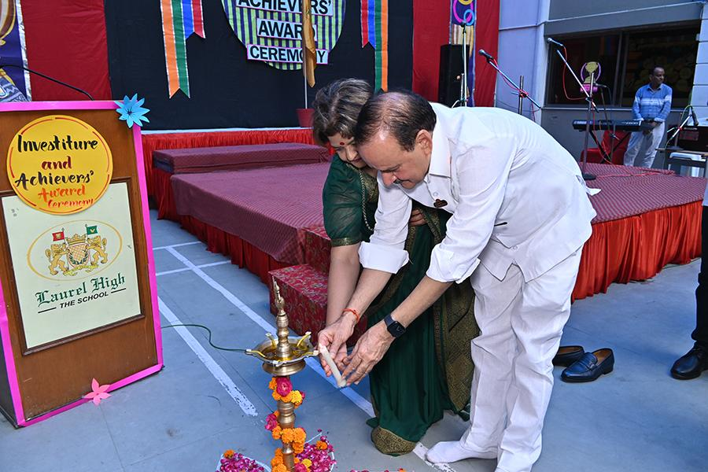
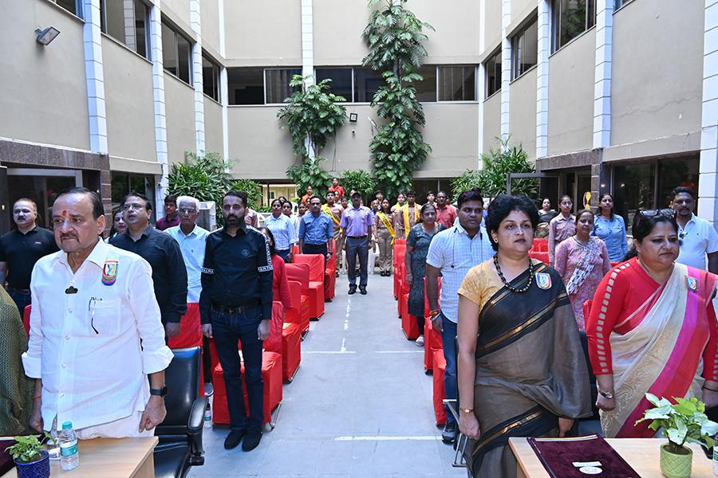
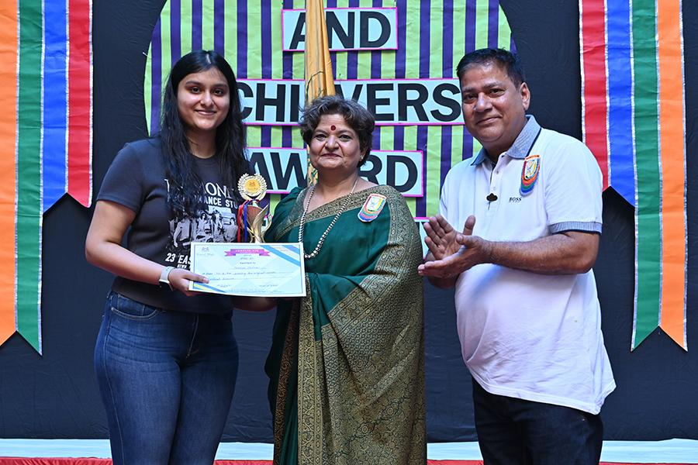
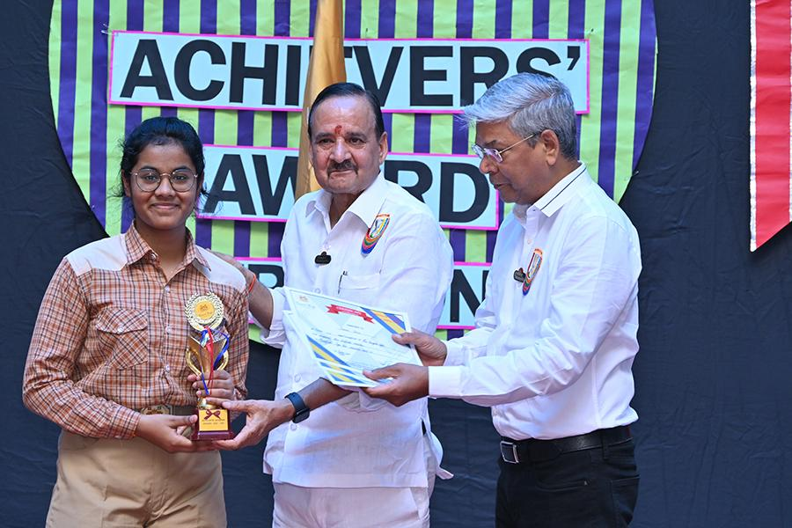
ACHIEVER’S AWARD CEREMONY

Slide 3
“Leadership is the capacity to translate vision into reality”
The most auspicious ceremonial occasion of the School, Investiture Ceremony was celebrated recently with full gusto and galore. The Student Council was bestowed with the leadership roles and responsibilities. The young leaders were conferred with the sashes and badges by Chairman Sir, Director Ma’am, Manager Sir, Head of School and other senior staff members. They inspired the young leaders to be the ultimate role models for others and contribute their best to the school and the society. The event concluded with inspiring speeches by the newly elected appointees. It aimed to espouse the confidence, development of leadership qualities and sense of obligation among the students. This was followed by the release of the latest edition of the school magazine, THE HORIZON.
Adding more sparkle to the event, a power packed Achievers’ Award Ceremony was held wherein the go getters of Classes XII and X were felicitated for being the top scorers in the CBSE BOARD Examination. The esteemed members of the Management and Head of School lauded the performance of the achievers and urged them to raise the bar and lead by example. The event turned out to be gala and was well appreciated by the parents and the esteemed dignitaries for surpassing excellence!

Slide 4
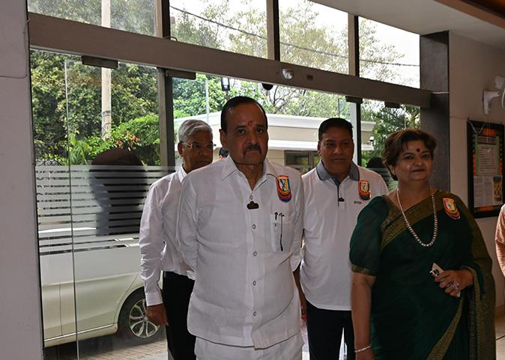
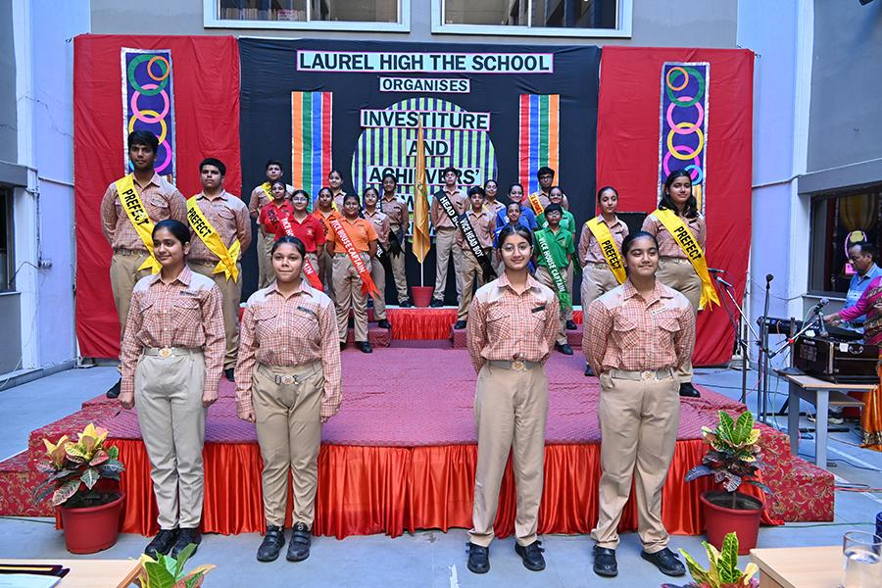
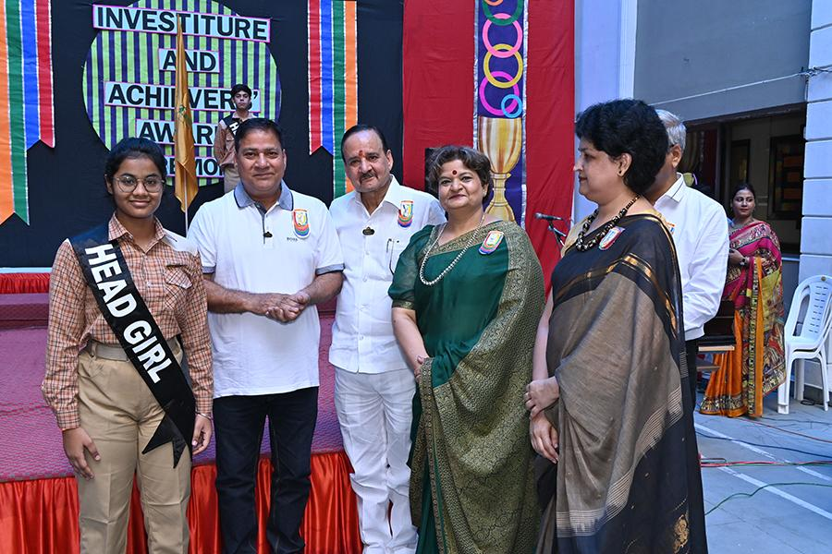
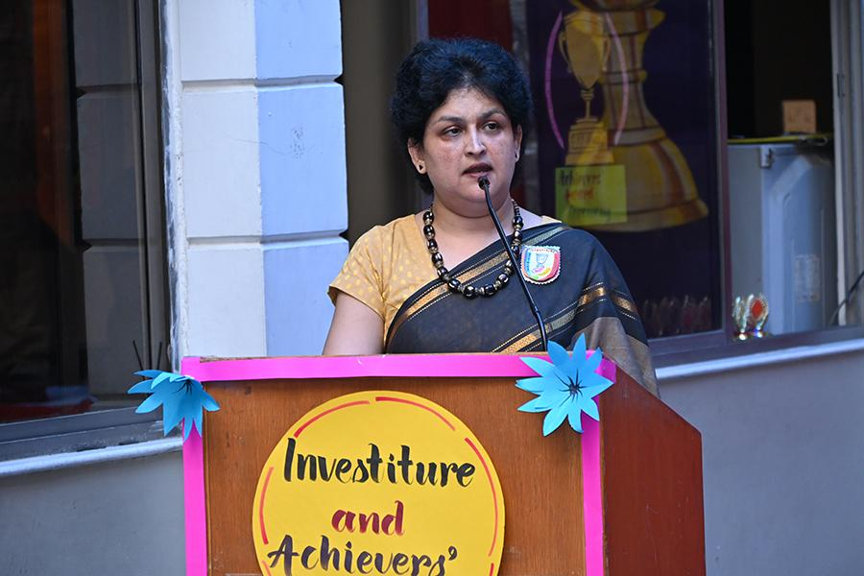
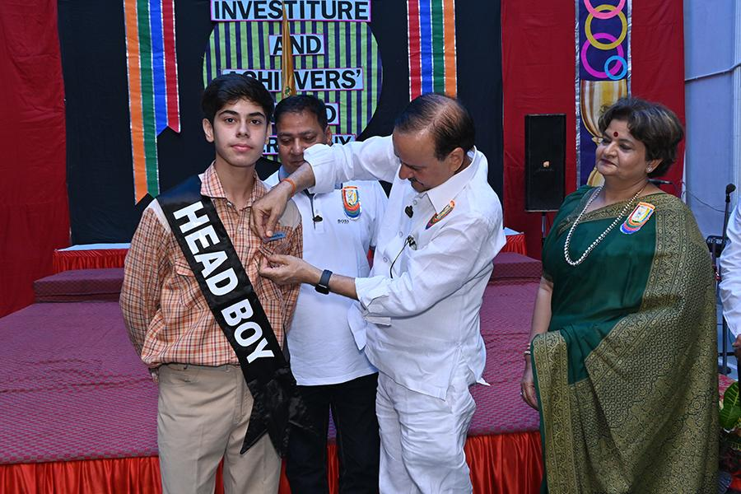

INVESTITURE CEREMONY

Slide 5
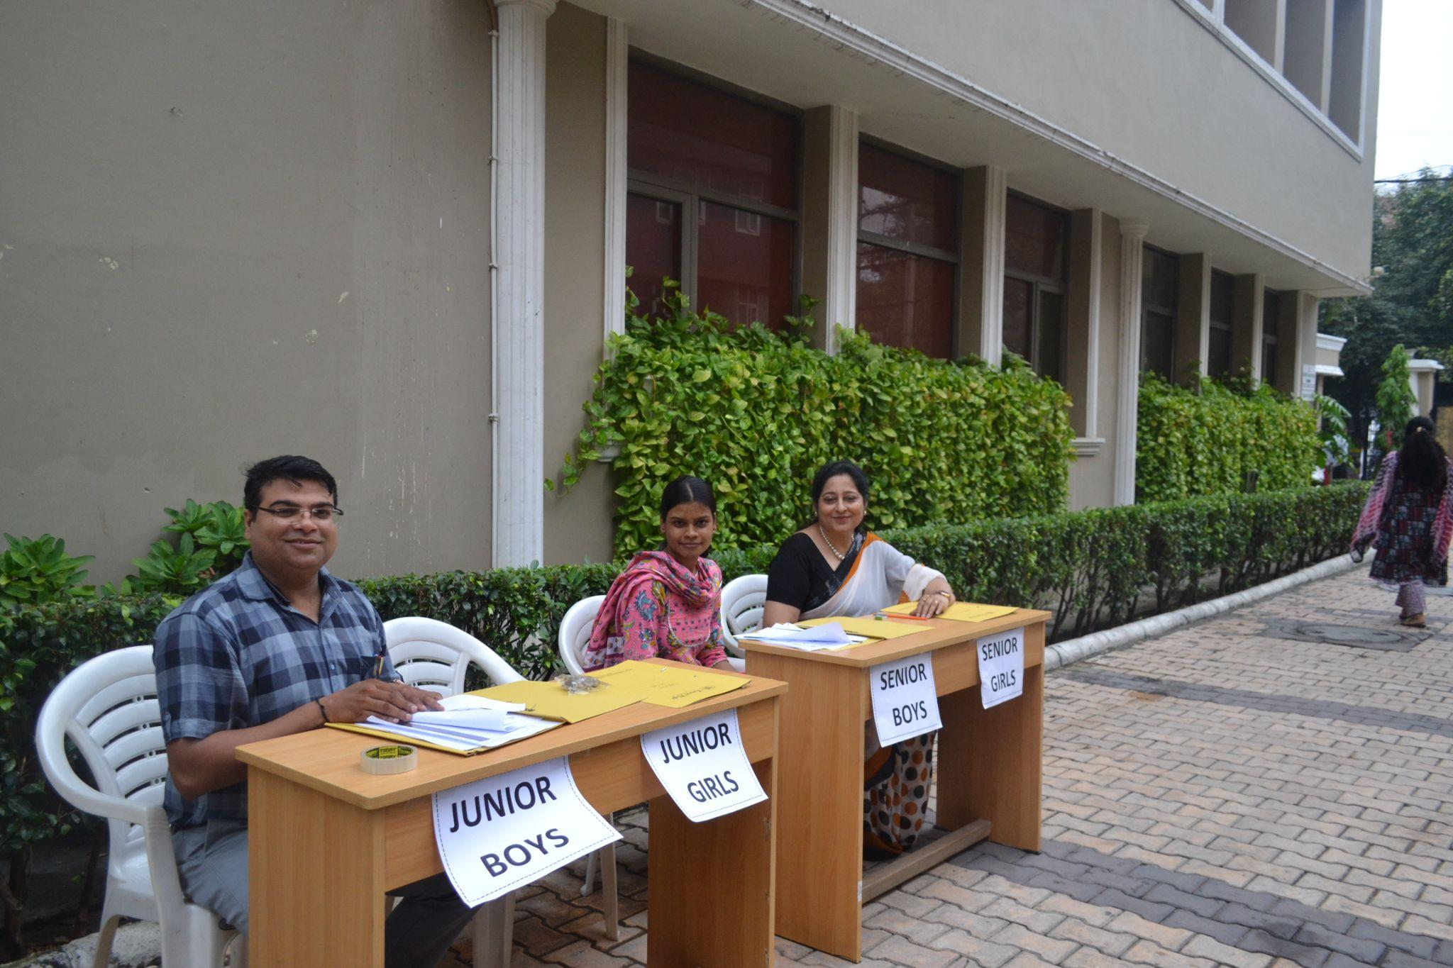
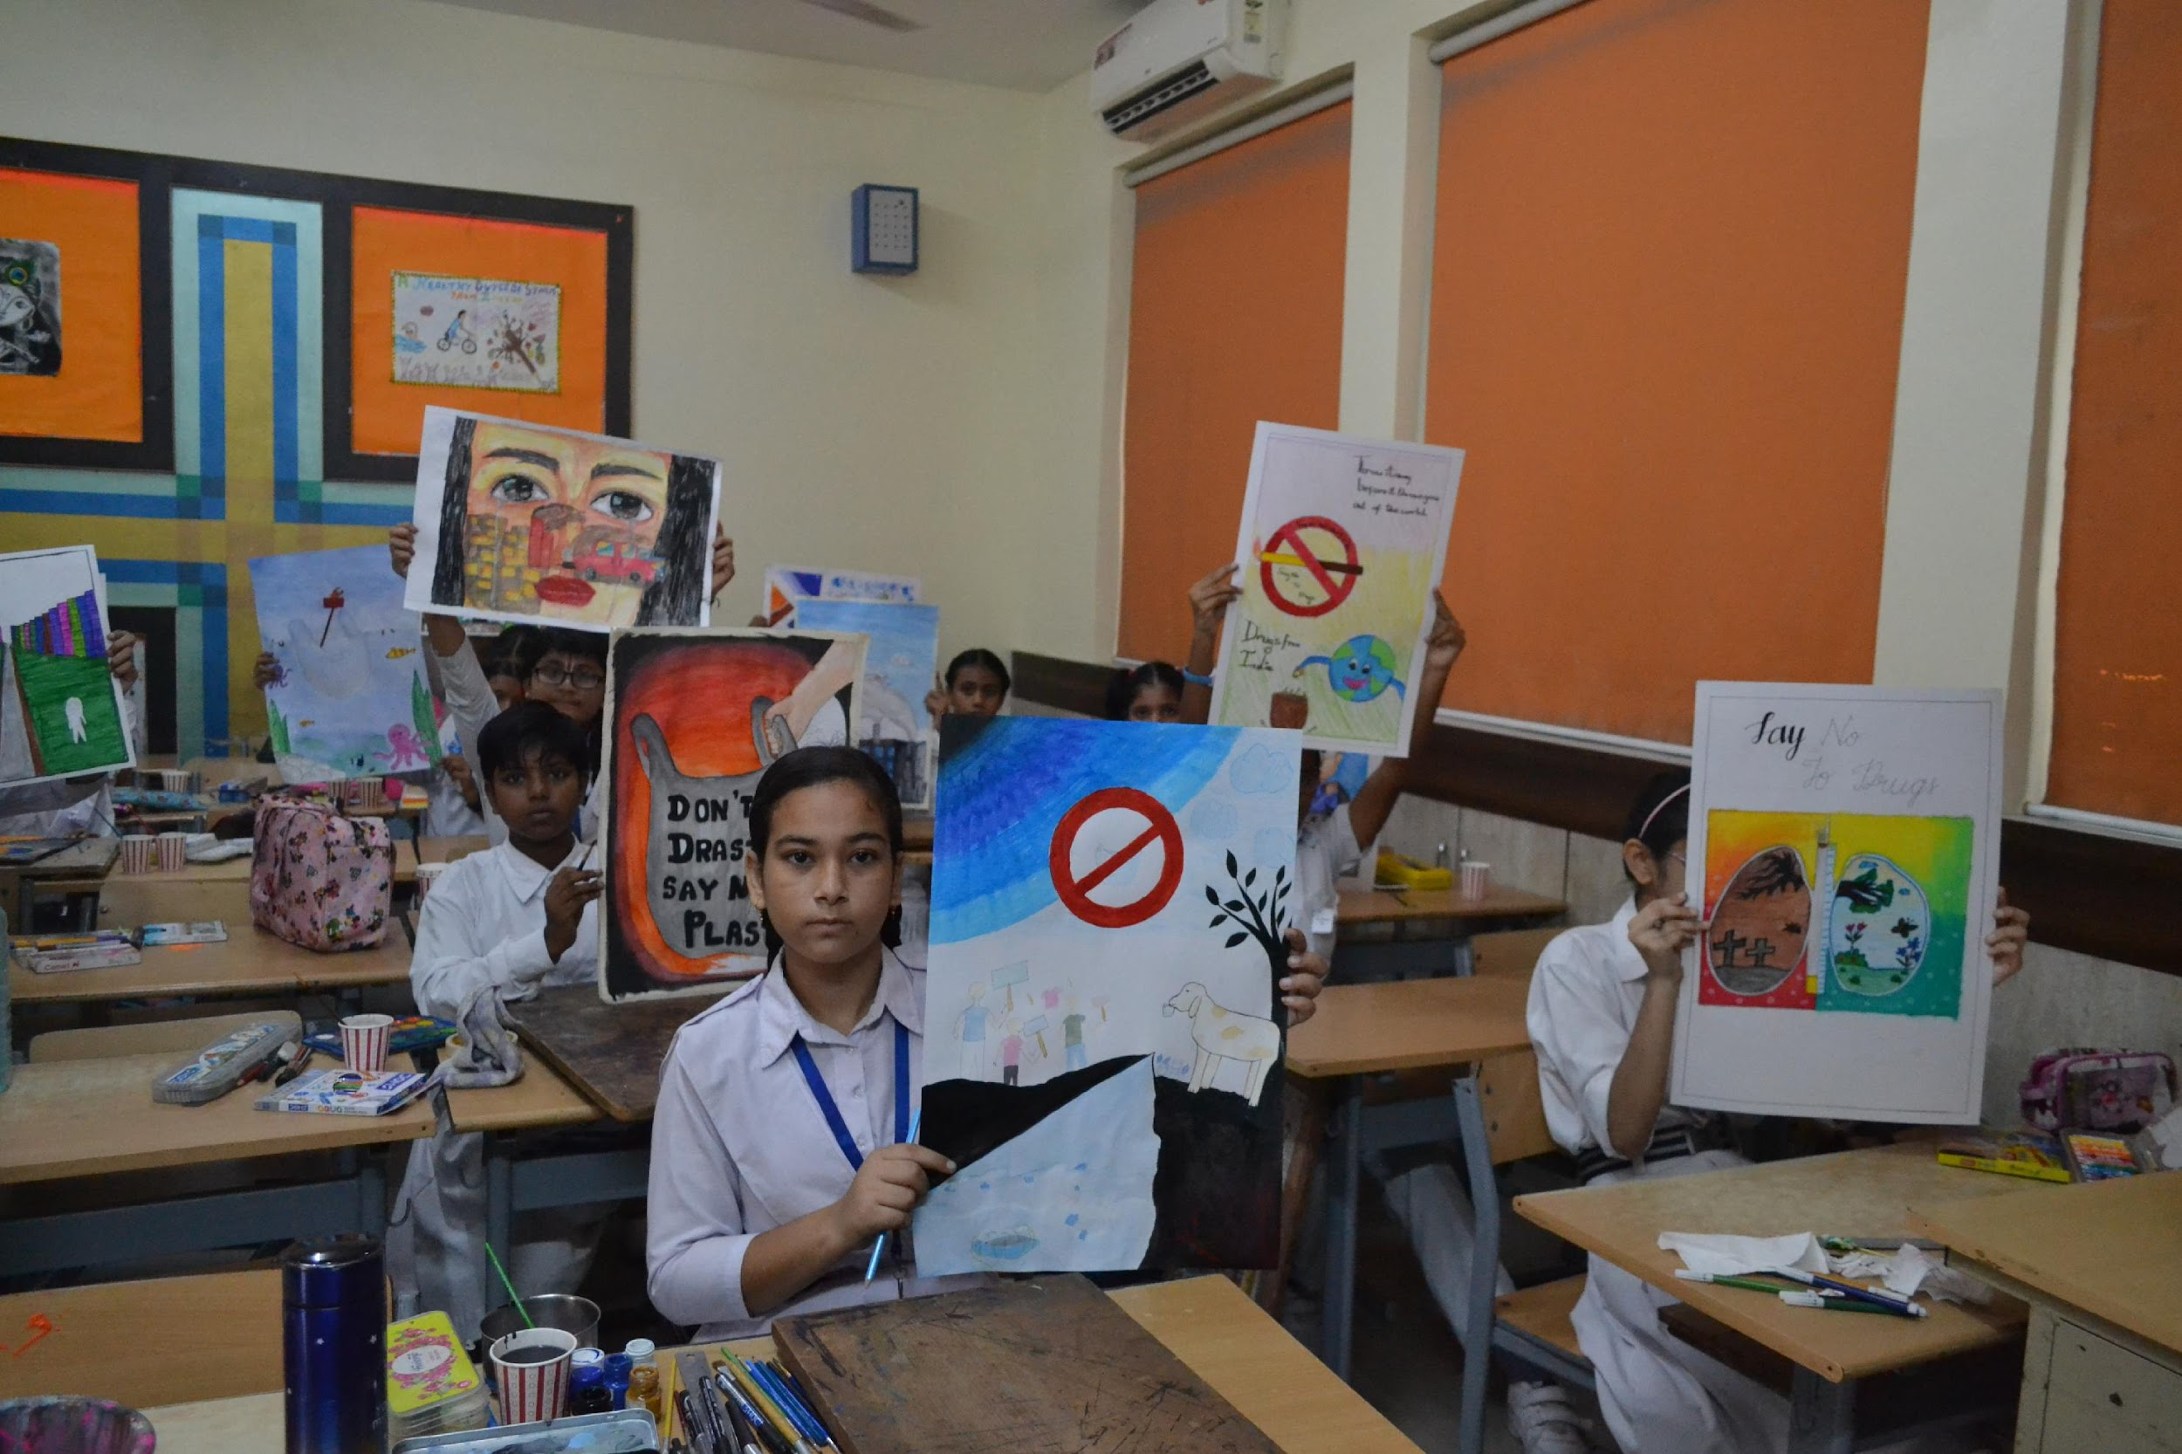

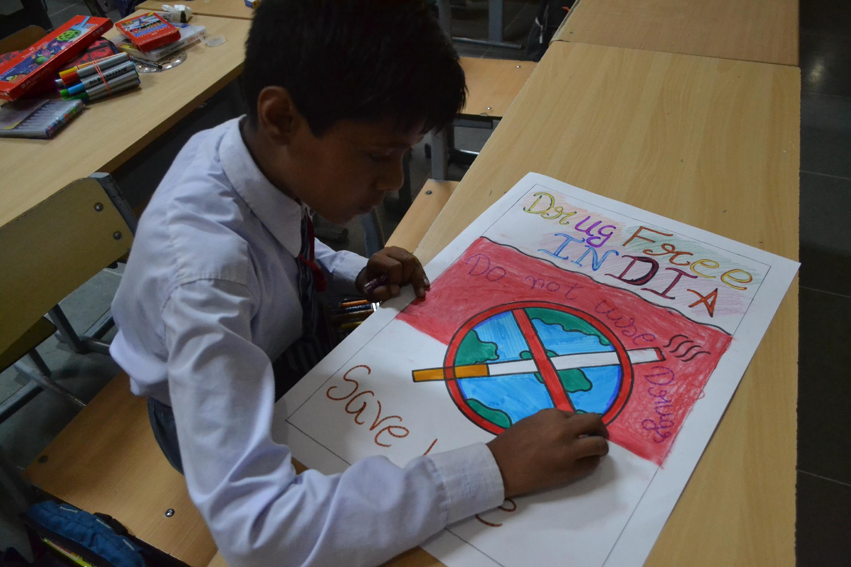
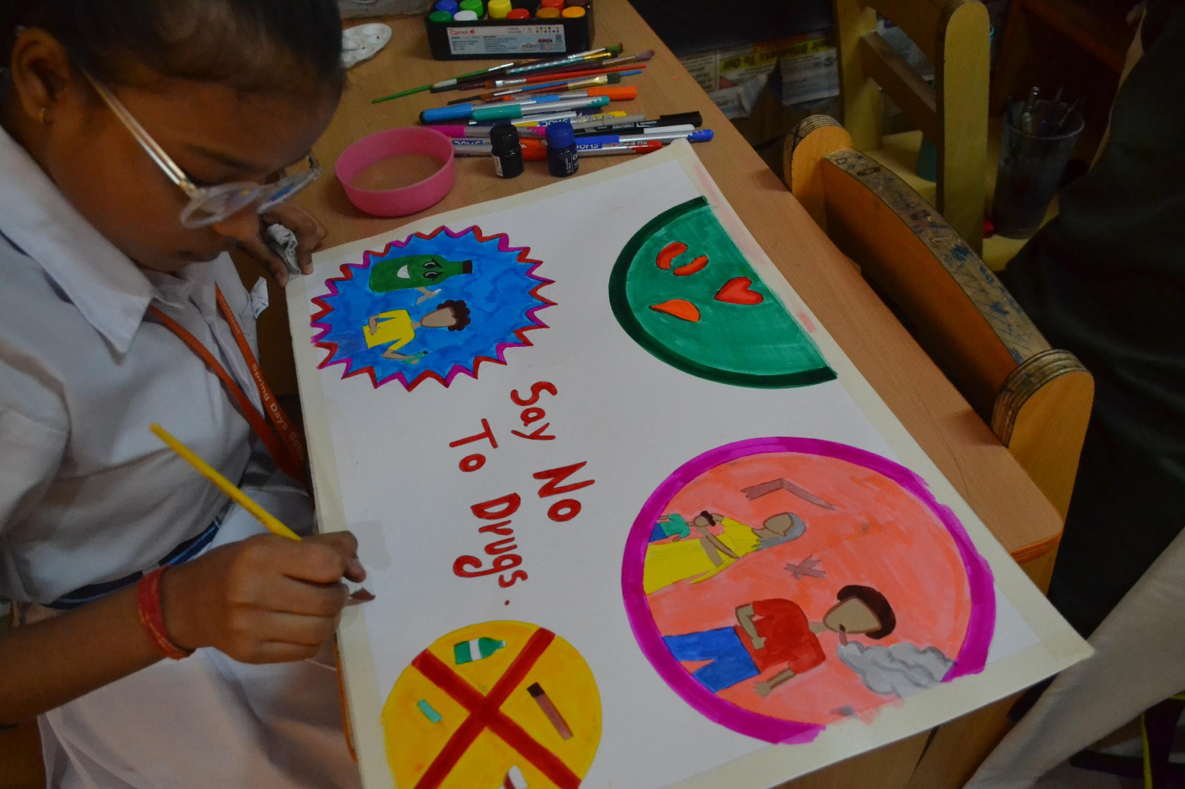
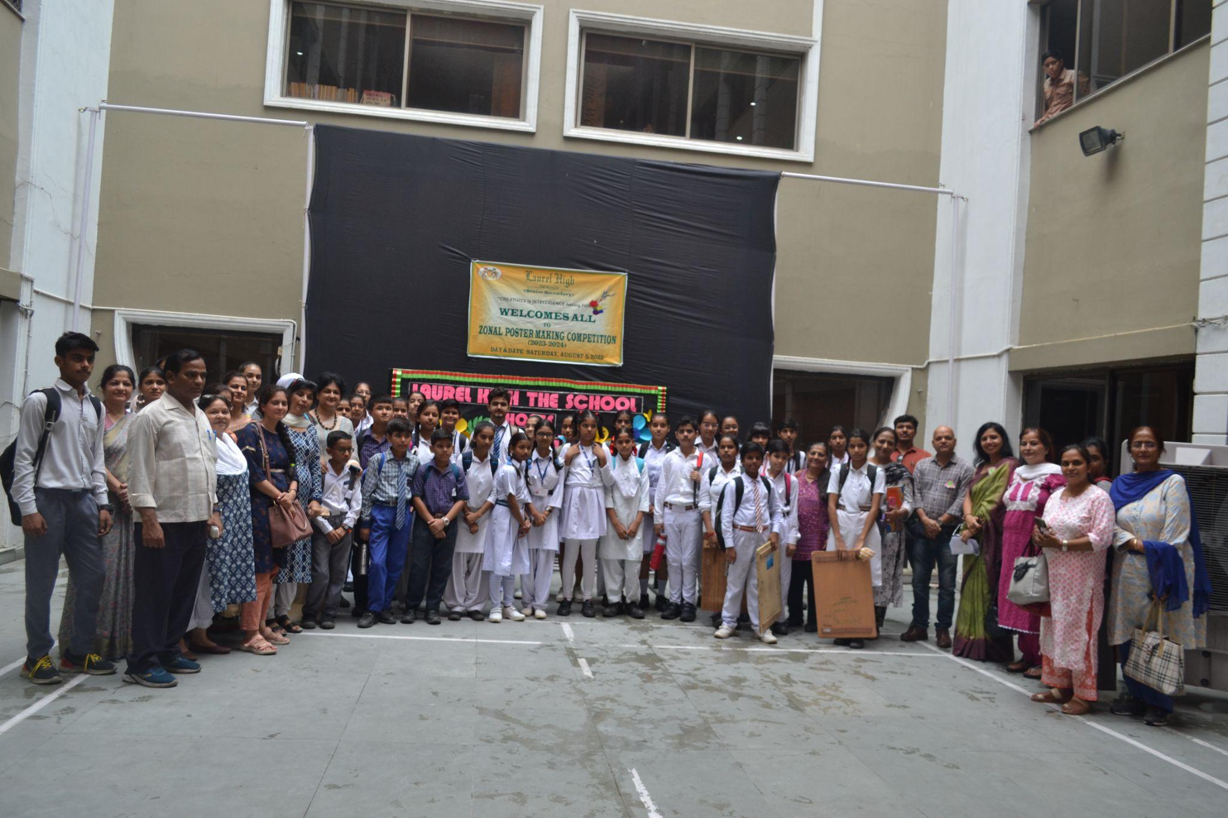
ZONAL POSTER MAKING COMPETITION
'Art washes away from the soul ,dust of everyday life.‘
The school hosted the Zonal Poster Making Competition on 5 August, 2023. Around hundred twenty students took part from various schools of the Zone. Students expressed their ideas and showed their creativity on burning topics like Clean India, Drug Addiction, India of my Dreams, Pollution: A silent killer, Technology: Boon or Bane.
They came up with wonderful
thought provoking and innovative
posters. The Student Council
ensured a smooth conduct of the same. Cultural Convener along with Ms. Hashmeet was also present. The event was judged by Ms. Vaishali Goel and Ms. Nidhi Sharma, both talented and experienced art professionals. It was a memorable day for the school.

Slide 6
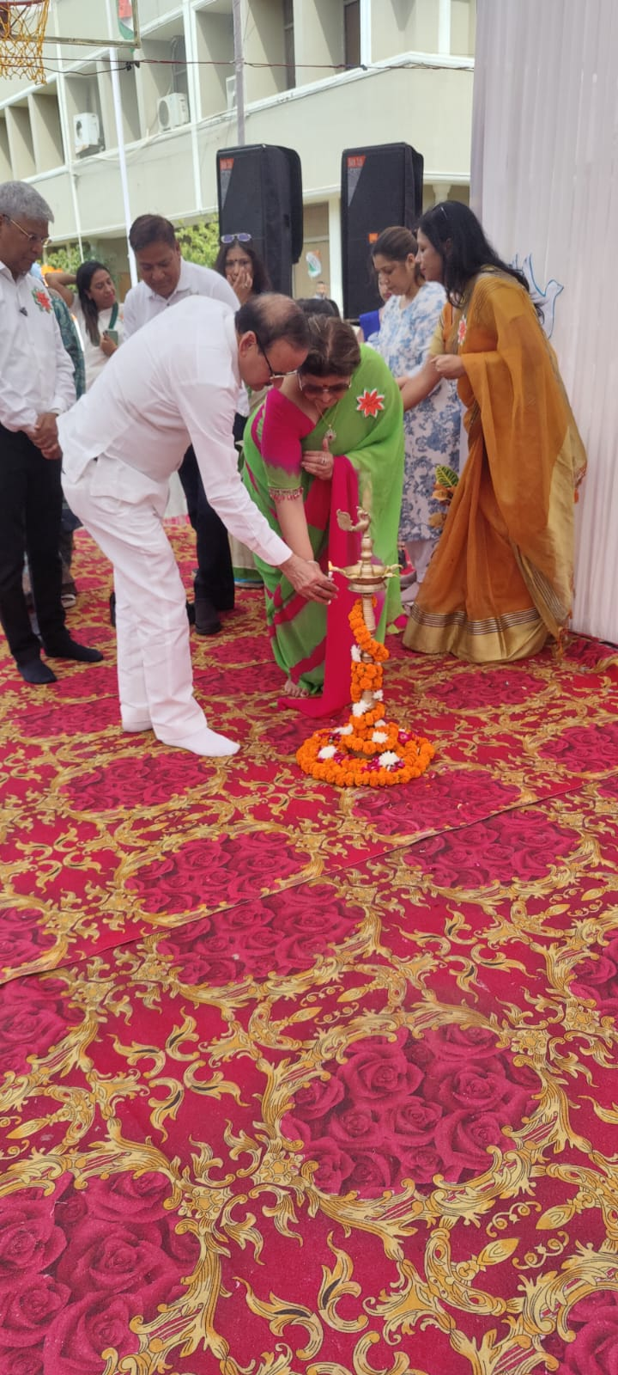
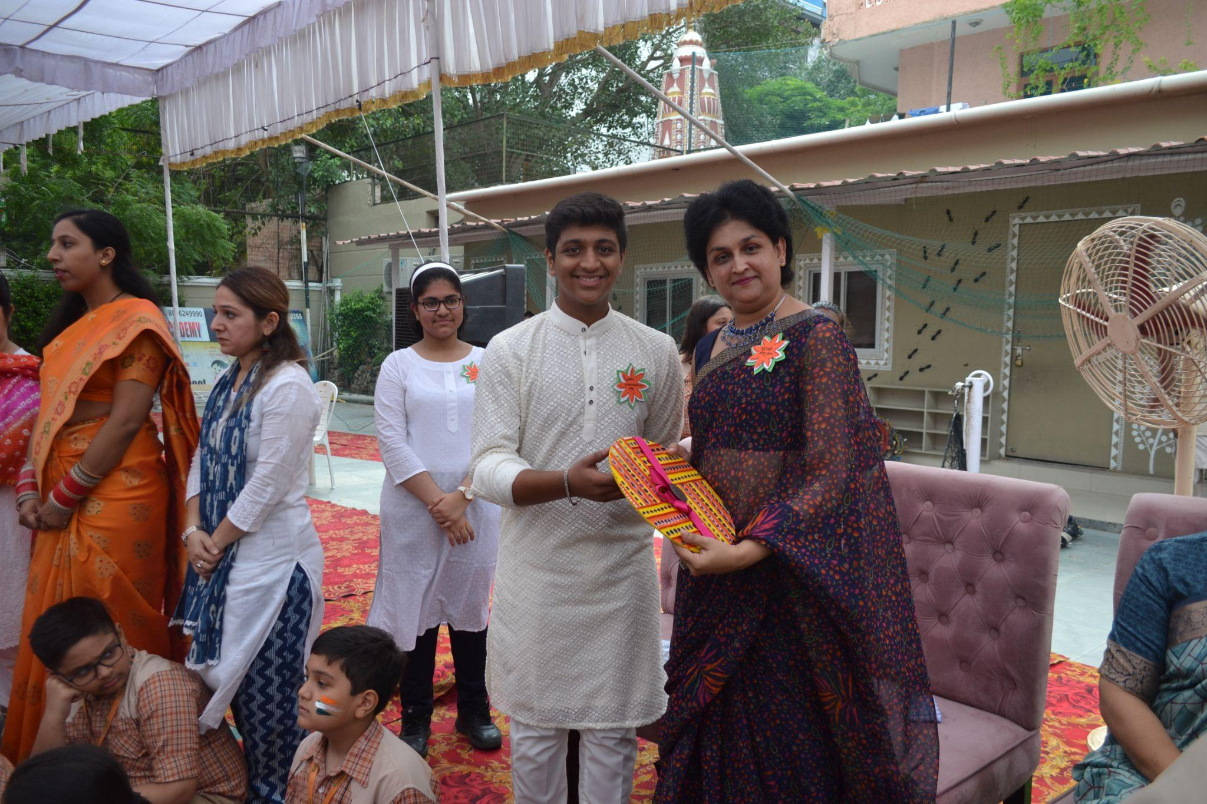
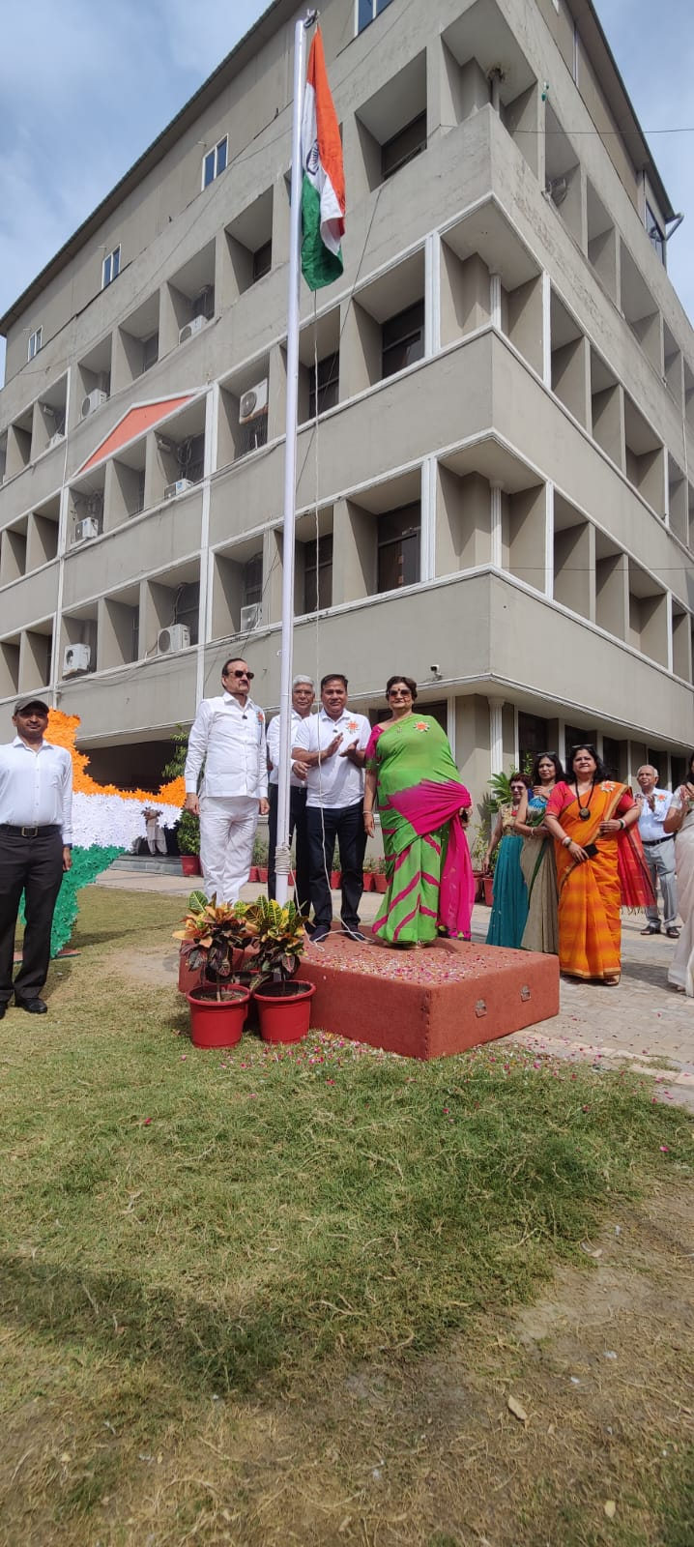
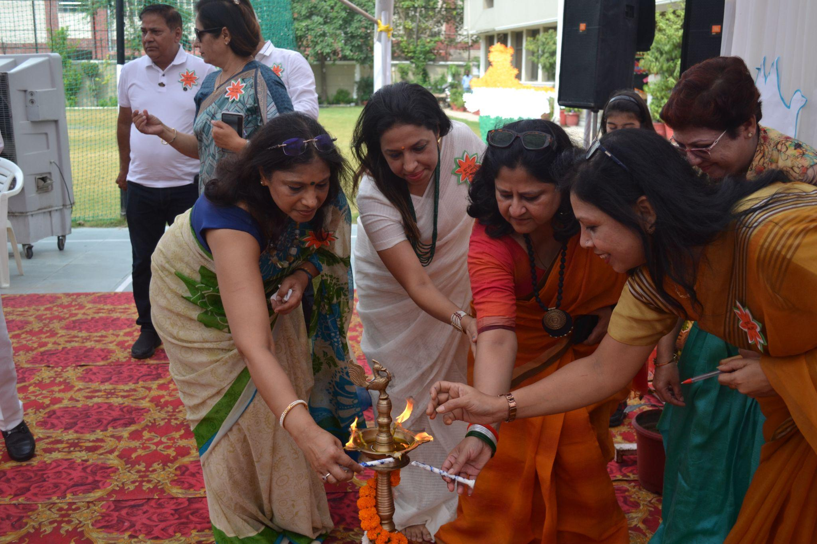
INDEPENDENCE DAY CELEBRATION
‘The future depends on what we do in the present, so let’s pledge to make ourselves fair-minded, fearless and faithful.’ Jai Hind! Mahatma Gandhi
Laurel High-The School celebrated 77th Independence Day with great enthusiasm and patriotic fervor. The National Flag was hoisted to the melody of the National Anthem . The echoes of patriotic songs were mesmerizing . A Nukkad Natak highlighting an important social issue was an eye opener for the audience. A skit on unsung hero Khudi Ram Bose was presented by the students of the Theatre Club. Dance performances by the students of Mont Branch and junior classes were commendable. Synchronised tunes of patriotic songs played by orchestra were the highlight of the day. Chairman Sir addressed the event with a solemn speech to pay ‘Shradhanjali’ to the brave martyrs of the country. Manager Sir gave a motivational speech and paid tribute to the brave hearts of the country.The Grand Finale was based on the life of a soldier who spends all his life for his country and leaves his family behind with lifelong emptiness. The program concluded with a promise to serve the country. The efforts of the students were appreciated by everyone.
VANDE MATARAM!

Slide 7
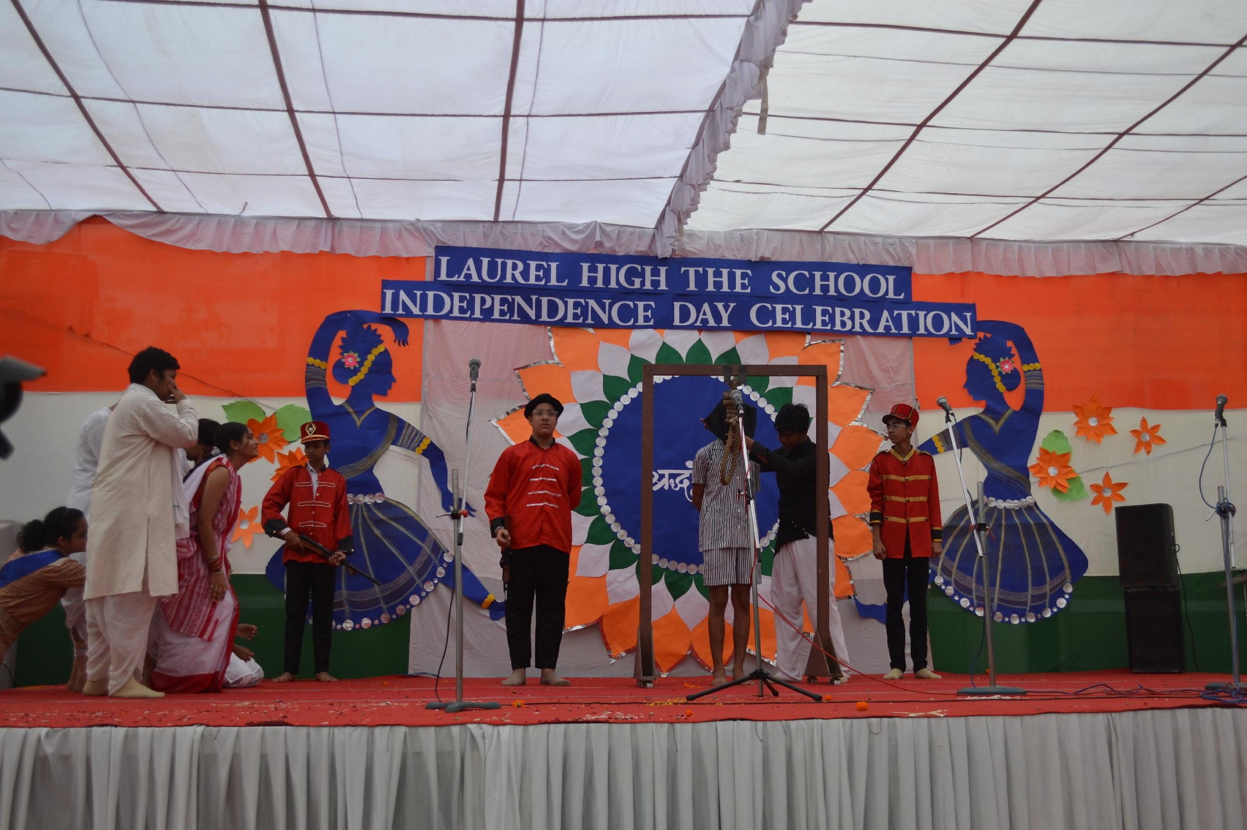
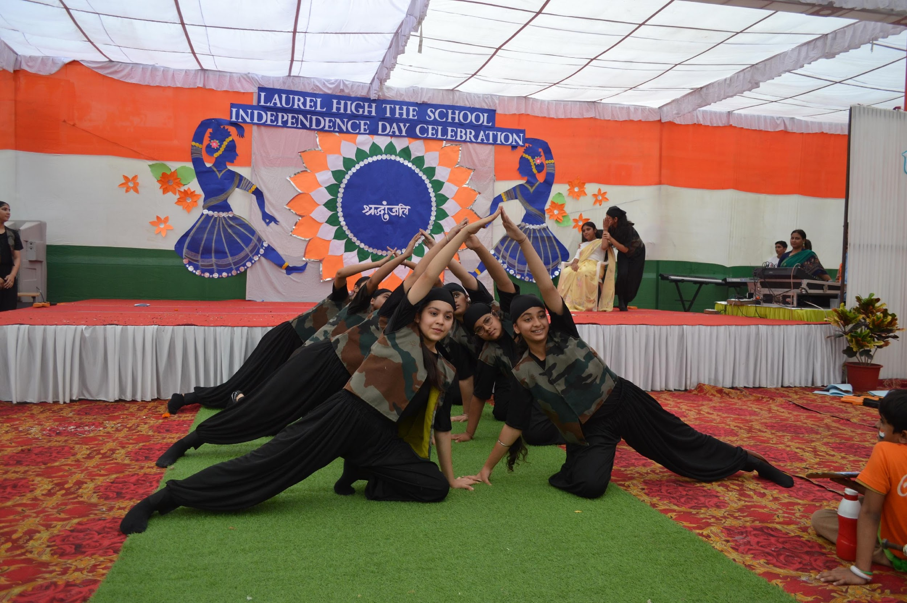
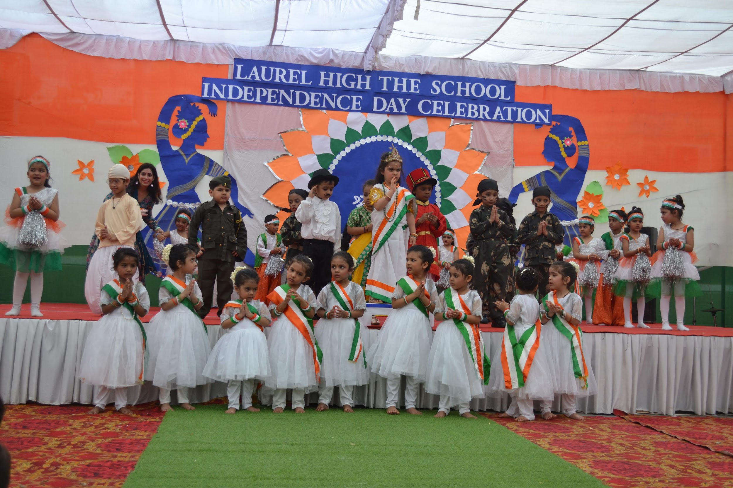
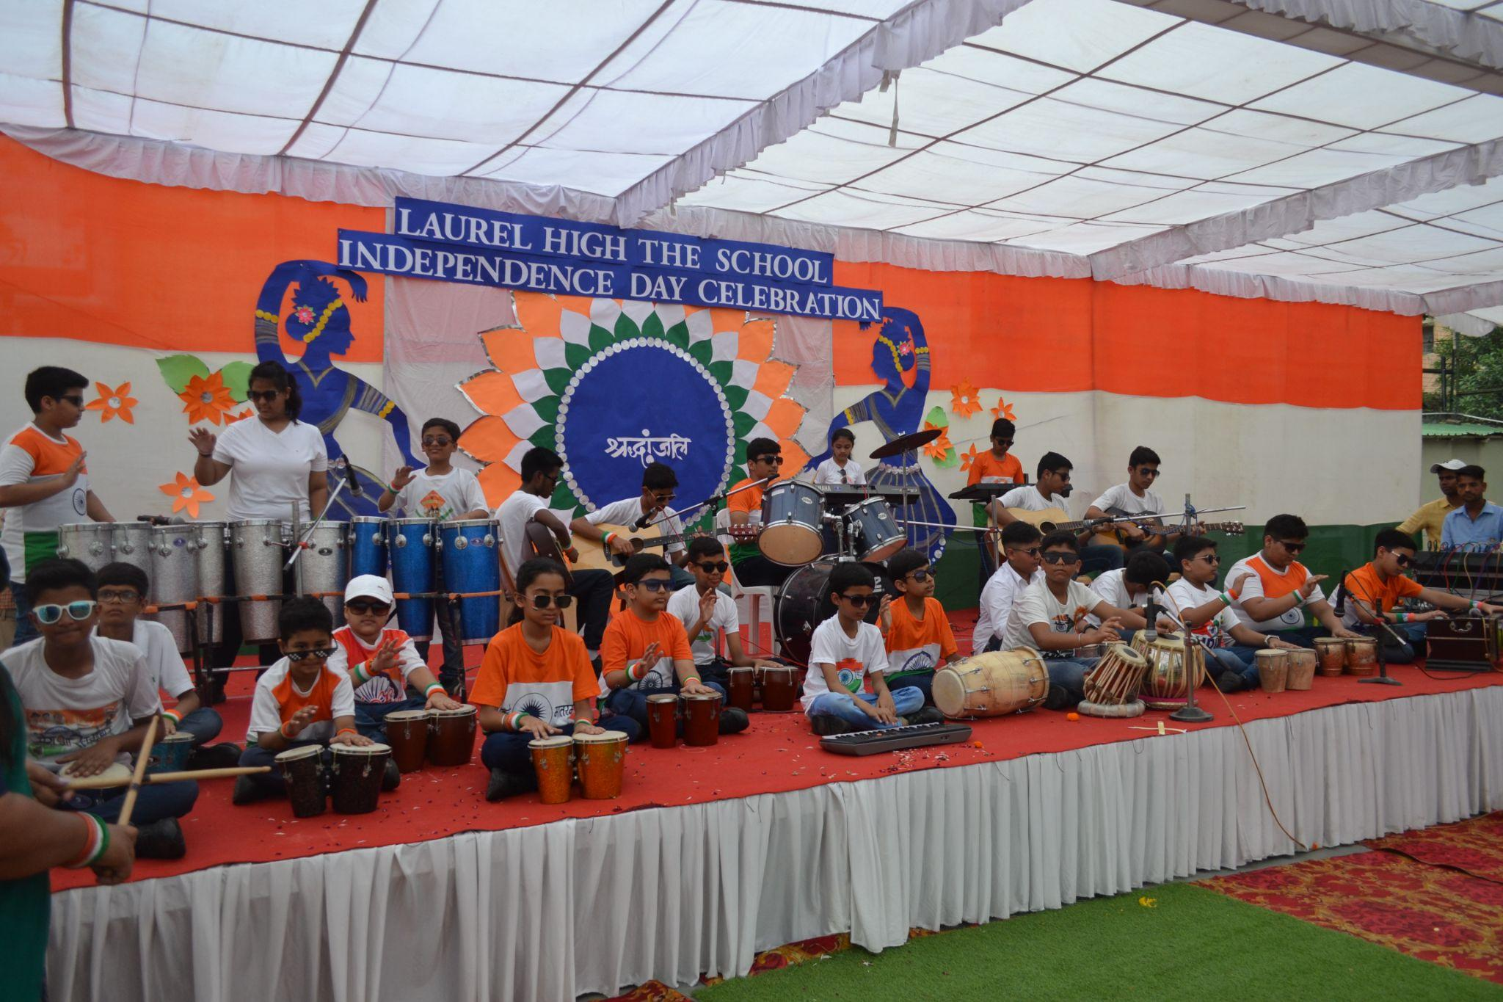
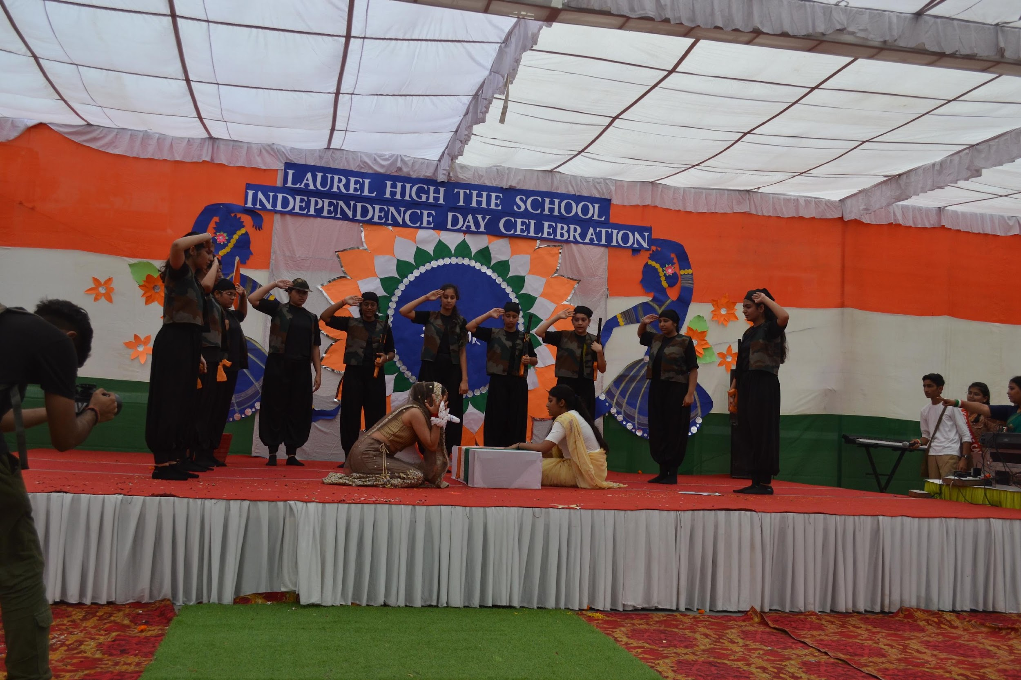
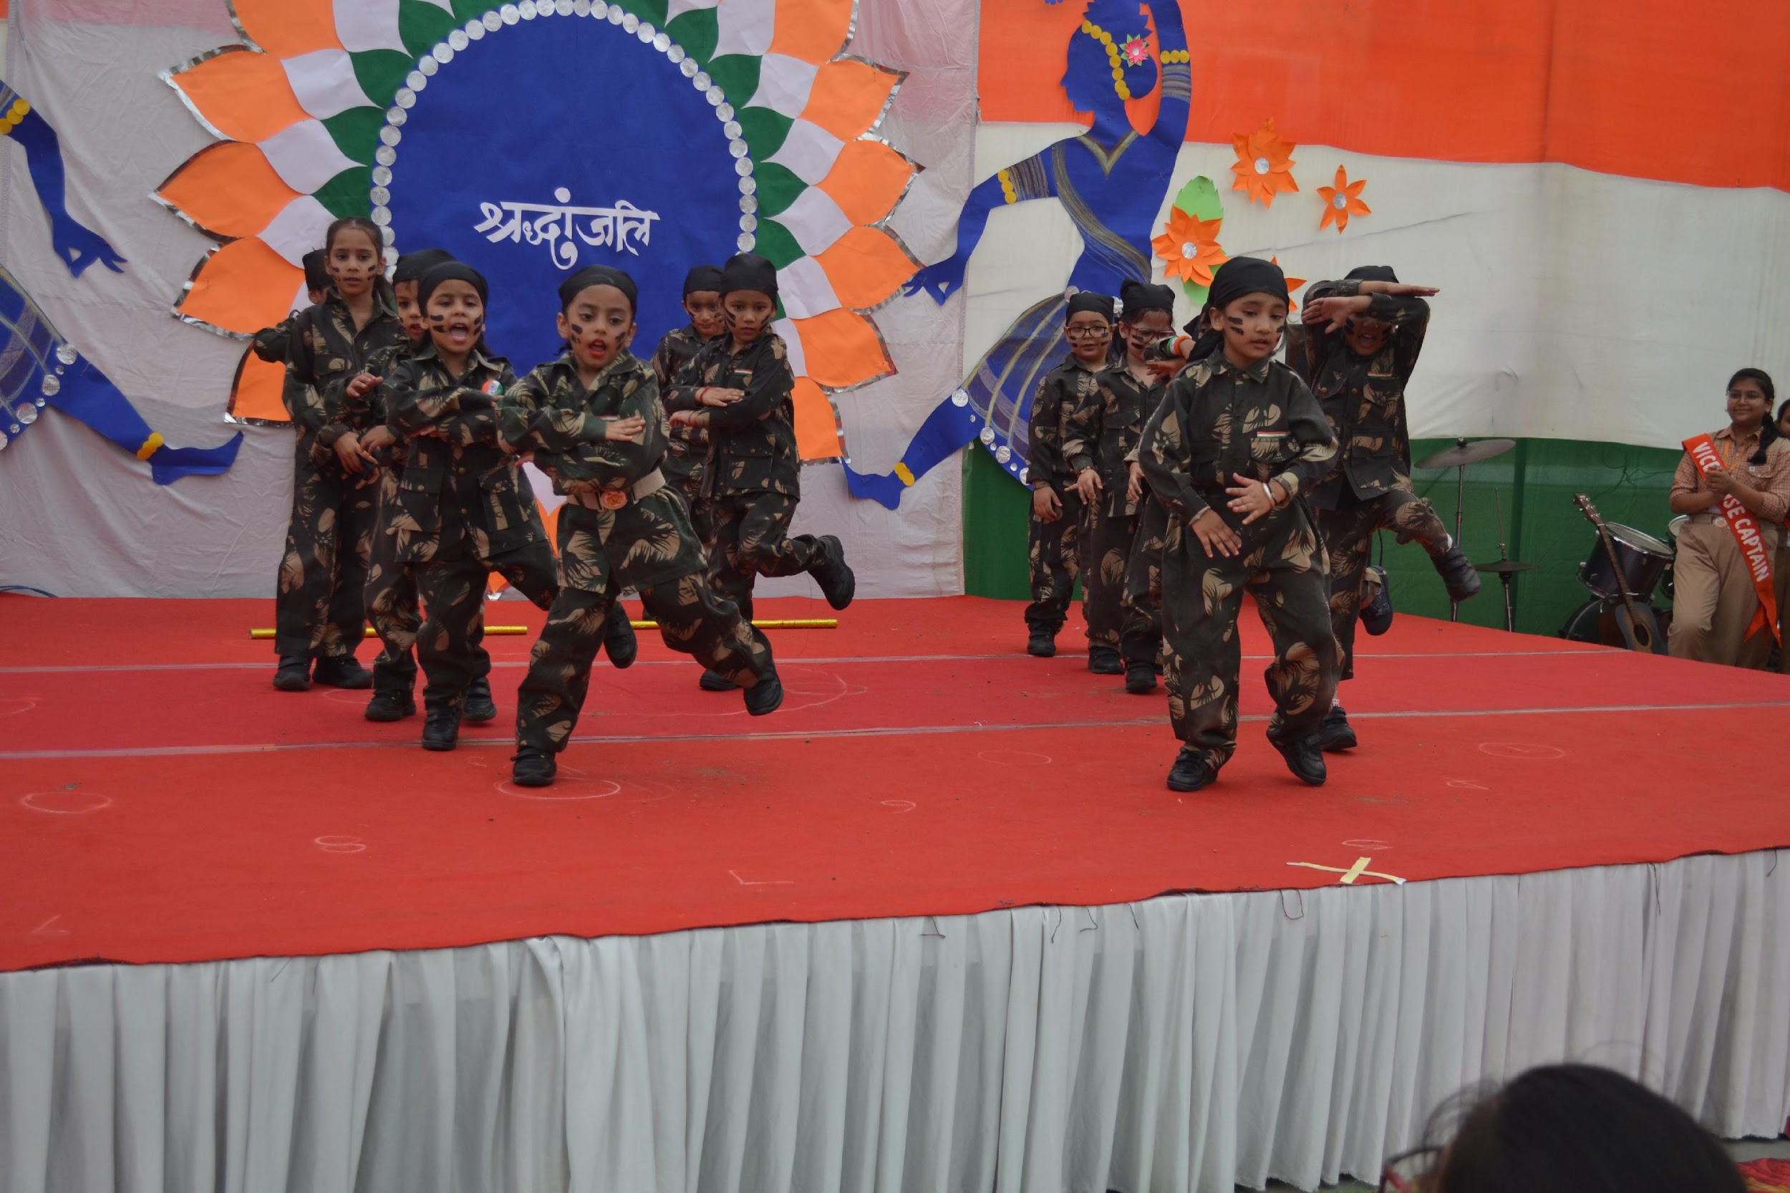
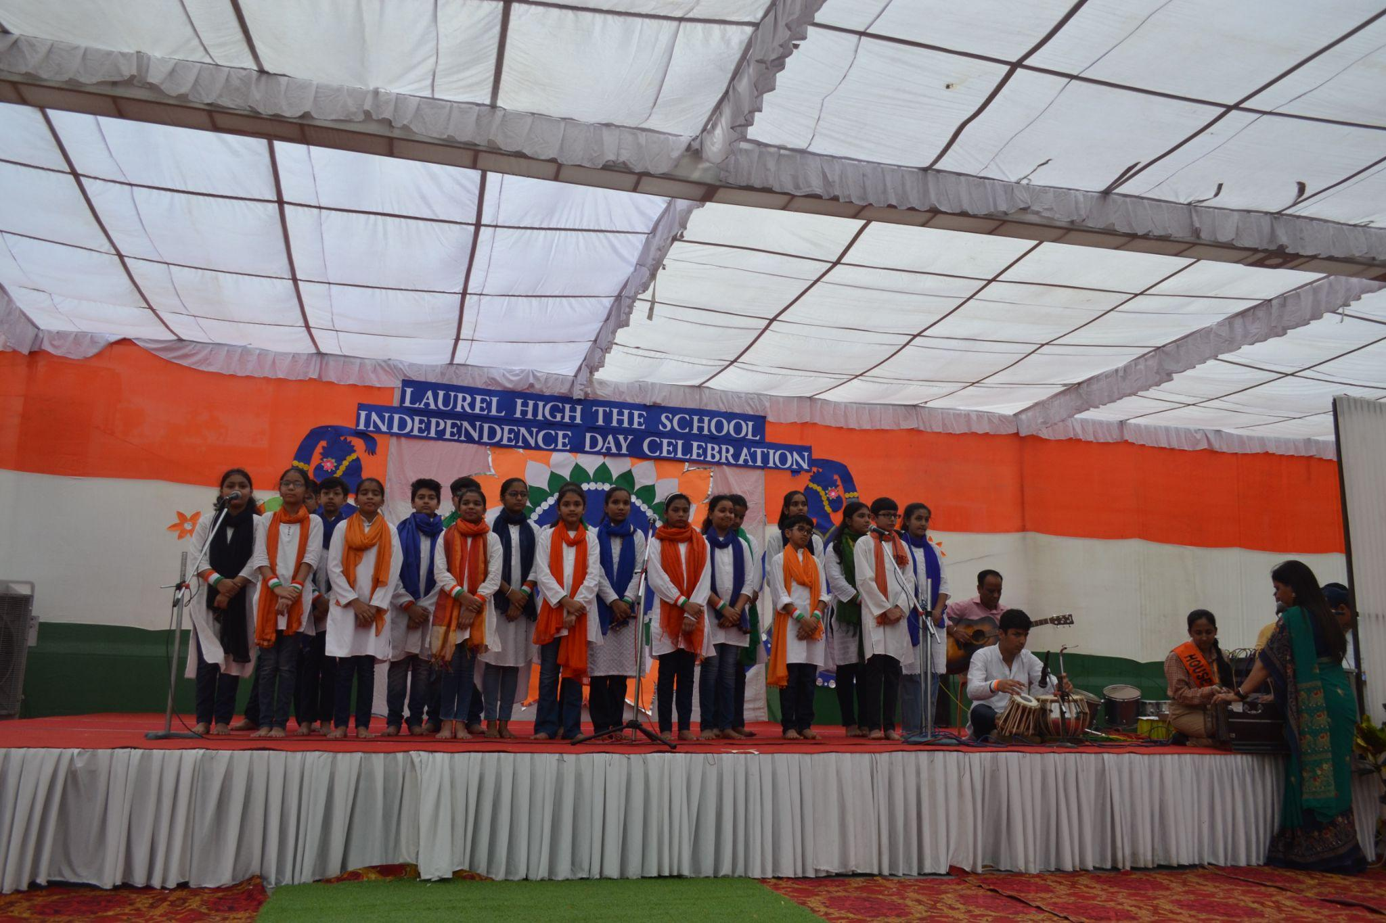


INDEPENDENCE DAY CELEBRATION

Slide 8


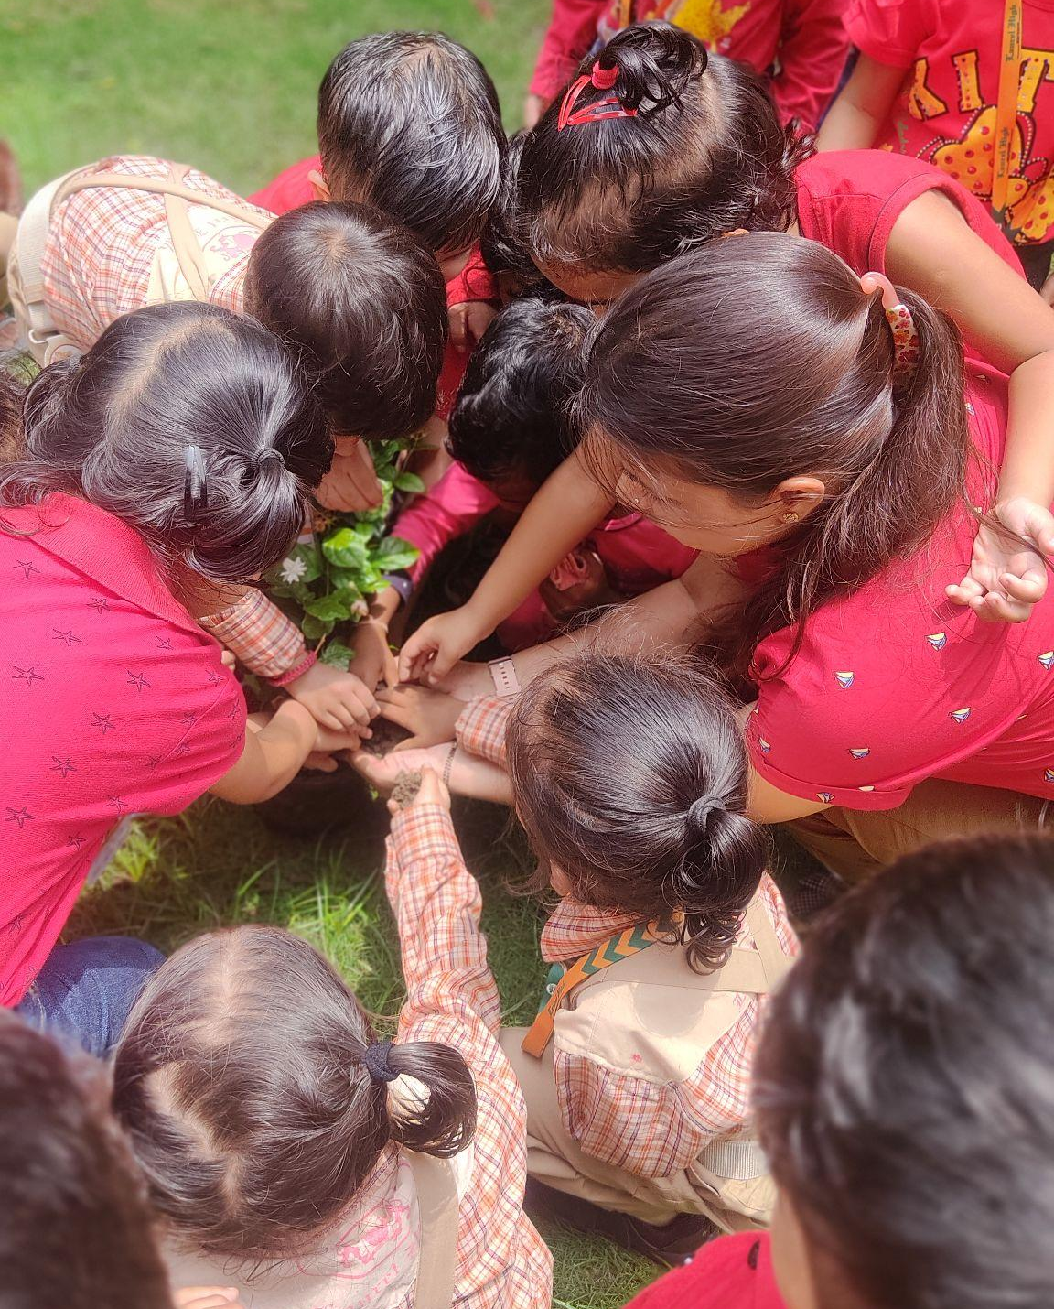
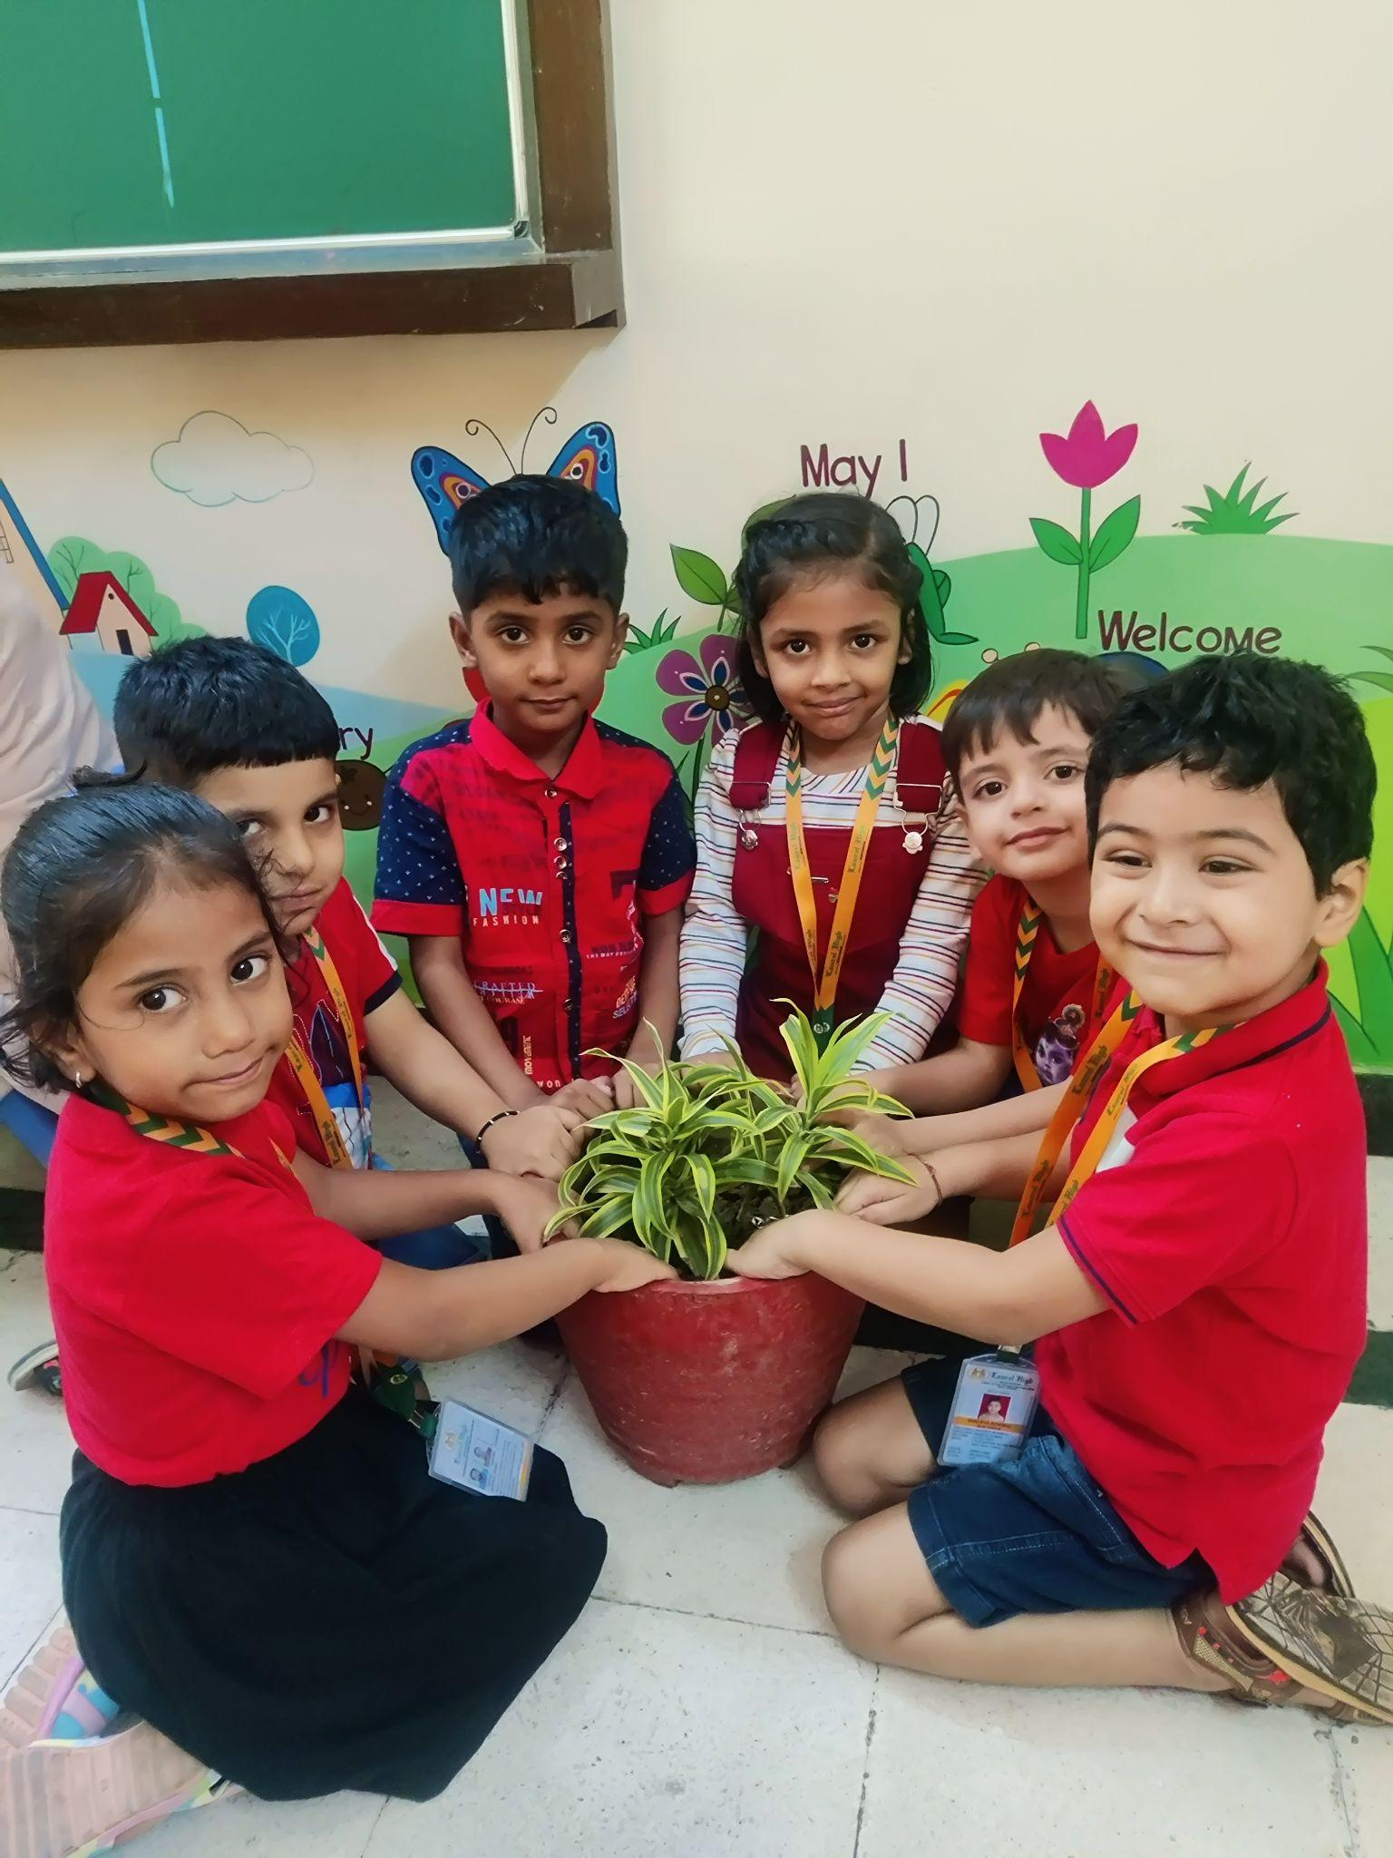
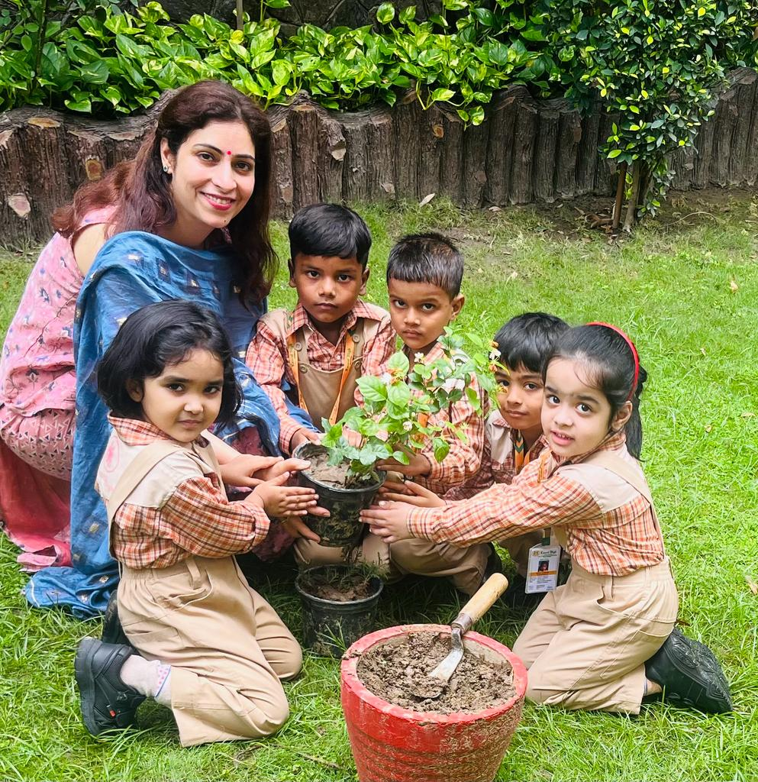
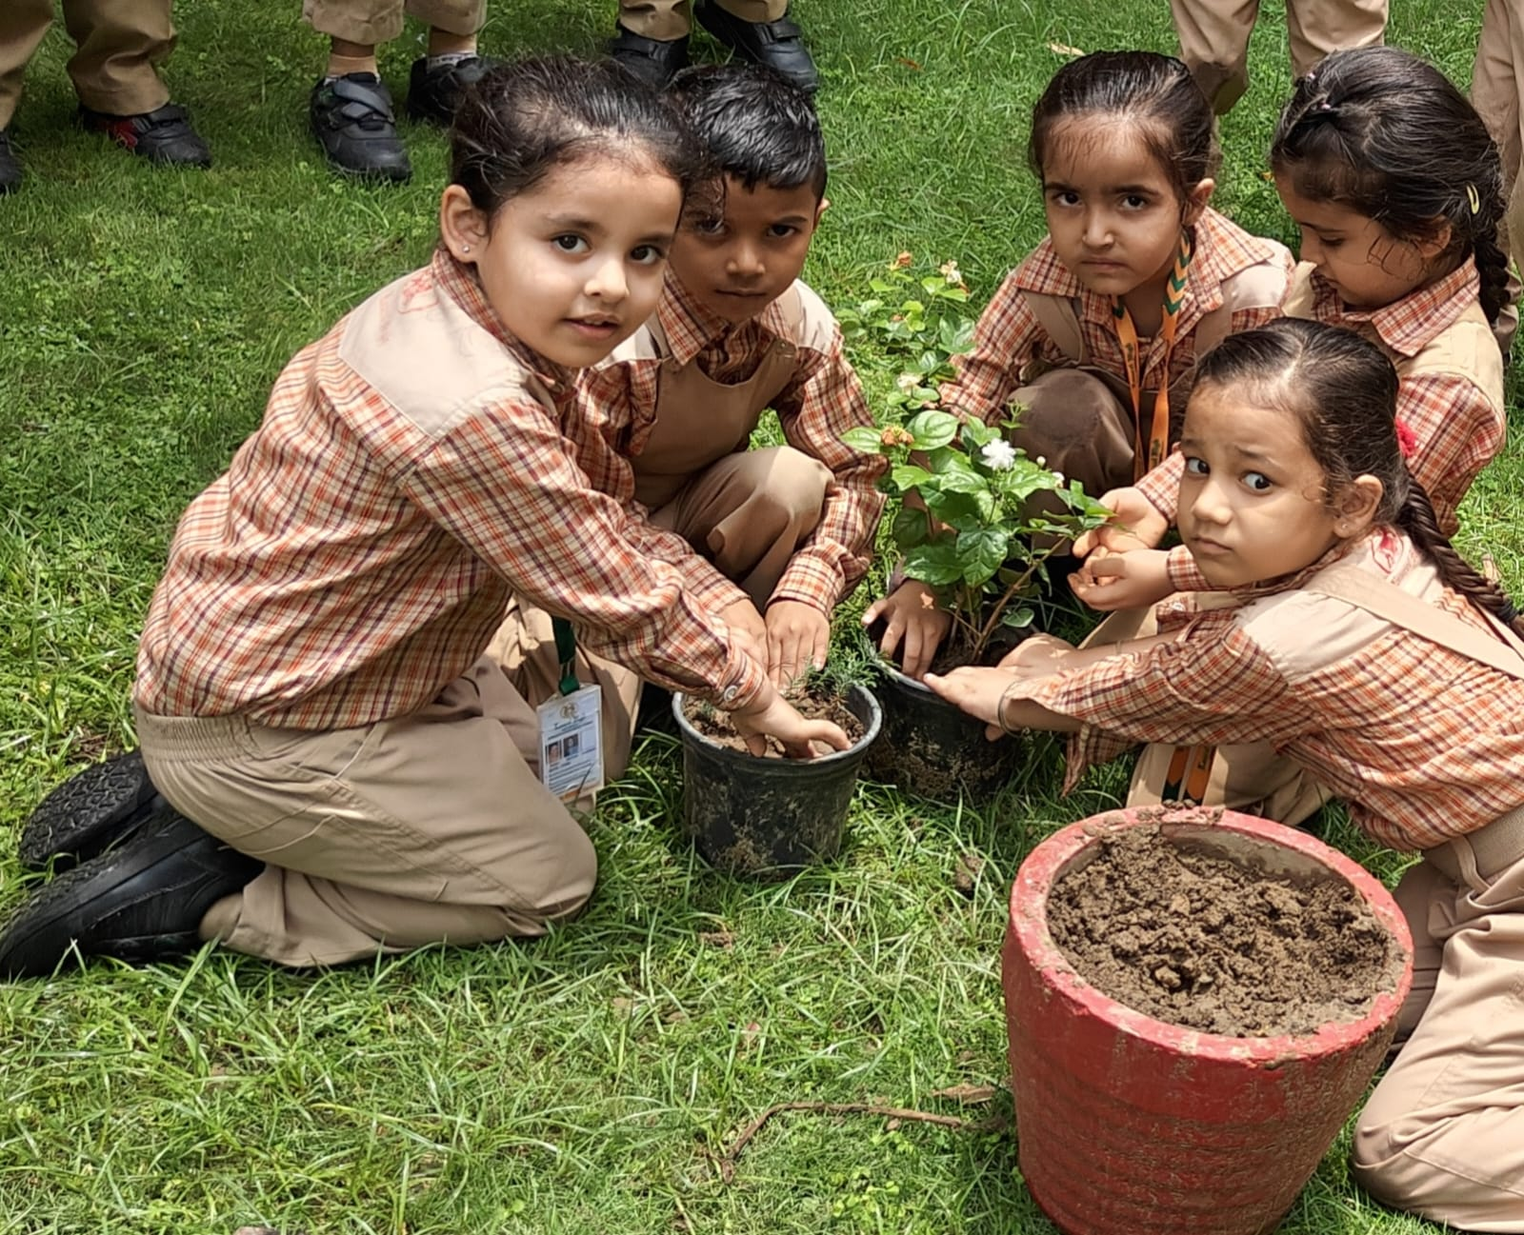
VAN MAHOTSAV
MONTESSORI BRANCH
Van Mahotsav was celebrated with enthusiasm and our lovely children participated in the activity which aimed to inculcate the value of protecting our green friends. They dressed up as trees and urged everyone to save our green friends. Plantation drive was done to promote Green India Clean India Movement.

Slide 9

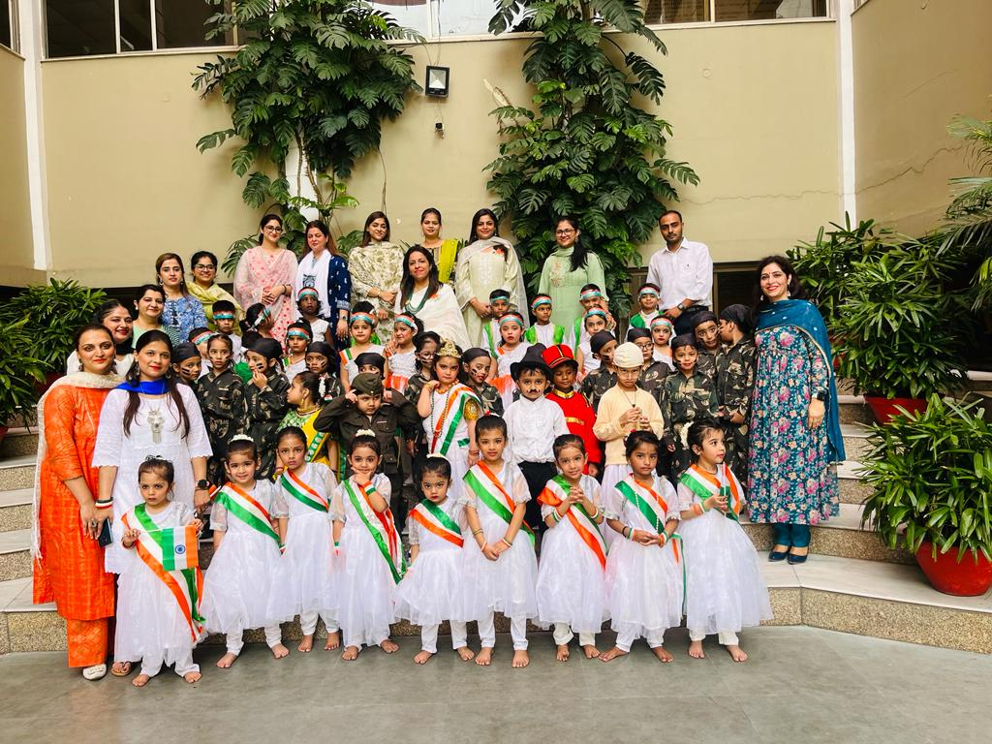
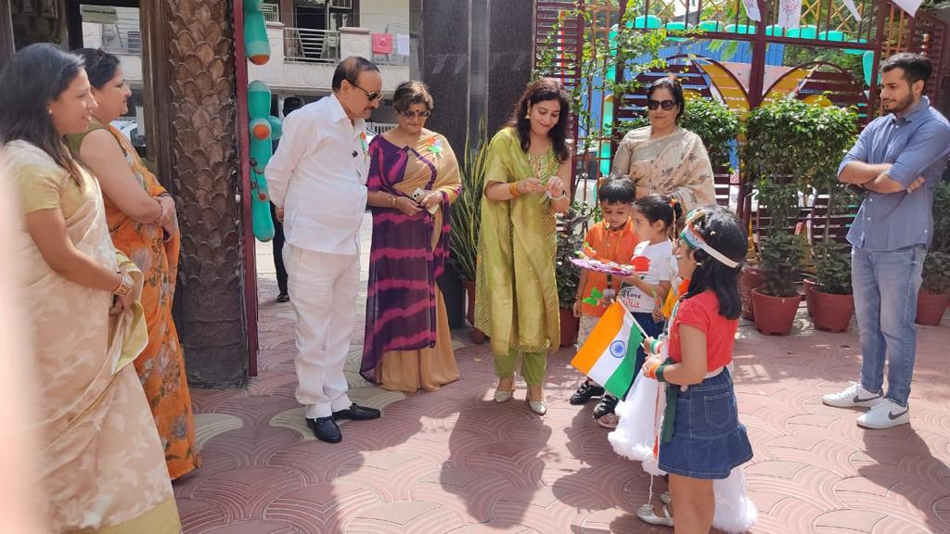
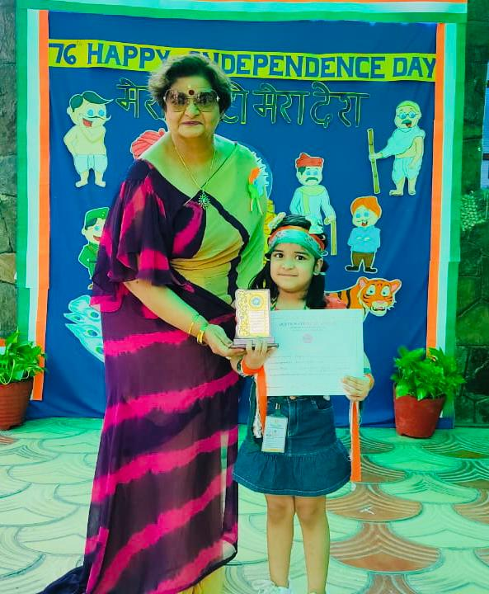
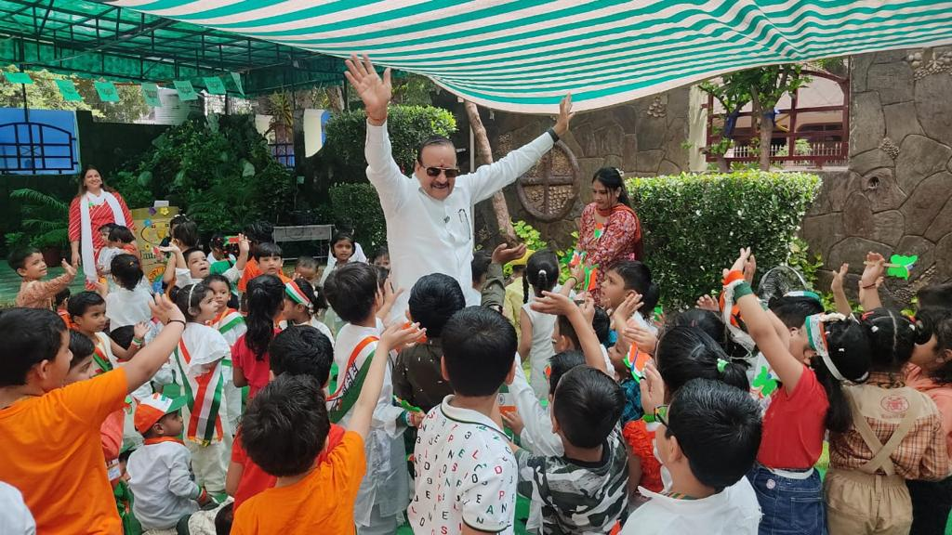
INDEPENDENCE DAY CELEBRATION
Independence Day was celebrated with great enthusiasm and patriotic fervour at the Montessori Branch on 11 August’ 23. The National flag was hoisted by Chairman Sir who also inspired the students to be good and well behaved. The school campus was beautifully decorated with tricolour flags and balloons to commemorate the day.

Slide 10


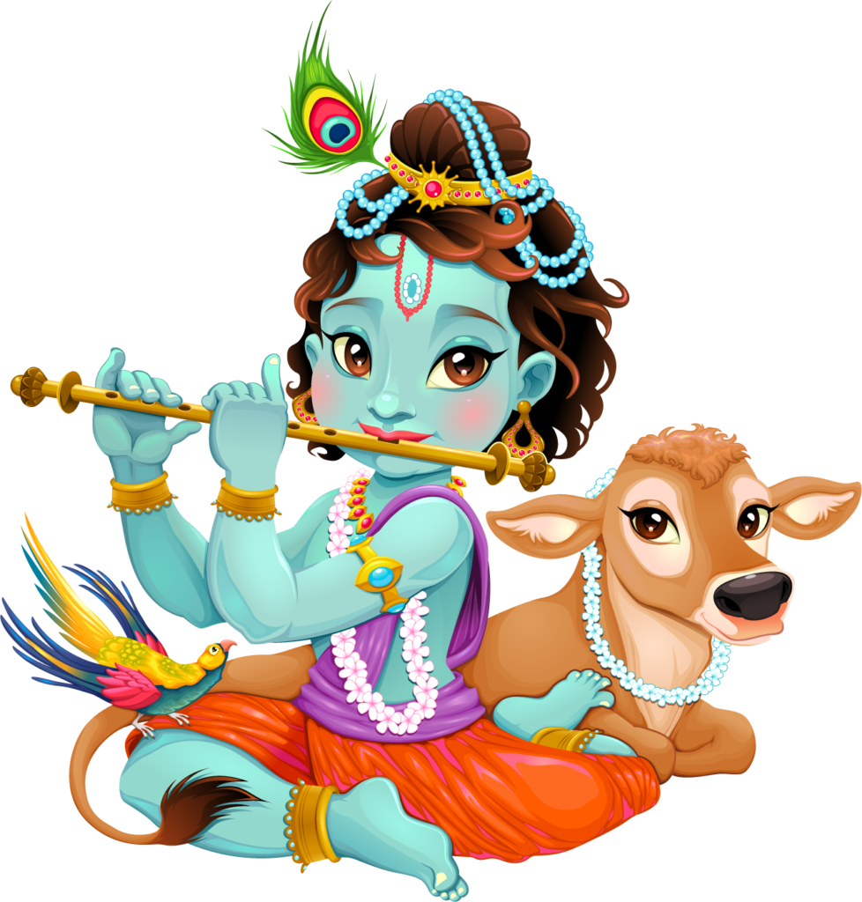
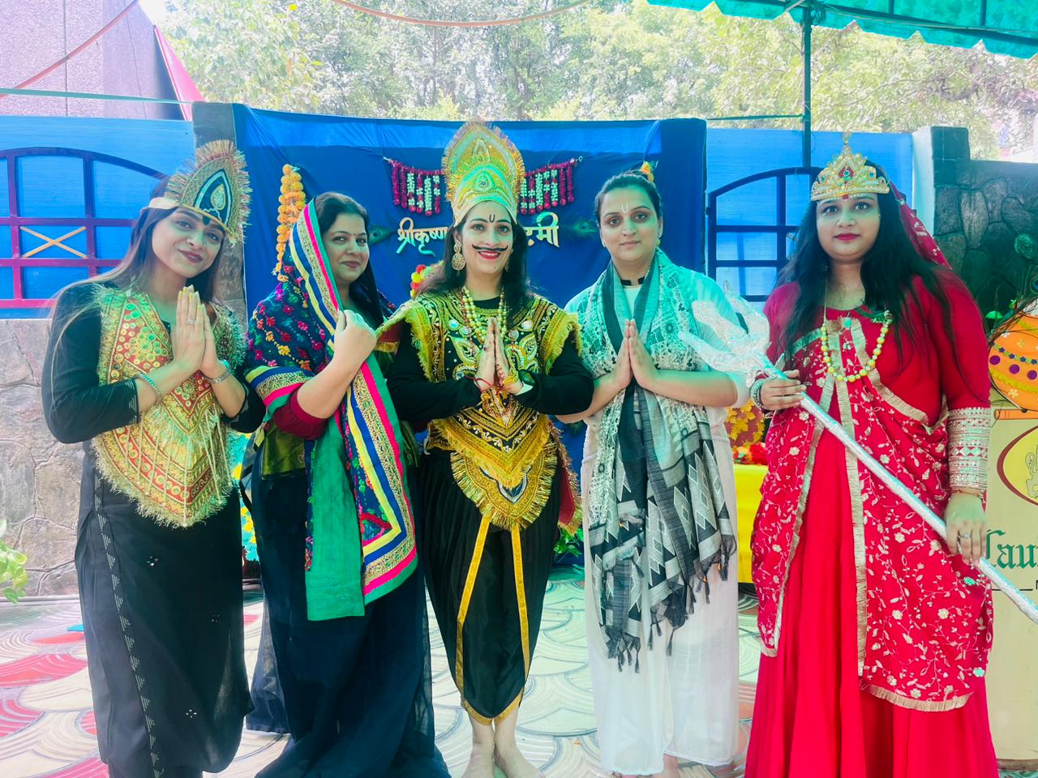
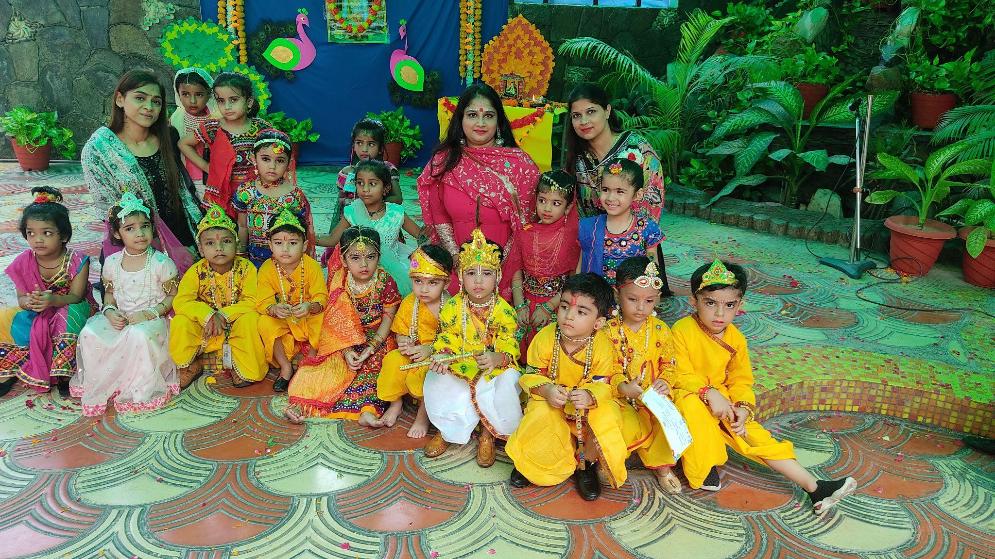
JANMASTHAMI CELEBRATIONS
Janmashtami is a great day of significance all over the world. It commemorates Lord Krishna’s birth anniversary. To cherish the beauty of this festival children were dressed up as Lord Krishna and Radha. The festival was celebrated with full exhilaration and happiness.

Slide 11
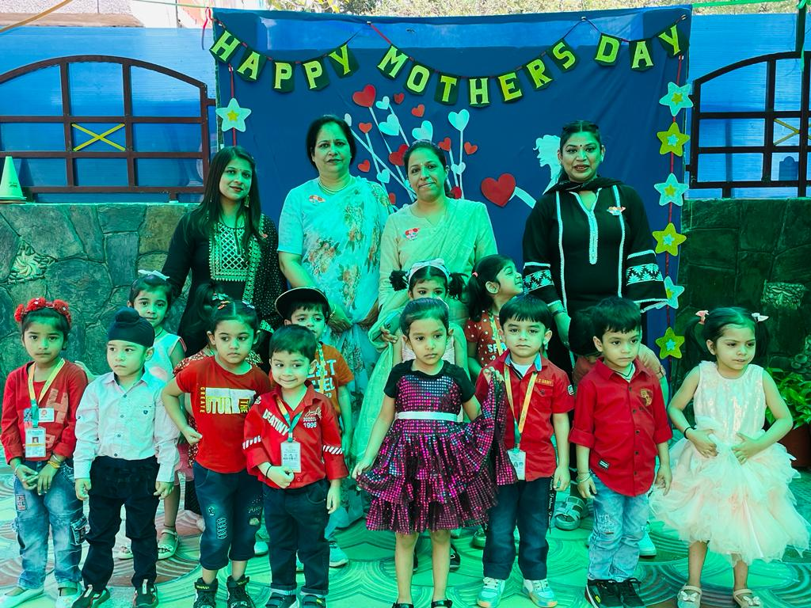
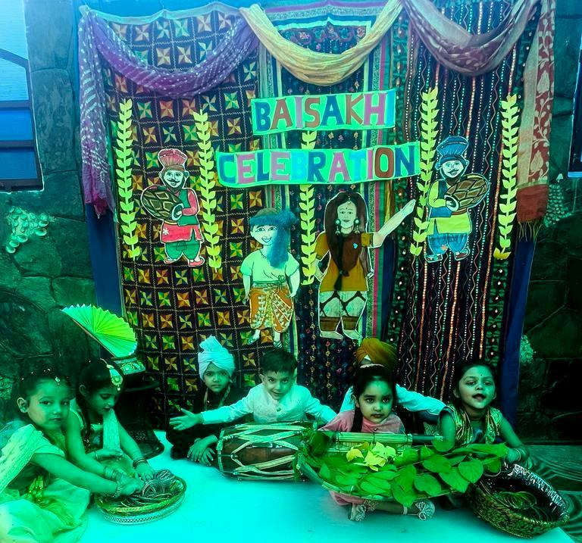
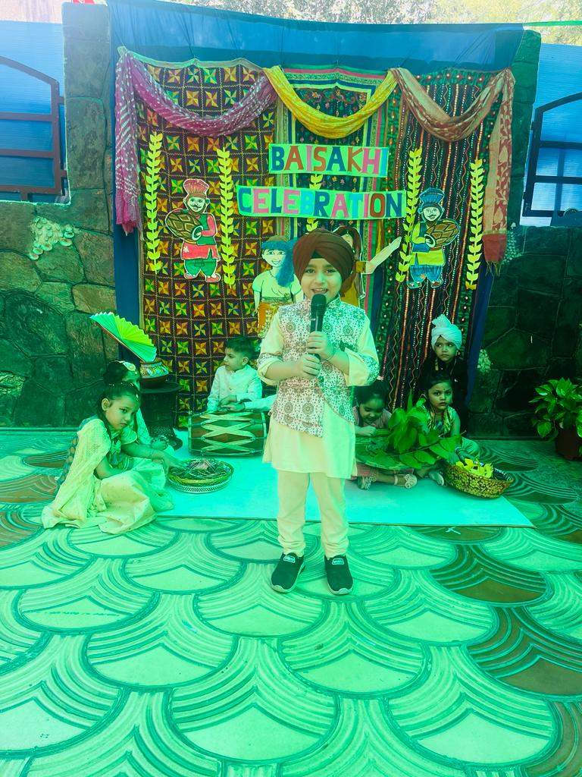
BAISAKHI & MOTHER’S DAY
Mother’s Day is a celebration honouring the mother.
To show the love and respect to their mothers, the young,
enthusiastic and adorable Laurelites gave mesmerizing
performances. A spirit of ecstasy and fervour reigned as
young Laurelites celebrated Baisakhi to help them get
culturally connected.

Slide 12
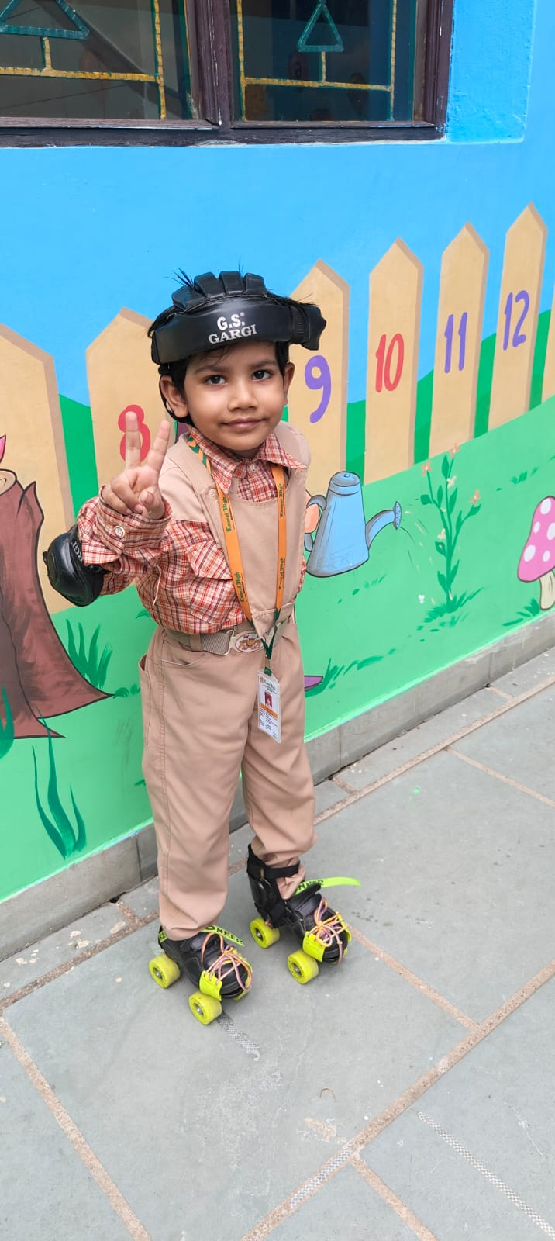
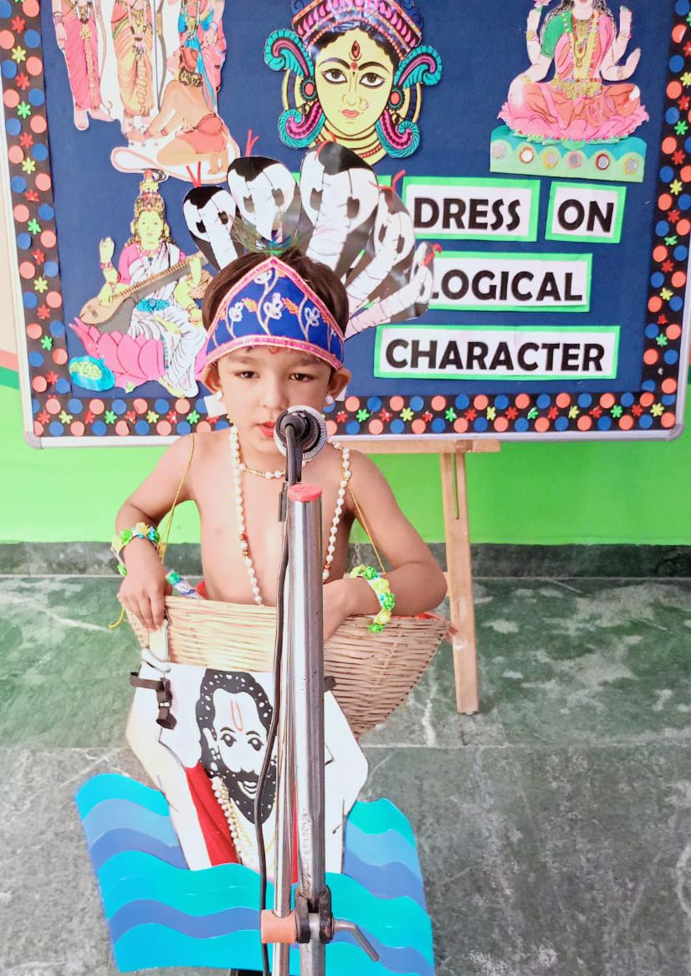
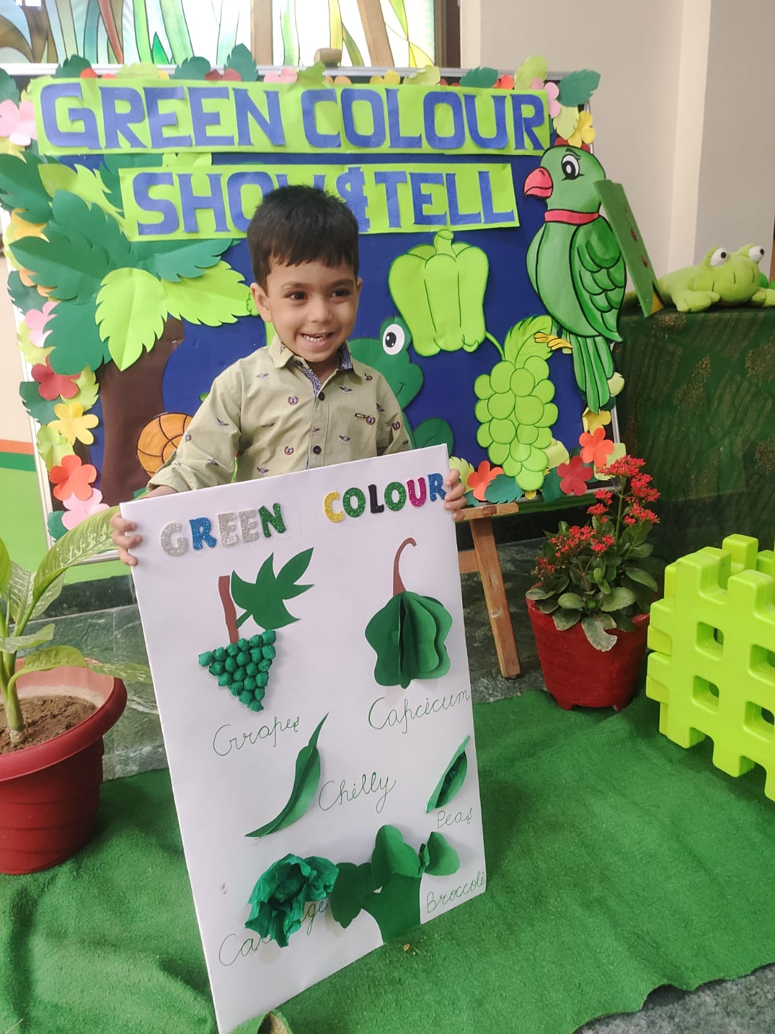
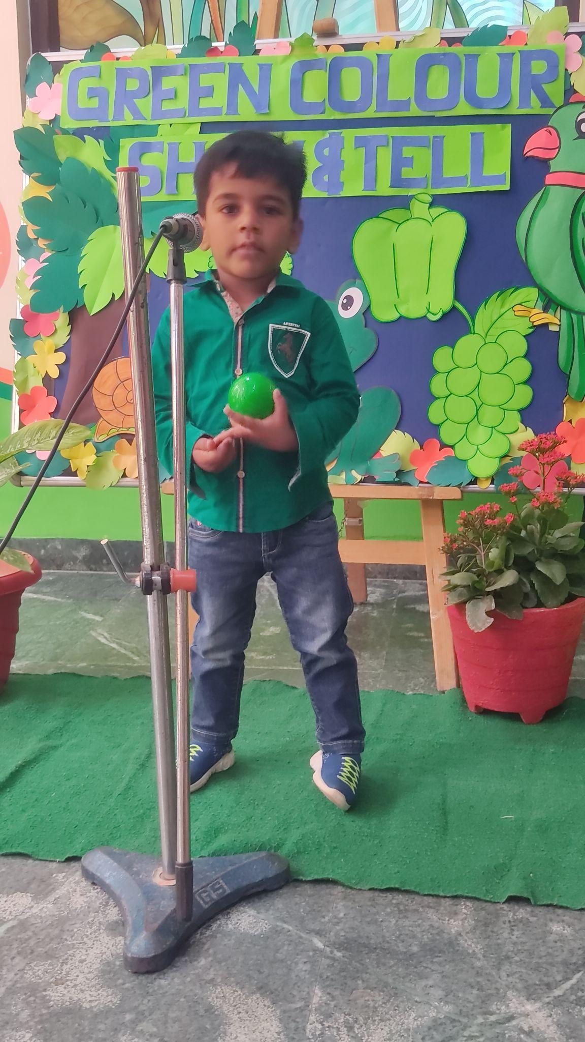




“Play is not just about having fun but about taking risks, experimenting, and testing boundaries.”
Activities help children to develop their social skills and they learn how to work in a team to achieve a shared goal. Activities like skating, pottery and mike gladiator are highlights of the school.

Slide 13




Class I
Our little talented students performed their best and displayed their magnificent work. Each and Every child presented his/her work with dedication. They have enjoyed a lot which can be seen in their glittery eyes.

Slide 14



VAN MAHOTSAV
Class I
A Tree Plantation Drive was organised by the school on the occasion of Hariyali Mahotsav
for the students . The students brought saplings and planted them under the guidance of their
teachers and gardener bhaiya.

Slide 15






पहली कक्षा के छोटे छोटे बच्चों की "देखो व बोलो हिंदी गतिविधि करवाई गई। जिसमें सभी बच्चों ने बहुत उत्साह के साथ भाग लिया । मंच पर प्रदर्शन करके बच्चों ने अपना आत्मविश्वास बढ़ाया। "

Slide 16





RAKHI MAKING
ON
RAKSHA BANDHAN
Class II
Young Laurelites made beautiful and colourful rakhis to celebrate the pious festival of Raksha Bandhan festival .The vibrancy of their happiness and zeal has lightened up the atmosphere .

Slide 17




कविता वाचन
दूसरी कक्षा के बच्चों की कविता वाचन गतिविधि करवाई गई। जिसमे बच्चों ने उचित उच्चारण द्वारा कविता गाकर अपना आत्मविश्वास बढ़ाया।

Slide 18







TRADITIONAL DRESSES
Class III
India is a land of diversity. Different cultures and states have their own separate identity. To acquaint the students about the diverse culture and costumes of different states of India, an activity was conducted for class III.

Slide 19



कहानी वाचन गतिविधि
तीसरी कक्षा के विद्यार्थियों द्वारा ‘ कहानी वाचन करवाया गया l जिसमें सभी विद्यार्थियों ने बढ़-चढ़ कर भाग लिया l सभी विद्यार्थियों ने उत्साहपूर्वक प्रदर्शन किया l इस गतिविधि के दौरान उन्होंने कल्पनाशक्ति एवं विचारशीलता को अभिव्यक्त किया l

Slide 20




‘A love between a brother and a sister is one of the deepest and noblest of human emotions’
A joyous assembly was conducted by the students of class III-A on the occasion of Raksha Bandhan . The students presented a small but meaningful skit on the significance of this pious festival in which a young girl tied a Rakhi on her brother’s wrist and went on to enact how the ritual of the festival is performed. A melodious choir and traditional dance was presented with full zeal by the students.

Slide 21




Class IV
CREATIVE WRITING
Class-4 mastering the art of putting thoughts into words to become effective communicators by participating in creative writing activity.

Slide 22



Unity in Diversity
Wearing traditional clothes is a way of letting the world know who you are without having to say it. The students of Grade Four presented a collection of dresses from India- The Land of Unity and Diversity. Children were dressed in beautiful dresses and spoke a few sentences in different languages of India. The fervour of Independence Day could be seen in the sparkling eyes of these young citizens of India They were lauded for their showmanship by respected Head Mistress,
Shalini Durga.

Slide 23





Art Is An International Language Understood By All!
Class V
Art plays a pivotal role in the development of students by fostering creativity, critical thinking and emotional intelligence. It enables the students to manage their emotions and empowers them with perseverance and patience.

Slide 24




SWACHHATA PAKHWADA
The students of class V observed Swachhata Pakhwada , a collective effort to create a cleaner, healthier and more sustainable society. It is a campaign to instil the values of cleanliness, hygiene and responsible work management in our youth.
We pledge to keep our environment clean!

Slide 25




Class VI A
Harshit Kamra
Harshit Kamra
Ragatmika Dutta
Aarav Madra
“Happiness lies in the joy of achievement and the thrill of creative effort.” Franklin D. Roosevelt

Slide 26

A MESSAGE TO MY FUTURE SELF
‘Life isn’t easy for anyone but how we live our lives and view the world around us is completely our choice.’
Hopefully someday, I will stumble upon this article and read these reminders of how to continue living my dream. I encourage you, my readers, to use this list and create your own also, as a continuous reminder to follow your goals.
● Be Successful: You will have too much more going for you in your later years. Life can get rough but there’s a reason you put yourself through all the stress and focus on my dream of becoming an astronomer
● Completing My Bucket list: I just hope that my bucket list of sleeping under the stars, reading a 100 books, see the Northern Lights , get a tattoo ,visit Ladakh to see the milky way band and of course as astronomer looking through a telescope which was set all by myself and maybe so much more. I pray, my grandmother will still be here. But I know that she maybe won’t because she is so sick now. I am terrified of growing up but at the same time. I hope everything fell into place for me
I want to be able to finally take risks, face my fears and try new things. I will still love my family even though they get on my nerves. I will always try to please them.
Dear future self ,I can’t think ahead to five years from now. If you don’t get some college acceptance letters soon you’ll be going nowhere. I am too stressed out for this right now.
To: Future Ragatmika
By—Ragatmika Dutta
VI A
From the budding writer’s desk
Class VI A

Slide 27

Sun could reach solar maximum by end of 2023
The Sun could potentially reach solar maximum—a peak in the solar cycle that could cause majors problems for those of us on Earth—by the end of the year, according to a report. Roughly every 11 years, the sun's magnetic field gets tangled up until it results in a massive reversal of its north and south poles. During this period of increased solar activity more sunspots appear on the surface of the Sun, prompting more solar flares and storms that could potentially disrupt communications, damage power infrastructure, and affect satellite operations on Earth.
The current cycle, referred to as Solar Cycle 25, officially began in December 2019, according to NASA. At the time, scientists predicted the current solar cycle would hit its climax in 2025, with a peak of roughly 115 sunspots. However, recent observations of sunspots and solar phenomena indicate it may reach this apex sooner and be more potent than originally anticipated. It's "going to peak earlier and it's going to peak higher than expected," Younit Jain (VI B)
Creative Corner

Slide 28
Facebook Should Be Banned
Admittedly, social network have become an indispensable part of human life. On one hand, network such as Facebook is one of the most famous social network which has are than 5 billion users. Of course, this network provides lots of opportunities to finds new friends.
On the other hand, Facebook may lead to increase of crimes and social unrest. It also negatively affects personal lives of users as it negatively influences the development of real life relationships. Unlimited access to information often becomes great problem for social life.
Facebook can also affect the development of the society. For instance, many people claim that societies only benefit from the use of such social network, since we are aware of the real situation all over the world, we should share our opinions. Some argue that the ban of Facebook and other social networks proves that government tries to limit communications in order to control nation. Reportedly, they sold personal information of users to certain companies. Therefore, Facebook should be banned as it negatively affects the major aspects of human life. Anshika Jain (VI B)

Slide 29



Class VII
A healthy discussion took place to spread Awareness regarding ’Personal Hygiene Day’ under Swachhata Pakhwada. Ways to maintain personal hygiene were taught.
Mihika
Dishita
Sethi
Mihika

Slide 30
VII A
WRITING CORNER
THE HERO WE ALL HAVE
Been my hero since I was small,
helped me stand tall,
taught me to never fall,
always there when I call.
His strength and love have shaped me so,
and taught me to grow & grow.
I am grateful for the memories we share,
for very moment every care.
An industrious person I have seen,
he has always been there to wipe my tears,
and helped me overcome all my fears.
Mansha Baweja
VII A
SPARROW
The sparrow has a brown breast,
and it never stays at rest.
It has a melodious sound,
that can make one swing in joy around.
Sparrows are learned to eat served food,
but it always depends on its mood.
If you ever find the bird, just go near,
until and unless it flies in fear.
Sanskrit Jain
VII A

Slide 31


Class VIII
COURAGE
When you feel low Just smile and let go,
Of the fear and the loneliness that grows
Do what you like not what they think you should, Just ride on the road of life!
Many miseries come and many go Not all stay for too long,
Don’t stop yourself by saying “ I can’t face it “
No! Thinking something like that is wrong.
Smile for yourself
Don’t cry because of someone else,
Be positive , Be brave
You can do anything without any mistakes!
Sonam Verma (VIII A)
It is a pleasant morning to see
It's a pleasant morning, see out of the window
You will feel brighter in the day ,
Make all your wishes come true
The sun is shining at the bay .
The flowers are blooming for you
That sparrow on your window ,
Giving you the light of the day
Your spirit is up so get up high .
Look at the bright and wonderful sky
Things will go according to you ,
You will not feel bad and blue
Everything will be playful according to you .
Because its wonderful day and new
Wishing you a lovely morning
Good morning to you!
Sanchi Poddar (VIII A)

Slide 32






CREATIVE WRITING
BUDDING ARTISTS

Slide 33


POEM
In the halls of Laurel High, we all thrive
Where knowledge and potential come alive
With every step, we’re guided by inspired minds
Teachers who ignite passion in every kind
From Math to Science and all art forms,
In this fertile ground, creativity storms
Exploring literature, history’s vast array
Unlocking mysteries, uncovering each day
In Laurel High, friendships bloom and remain
Bound by shared experiences, our human chain
Through laughter, tears, and moments of grace
We navigate together, finding our place
- SUSHANT (IX A)
NEWSPAPER READING TIME

Slide 34


GURU PURNIMA CELEBRATION
Class Ix
“ Gurus are like candles that burn themselves to make other people’s lives brighter.”
The talented and enthusiastic students of class IX always make sure that all festivals are properly observed and celebrated with zest and zeal. Keeping up with the pattern, Guru Purnima was celebrated at the school on 5 July 2023 with lots of energy by the students of class IX which included a mesmerizing dance performance and a divine musical presentation as a tribute to express gratitude towards their educators. Following that, a brilliant skit portraying the story of Eklavya was presented which touched everyone’s heart. The Head of School Ms.Urvashi appreciated and valued the endeavors of the students of Class IX. She tended to the gathering with a soulful message of being idealistic and commendable and catering to the society unbiased.,

Slide 35



Class x
To give exposure to the students and develop their scientific temperament, various activities were organized. Students outshone themselves with the clarity of the concepts on the topics-PH of solutions and refraction of light”.

Slide 36
"Anne Frank: A Timeless Beacon of Hope and Resilience"
In a world consumed by shadows deep,
A young girl's voice, a secret keep,
Anne Frank, her name etched in time,
Her words, a beacon, forever to chime.
Within the walls, her spirit soared,
A whispered tale, a soul explored,
Amidst the darkness, her heart aglow,
In her diary, emotions would flow.
Inscribed with ink, her dreams took flight,
Through pages penned, she found her light,
Though confined in walls of fear,
Her words spoke of hope, crystal clear.
Paper has more patience than people
Was she always believed ,
At least it’s not a blabber mouth,
She was relieved.
Her voice, a song of courage and grace,
A testament of love's embrace,
In times of torment, she sought to find,
The beauty in the human mind.
From days of innocence to nights of dread,
Her words like stars, they softly spread,
Across the canvas of history's span,
A young girl's dreams, a lasting plan.
Anne's legacy, an echo strong,
A gentle reminder that we belong,
To a world of love and empathy,
Where hearts unite in harmony.
So let us cherish her story, dear,
And hold her spirit ever near,
For Anne Frank's light will never fade,
In every heart, her love displayed.
~Amaira Bhaskar (X A)

Slide 37




Students stepping into the shoes of a character from literature and being interviewed.

Slide 38
FROM A BUDDING WRITER’S DESK
The Magical Friendship
In a cozy village, there lived two best friends, Lily and Max. They were inseparable, always exploring and having fun together. One sunny day, while wandering in the woods, they stumbled upon a mysterious cave. Curiosity got the better of them and they entered the cave. Inside, they found a glowing crystal that shimmered with magical colours. As they touched the crystal, a burst of light surrounded them. To their surprise, they had swapped bodies! Lily was in Max's body, and Max was in Lily's. At first, they were bewildered, but they soon realized the fun they could have with their new identities. They laughed as they tried to imitate each other's mannerisms and found joy in seeing the world from a different perspective. However, they knew they needed to find a way to return to their original bodies. They sought the village's wise elder, who explained that the crystal's magic would wear off at sunset. With renewed hope, Lily and Max spent the day adventuring, cherishing the time in each other's shoes. As the sun began to set, they returned to the cave, holding hands tightly.
As the last rays of light touched the crystal, they closed their eyes and made a wish to be themselves again. When they opened their eyes, they were back in their own bodies. Relieved and grateful, they realized that the magical adventure had strengthened their bond even more. From that day forward, they cherished the magic of their friendship and the unforgettable experience they shared. And so, in the village of laughter and love, Lily and Max remained the best of friends, knowing that even the most unexpected adventures could bring them closer together.
Mitakksh Doseja (X-B)

Slide 39

UNLEASHING THE WRITERS
Bullying: A Trait of the Weak
“If you have strength, show it in ways that would benefit others.”
Bullying is the brutal practice of suppressing the people surrounding the bully. There are different kinds of bullying like cyber bullying, bullying in school, etc.
Bullying is indeed the trait of the weak. Those who fail to discover contentment in themselves, take up these cruel activities and devastate the peace of others. Bullying leaves a permanent scar in the hearts and minds of the people who have to go through it. It shakes their mental and physical strength and drains their social battery. Taking advantage of some unfortunate incidents that happen with people, the bullies try to overpower them. However, it is a fact known to all that it is the bullies that try to keep their weaknesses latent by sabotaging the others.
One often observes in schools that being bullied is a part of almost every teenager’s life. In spite of several provisions introduced by the school, these practices sustain. It is high time that the children understand the damage caused by bullying. They contemplate that it is all fun and games until they have to experience bullying themselves. The people laughing while someone is getting bullied around them are equally guilty. Instead of mocking the person, one should help a helping hand. In addition, the children should be taught to stand up for themselves and prove the bullies wrong. The bullies anticipate that the others are weak but actually it is quite the opposite! Thus, one must learn some humility and humanity for the greater good of the society and also for a healthy self-development.
ChehakThukral (X-B)

Slide 40
AI -AIn’t That Cool
Artificial intelligence is a rapidly growing technology in the world. We all are now familiarised with it and most of us use it in our daily lives, but are we really?
Artificial intelligence is made by humans, used for humans, and would result in the destruction of humans. Artificial intelligence is a nightmare dressed like a daydream, we think that it would benefit humanity but in reality we would be so dependent on it that we won’t be able to perform our menial tasks.
We think of it as a harbinger of efficiency but in reality we never look at the dark side of AI. According to the data given by the United Nations Planning Committee, AI would expand to many different sectors and would snatch jobs from more than 12 million people till the year 2030.
Artificial Intelligence is a serious danger to society if strict laws are not formed regarding the same as nowadays, we can observe students writing graded material with the use of some well-known Artificial Intelligence software.
If it is not used in a limited manner, AI would reduce our thinking capability and our dependency on it would increase, making humanity a weaker version of its current self. Jivish Ghai (X-B)

Slide 41






Creative Corner
Class xI
Paavani Jetli (XI B)
Vanya
(XI B)
Diya Dahiya
(XI B)
Shraddha kapoor
(XI A)
Shraddha kapoor
(XI A)
Shraddha kapoor
(XI A)
Shraddha kapoor
(XI A)

Slide 42








Class xiI
Commerce Day celebration
The students of Laurel High celebrated Commerce Day with great enthusiasm in the school courtyard on 7 August, 2023. The students of class XII A participated in the programme,
‘COMM HASYA’ - The Comedy Zone and presented a skit. It was appreciated by the Head of the School. The objective of the event was to make the students aware about the importance of studying Commerce and its significance in real life.

Slide 43

SPEAKING ASSESSMENT BY CLASS XII

Slide 44


VISIT TO PARLE - G FACTORY
Students of Classes XI- A & XII - A visited Parle G Factory on 12, August 2023 where they got an opportunity to enhance their practical knowledge. They witnessed the preparation of different types of products of Parle G. Overall it was a very good exposure for students

Slide 45

WHY ONLY GIRLS? WHY CAN’T BOYS ?
How important is it for us to recognize and celebrate our HEROES and SHEROES .
- Maya Angelou
We live in an era , where we strongly believe in equality and liberty . We have equal rights and equal opportunities both for men and women at work place .
But why only at work place ?
Why can’t we have equal share of work at our homes too ?
Why a woman has to perform all household chores ?
Why only ‘she’ takes all major responsibilities?
Why is it only ‘she’ who is to be blamed for every action that goes wrong at home ?
If we are the believers of equality ,then we must commence it from our homes only .
If you want something said , ask a man ,
If you want something done , ask a woman .
- Margaret Thatcher
A woman herself is an epitome of sacrifice and dedication . She is the one who has given birth to the mankind and nurtured it with utmost love, care and affection .
If she can manage her workplace and home together , then why can’t a man ?
They tried to bury us ,
They didn’t know that we were the seeds .
We expect women to achieve full equality and opportunity in the immediate future . We must condition our young future generations by making them free from all gender biasness and inequality . Parents can teach their sons to be responsible enough to take care of the domestic work along with the profession .
If we have to start moving towards the goal , we must believe in ourselves even if no one else does . We must match our aspirations with the competence , courage and determination to succeed .
- Ms. Sandhya Tomar (Educator )

Slide 46

      Being a Teacher!
Being a teacher is the most wonderful experience of my life.
Am I a friend, a philosopher or a guide? Am I an instructor, a service-provider, a mentor or just a disciplinarian? Which mould do I fit into or which mould fits into me? I am still looking for an answer.
But let me confess—in spite of all the challenges that I meet every day, my students are my inspiration. They have made me a better person. My patience level is increasing every year, not to forget their never ending discussions every day. My vocabulary is quite in tune with the times, my heart forever young and my bank balance in terms of love, affection and adoration increasing at a faster rate. Well, I am the richest person of this world!
I have no words to express how I felt when without realizing I became Mom from Ma’am for my students. It has made every moment as a teacher worthwhile for me.
I have learnt a lot from my energetic students and continue to do so today. I would just like to convey a message to all my students, ‘Thank you all…..for being enigmatic creations and for being an understanding source of inspiration .My gratitude for making me feel that we share mutual admiration; for making me feel that I have guided you towards your destinations! And for making our relationship a reason for a special celebration!
With lots of love and best wishes to my lovely students.
Now I have my answer to, “Why I am a teacher.
Ms. Pooja Gupta (Educator)

