Slide 1


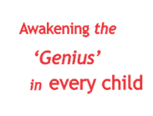


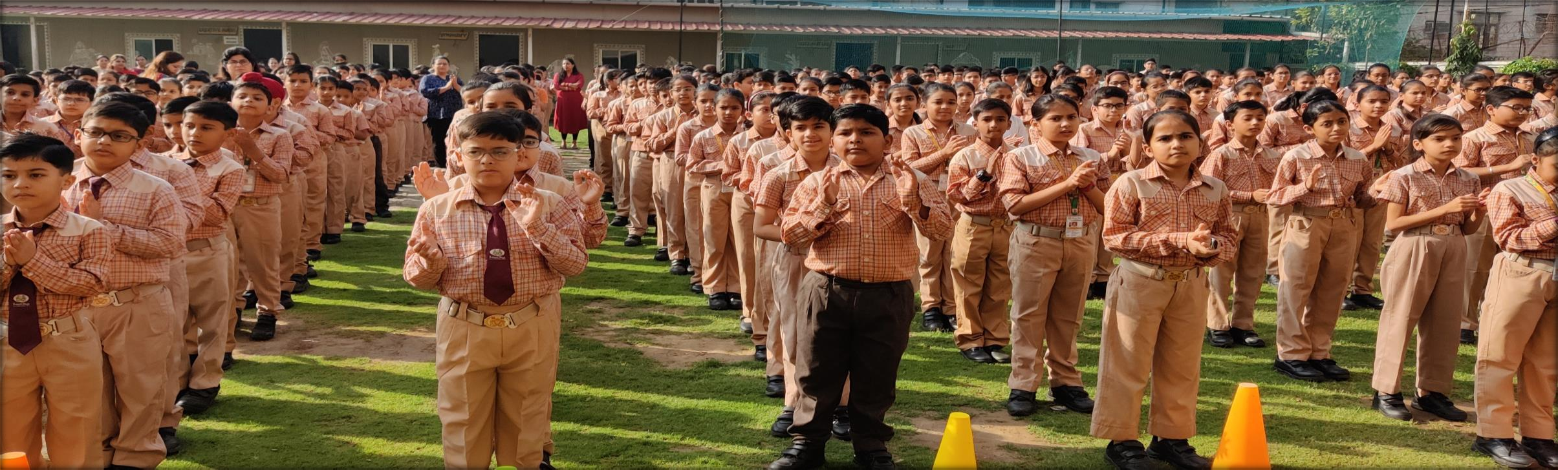
“Don’t wait for inspiration. It comes while working."
April 2023-May 2023

Slide 2

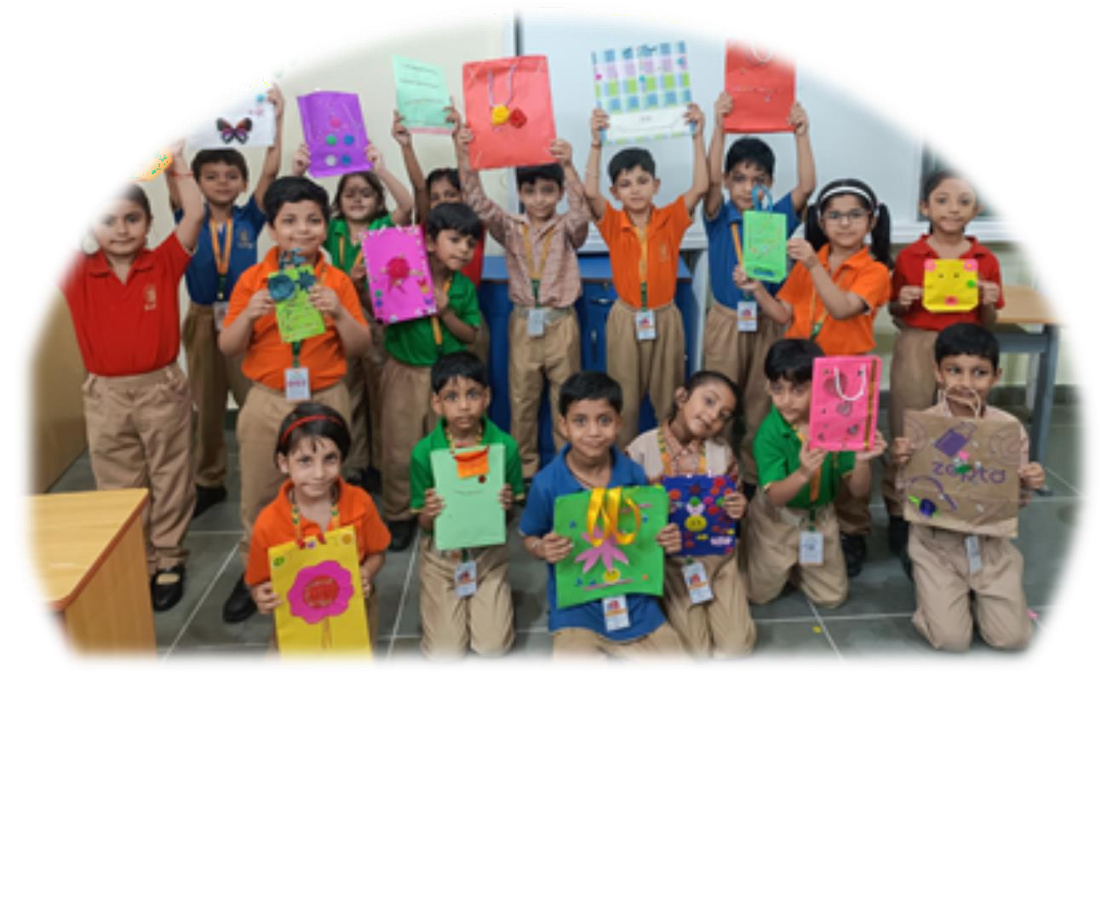

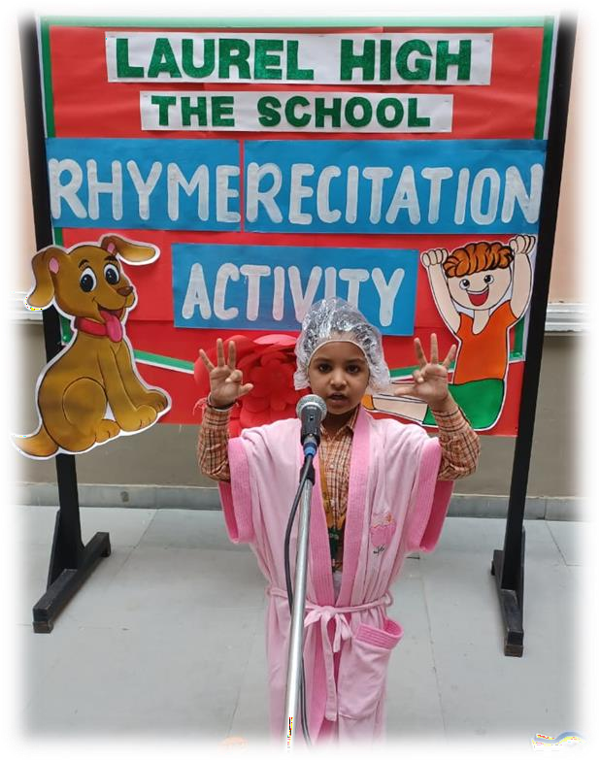
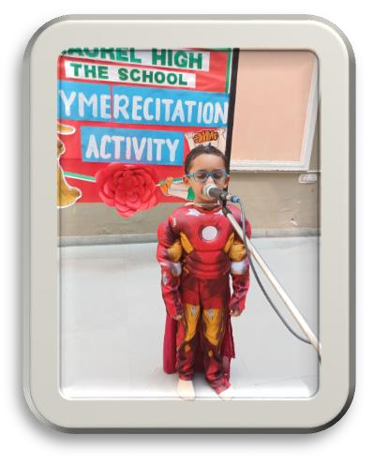
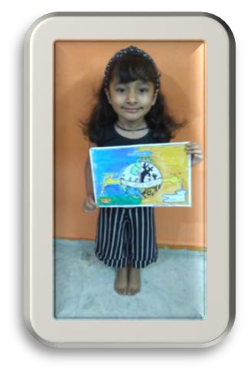
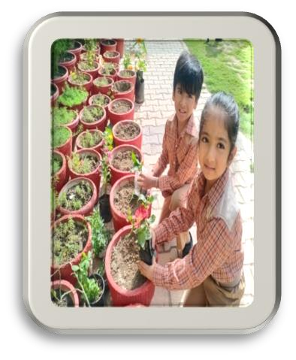
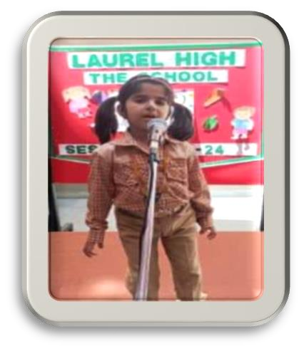
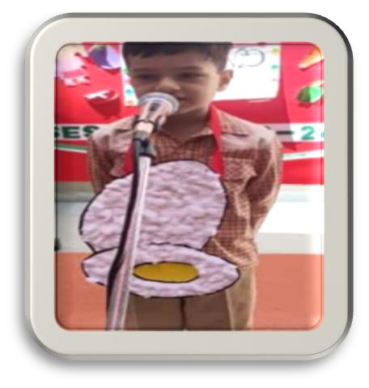
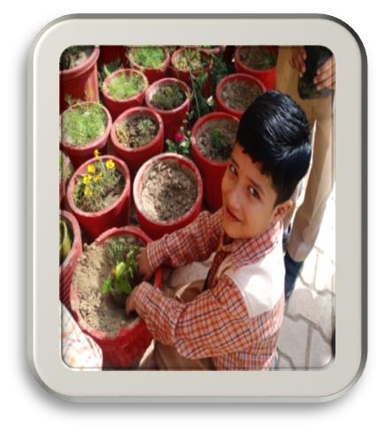
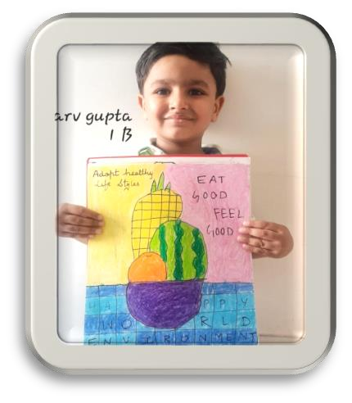
CLASS-1

Slide 3

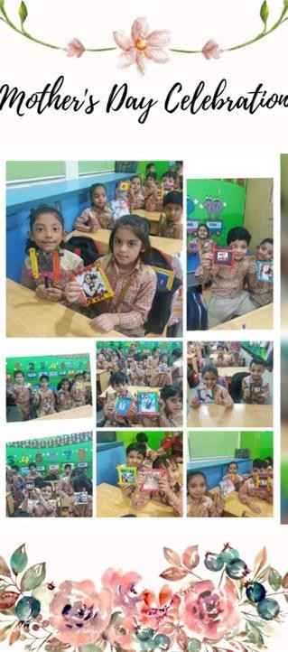
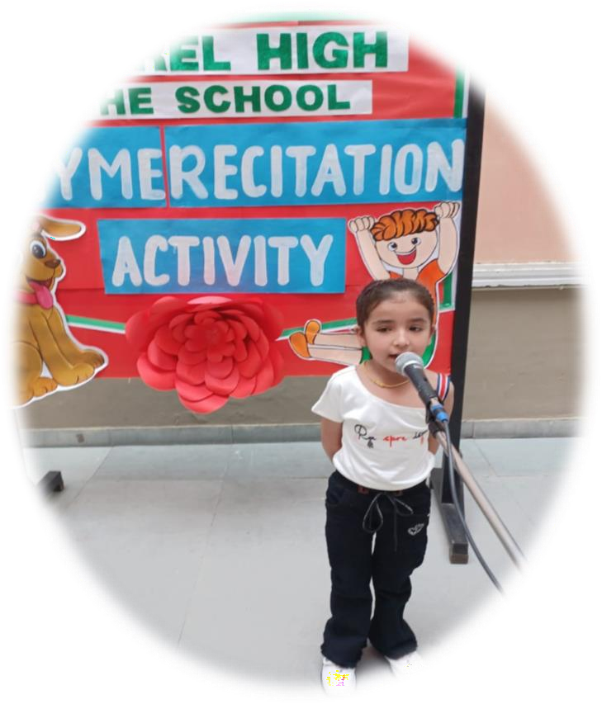
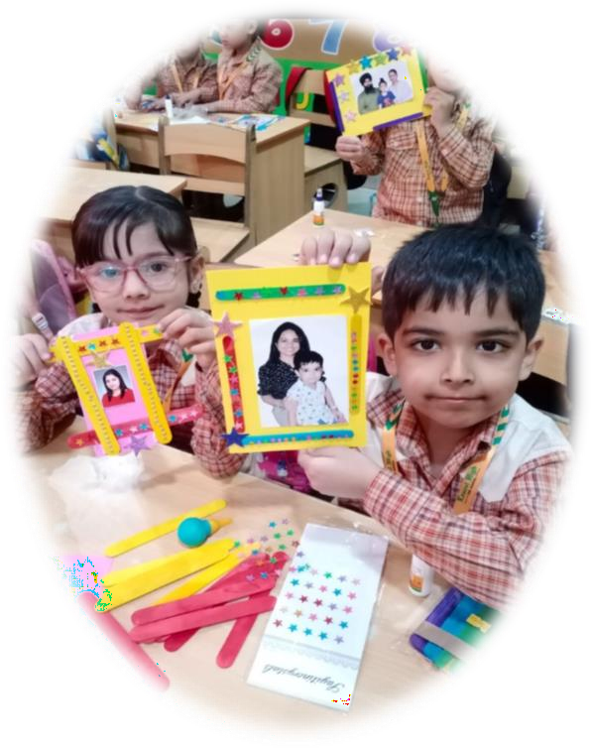
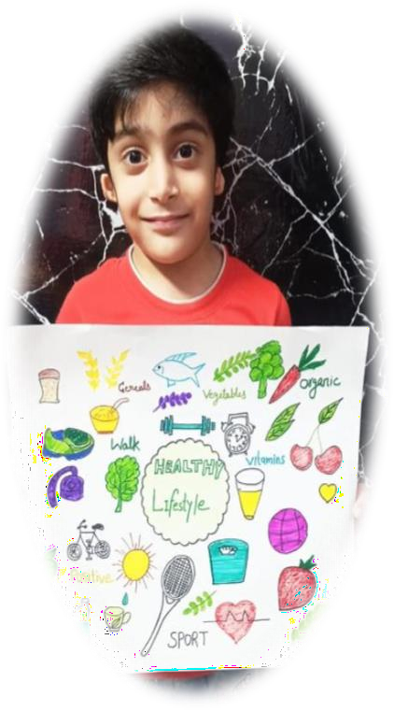
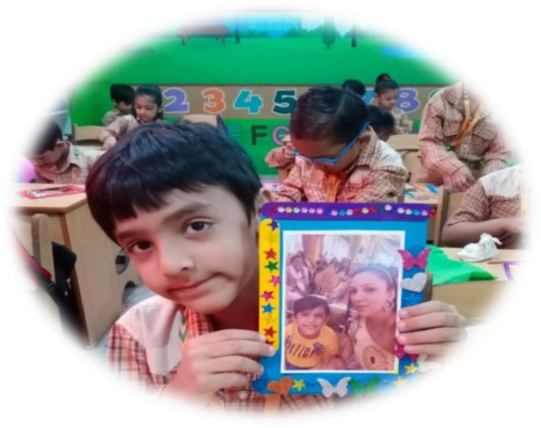
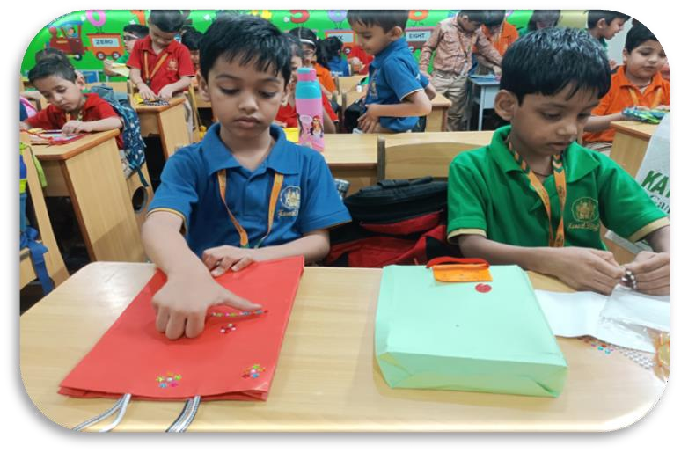
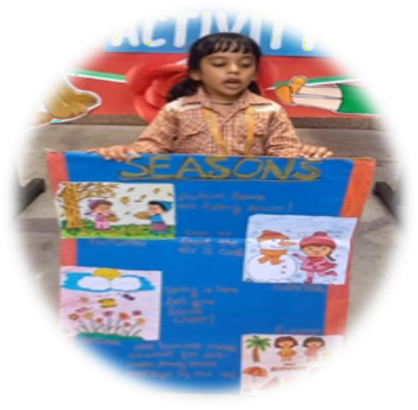


CLASS-I
“Children are like wet cement: whatever falls on them makes an impression.”

Slide 4
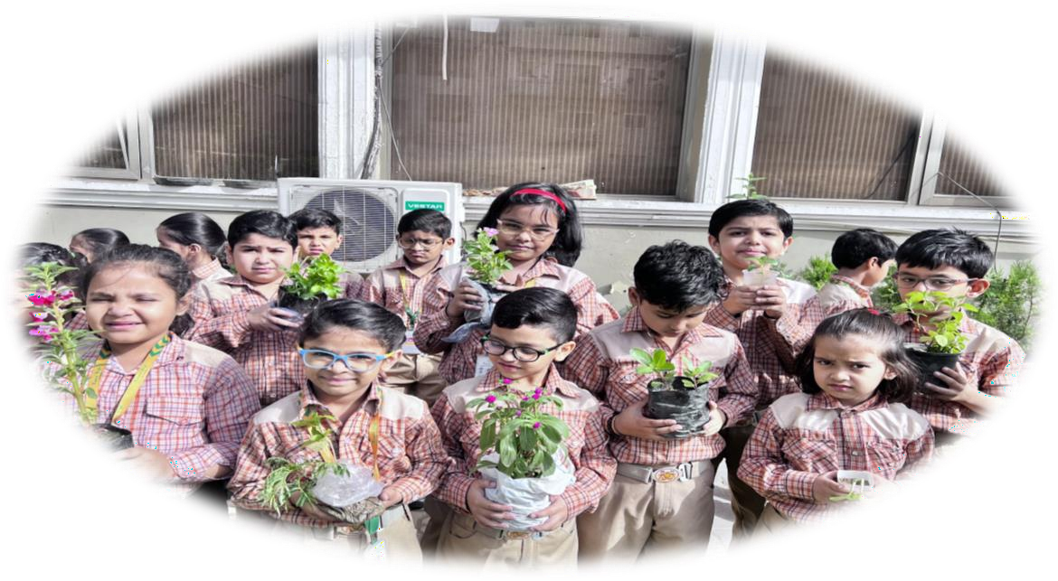

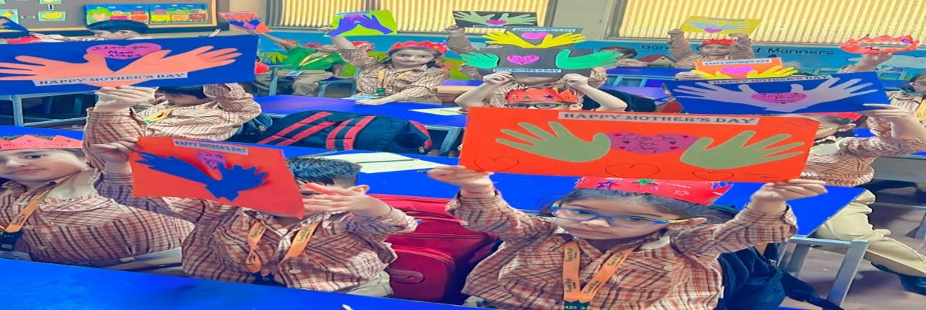
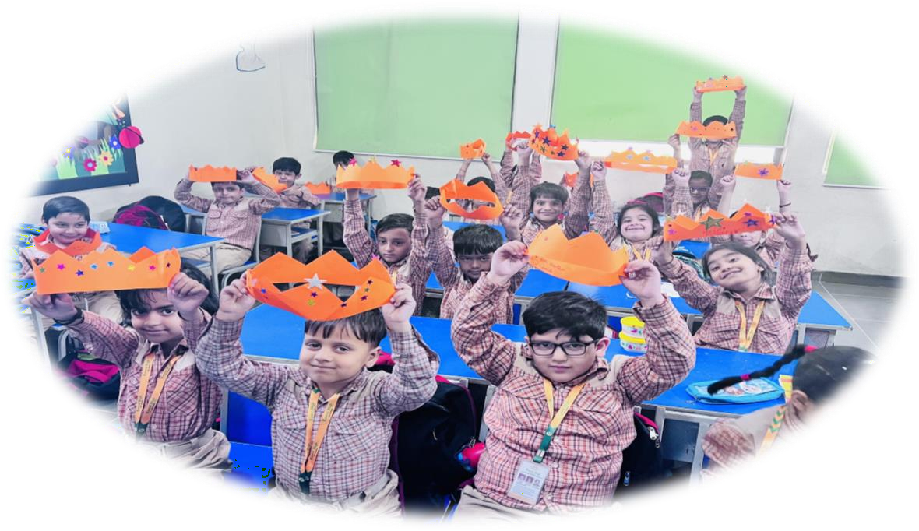
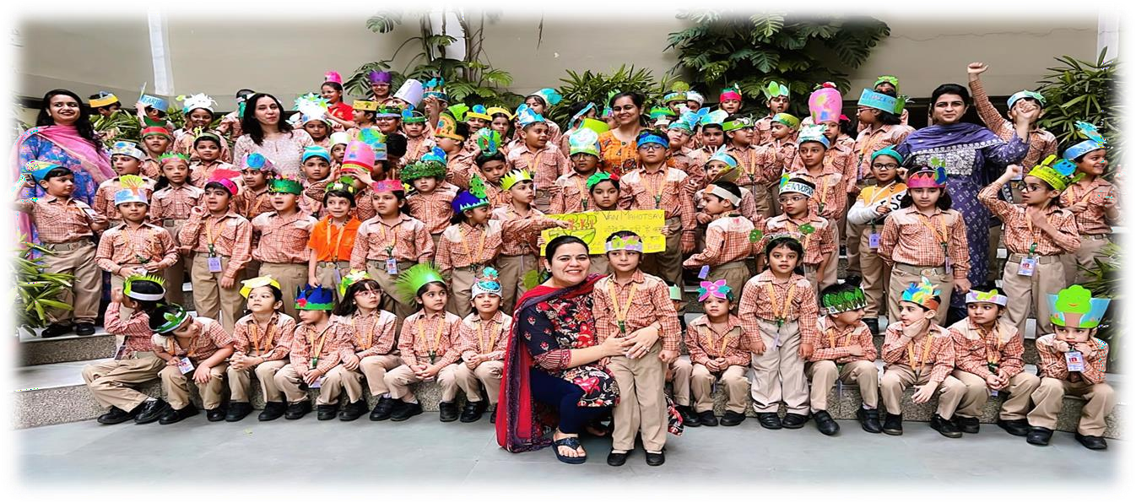
“The potential possibilities of any child are the most intriguing and stimulating in all creation.”
CLASS-II

Slide 5
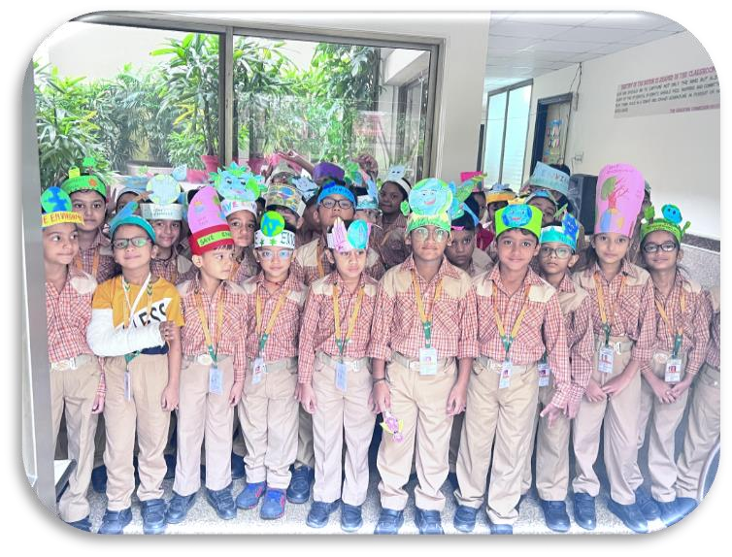
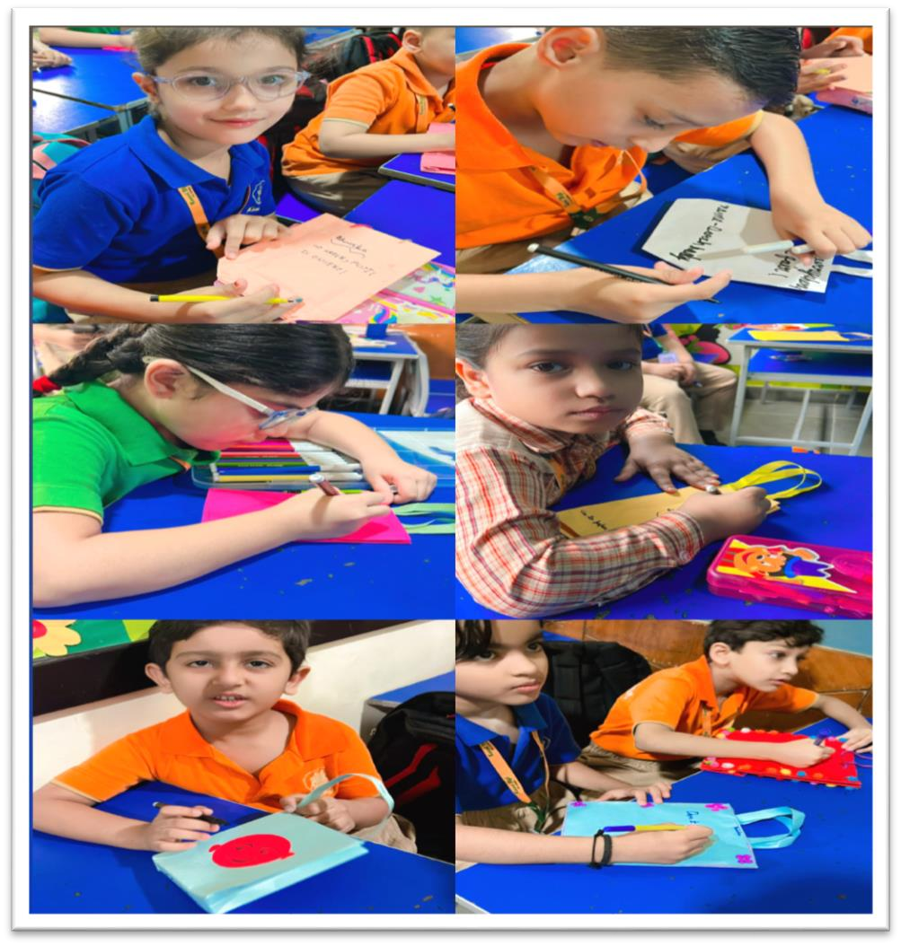
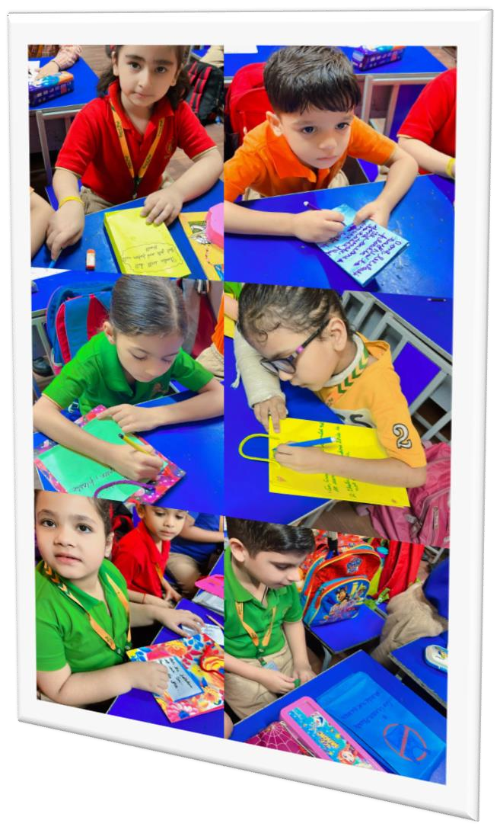
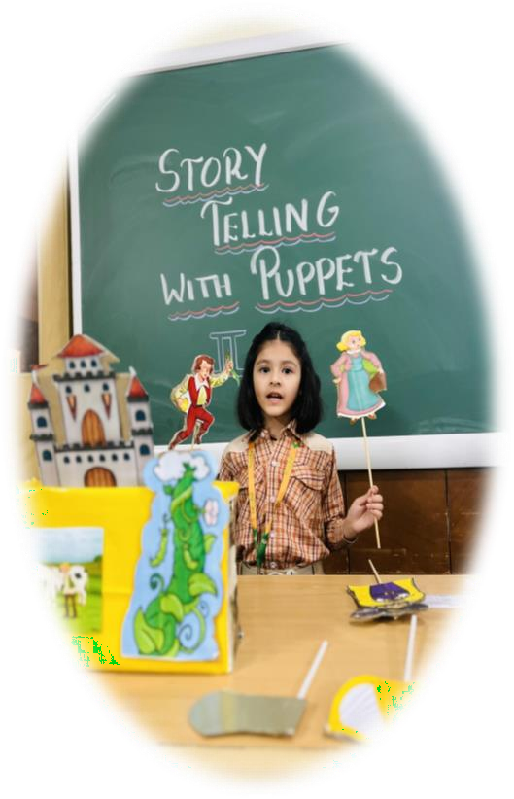
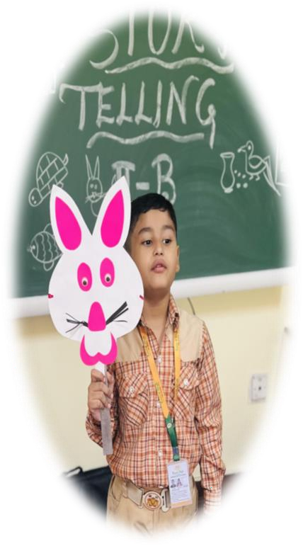
“The greatest gifts you can give your children are the roots of responsibility and the wings of independence.”
“While we try to teach our children all about life, our children teach us what life is all about.”
CLASS-II

Slide 6


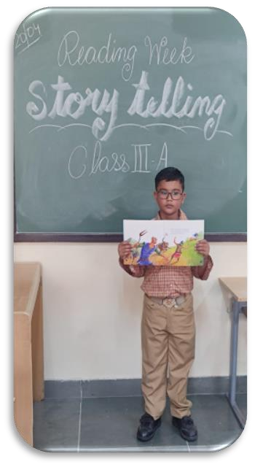
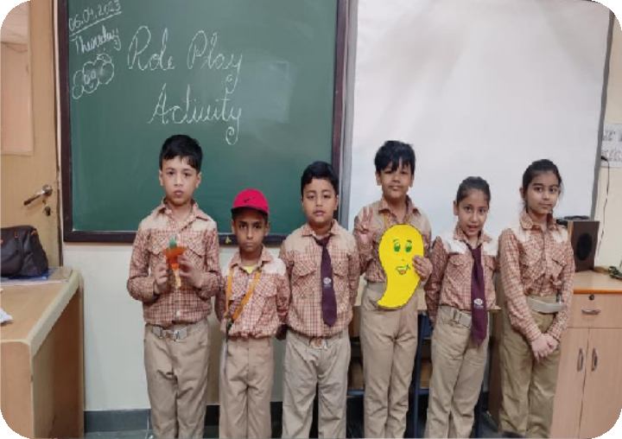
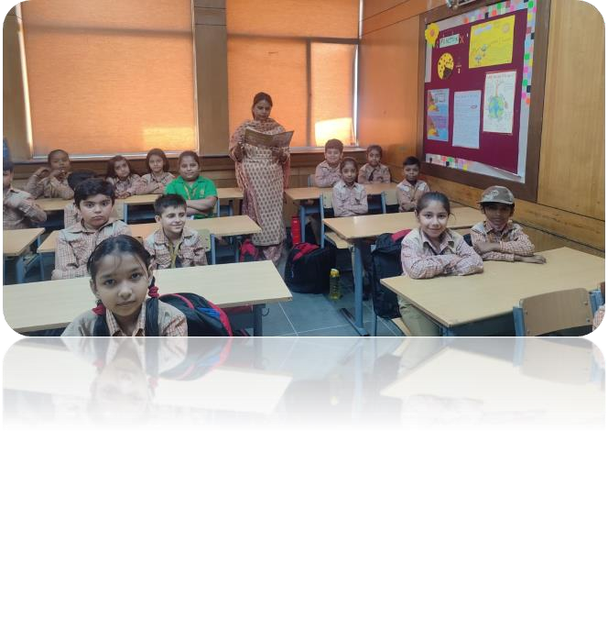

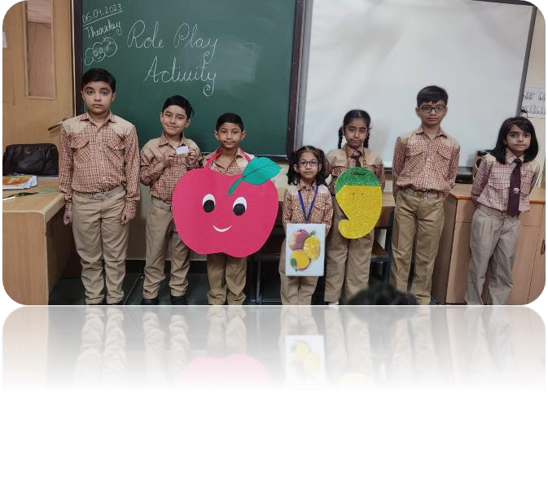
“The purpose of a storyteller is not to tell you how to think, but to give you questions to think upon.”
Story Telling Activity not only brings joy to the little ones but also gives a platform to learn and grow. An activity ‘Story Telling’ was organized for Grade III and the students came up with wonderful story narration.
Role Play Activity is an important part of
the classrooms as this area
helps nurture a child’s imagination; improves social skills, creativity and develop intellectual abilities.
Students of Grade III enjoyed
this activity which helps to brush their vocal as well as enactment skills.
CLASS-III
“If we nurture the dreams of children, the world will be blessed."

Slide 7

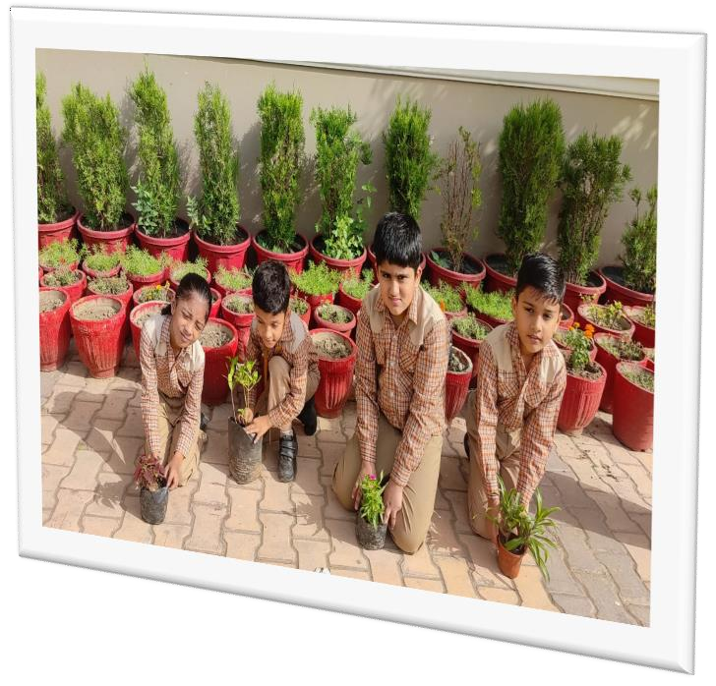
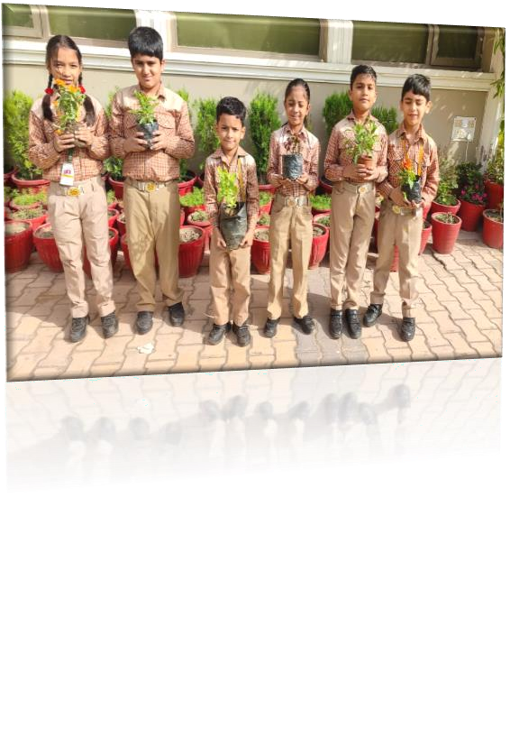

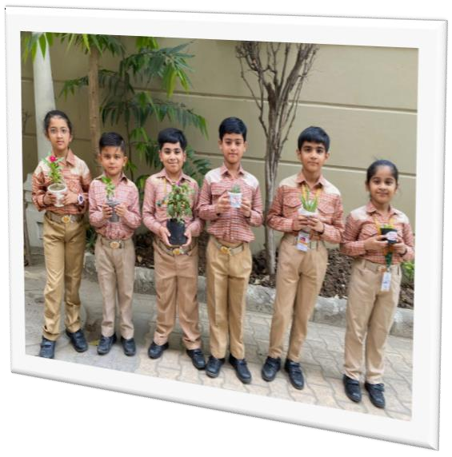
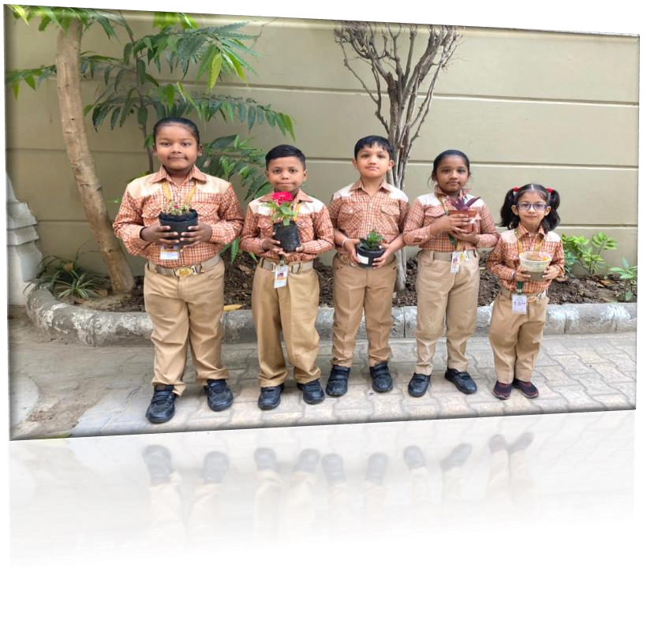
Seed Plantation Activity Experiential learning is significant in child’s brain development and learning. Seed Plantation Activity was conducted which determines continuous plant production necessary for human survival. Children enjoyed this activity with hands on experience.
CLASS-III
“A child is a beam of sunlight from the infinite and eternal, with possibilities of virtue and vice, but as yet unstained.”

Slide 8
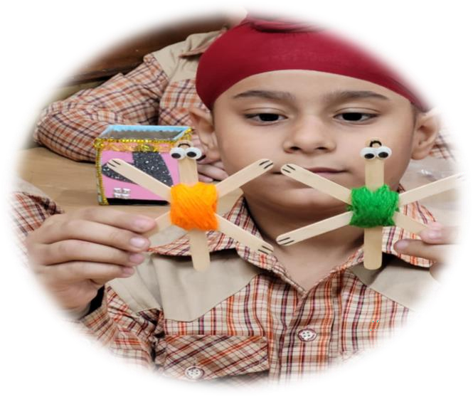
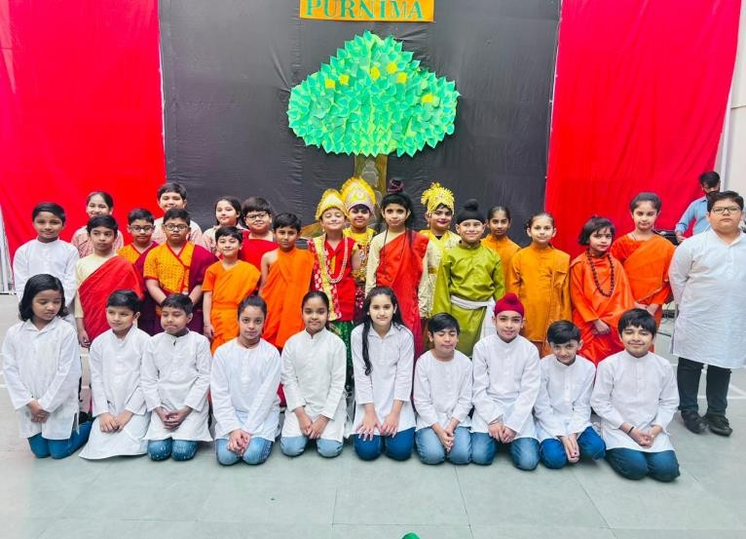
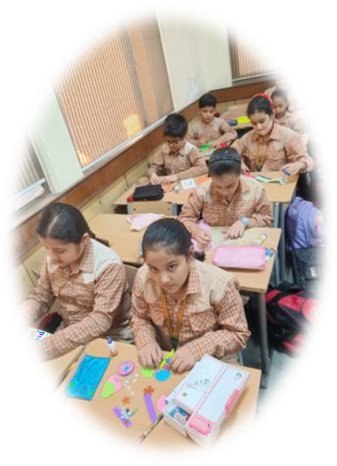

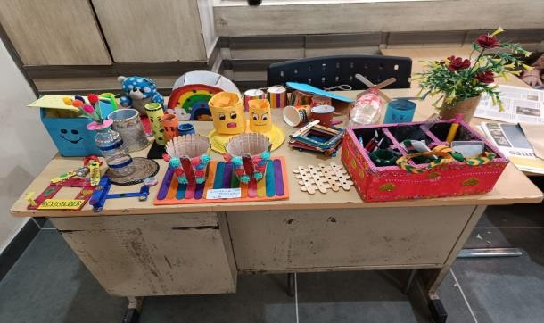
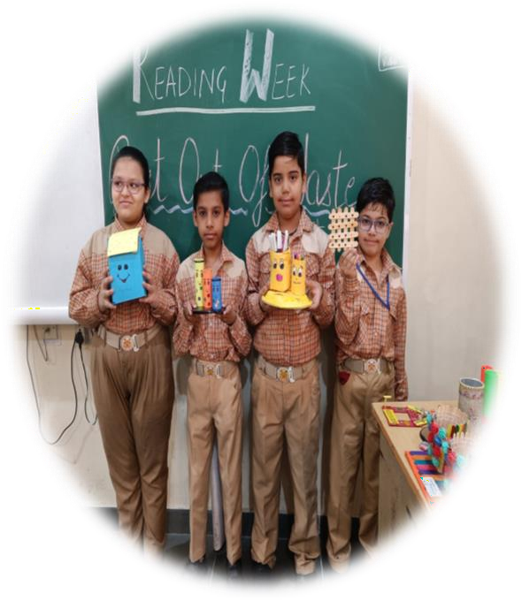

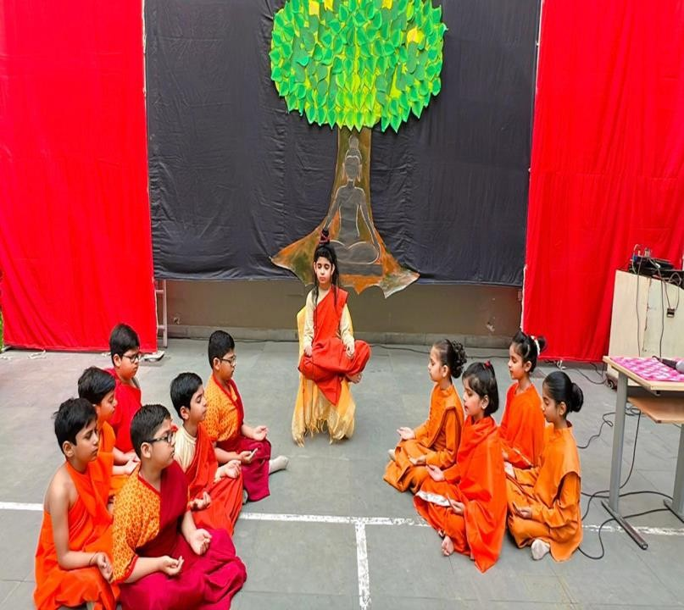
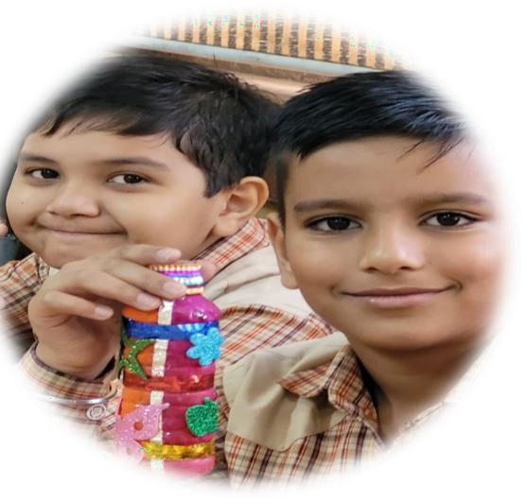
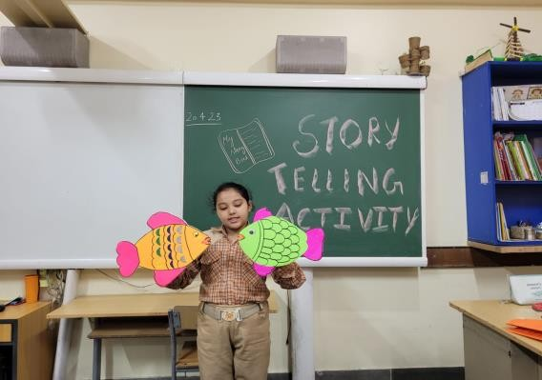


Recycling things is like magic that turn ordinary things into extraordinary.
“Children are the hands by which we take hold of heaven.”
CLASS-IV

Slide 9


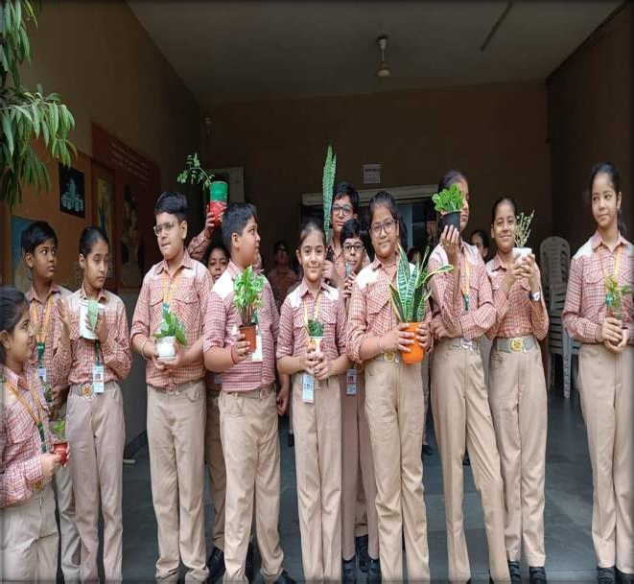
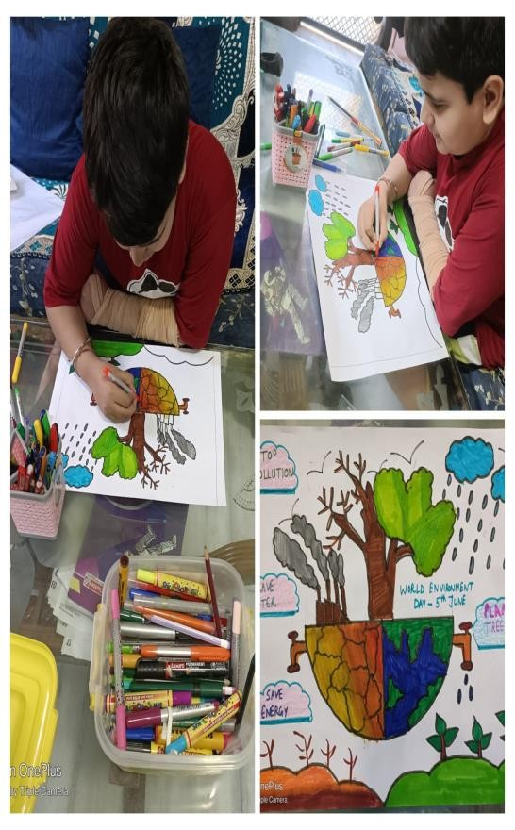
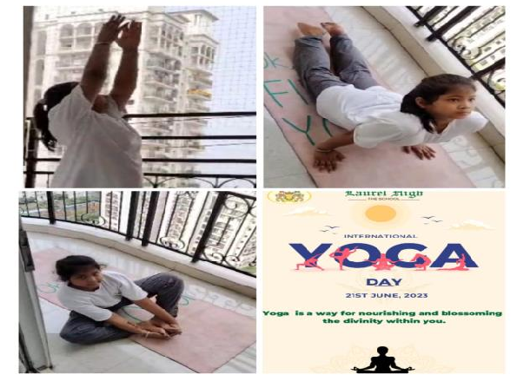
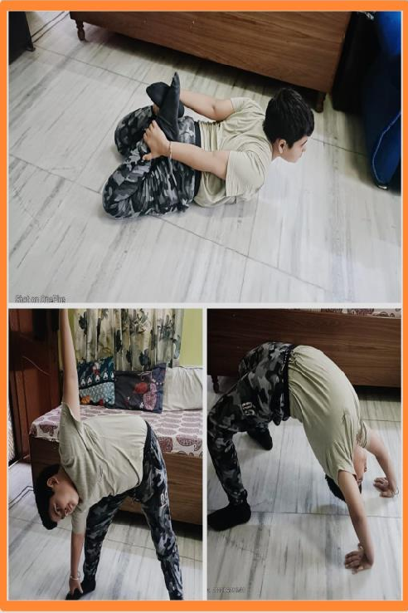

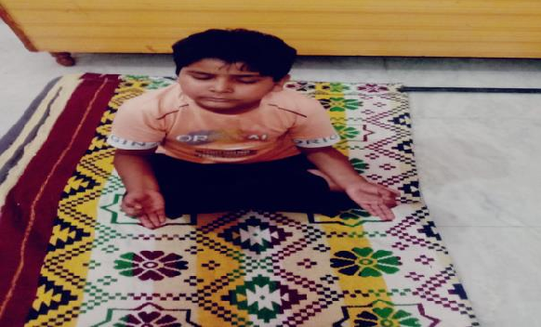
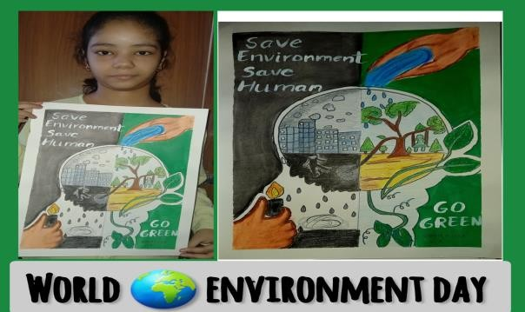


INTERNATIONAL YOGA DAY
WORLD ENVIRONMENT DAY
Better Environment,
Better Tomorrow!
Yoga is the art of listening to your body, mind, and soul.
“Enthusiasm is a wealth that is in abundance in childhood.”
CLASS-V

Slide 10
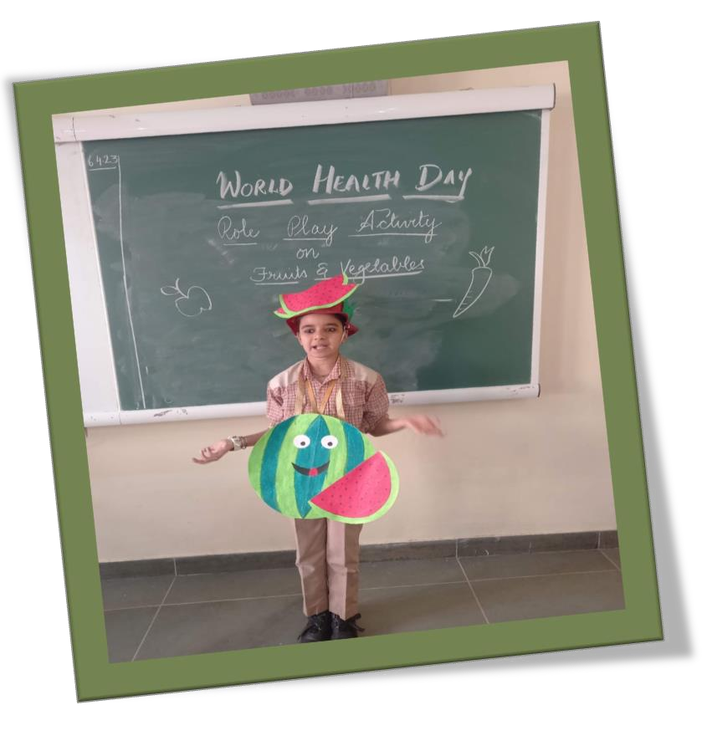





ROLE PLAY ON FRUITS AND VEGETABLES
WORLD HEALTH DAY
CLASS-V
"Health is a state of complete harmony of the body, mind, and spirit."

Slide 11


















CREATIVE GLANCE
A friend is who corrects your mistakes not the
one who agrees with it.
They are like comrades,
They are sent by God as we walk our path of life they fill it with joy,
Friends are like a rope that will never break.
By: Samaira kapur Class VI-A
Celebrating Yoga Day, Engaging in activities like: Salad Making, Book Cover Designing
CLASS-VI

Slide 12









Creative Minds
Creative Hands
CLASS-VI
“Visualization shapes art. Visualization turns abstract dreams into a reality.”

Slide 13





SCRAMBLE WORDS
BRINAWO -
OPBRERINAW –
MENEVONIRTN –
NIUCNOR -
Images can be powerful ways of communicating. People instinctively respond to images based on their personalities, associations, and previous experience. Graphic designers use this instinctive response to visually communicate ideas and information. They work with different tools and mediums to convey a message from a client to a particular audience Students create a new cover design for a book they are reading to demonstrate comprehension and explore character, plot, setting, symbolism, and conflict.
“Education is the movement from darkness to light.”
CLASS-VII

Slide 14










Eating Salad almost every day may be one of the most healthy eating habits you can adopt, experts say.
‘Salad Making’ as an activity was taken up by the students in their own creative way.
Books play an essential role in every student’s life by introducing them to a world of imagination, providing knowledge of the outside world, improving their reading, writing and speaking skills.
“Designing a book cover “ was an activity taken up by the students with
great enthusiasm.
CLASS-VII
“The beautiful thing about learning is that no one can take it away from you.”

Slide 15







Self composed
poem
Science is like a hidden treasure, It’s not much difficult to measure, Science is full of logics, Sometimes it goes beyond magics.
Science solves mysteries, Which is made of chemical histories,
Science teaches us various chemistries, Like branch on Banyan trees.
Science is like a Boon,
It carries people to the moon, Science is a symbol of silence,
It brings brilliance with challenge of excellence.
It is a hidden treasure, Science is not difficult to measure.
By: Navisha
‘Clean Delhi Green Delhi’ We need our Delhi to be clean, Everyone should be helpful, whether kids, old or teen. Stop using plastic and make Delhi neat, use jute and paper bags, as plastic would only make the Earth warm. Plant more trees
.Don’t destroy forests and build towers. Agriculture also needs land, we can also enjoy in sand, Plant trees and make it clean, Let’s leave a legacy behind and make our city clean!!!
-
Paridhi
Newspaper Reading
“Education is not preparation for life; education is life itself.” CLASS-VIII

Slide 16







वीर | कविता (काव्य)
सलिल कण हूँ, या पारावार हूँ मैं
स्वयं छाया, स्वयं आधार हूँ मैं
सच है, विपत्ति जब आती है,
कायर को ही दहलाती है,
सूरमा नहीं विचलित होते,
क्षण एक नहीं धीरज खोते,
विघ्नों को गले लगाते हैं,
काँटों में राह बनाते हैं।
मुँह से न कभी उफ़ कहते हैं,
संकट का चरण न गहते हैं,
जो आ पड़ता सब सहते हैं,
उद्योग - निरत नित रहते हैं,
शूलों का मूल नसाते हैं,
बढ़ खुद विपत्ति पर छाते हैं।
है कौन विघ्न ऐसा जग में,
टिक सके आदमी के मग में?
ख़म ठोंक ठेलता है जब नर
पर्वत के जाते पाँव उखड़,
मानव जब जोर लगाता है,
पत्थर पानी बन जाता है।
गुन बड़े एक से एक प्रखर,
हैं छिपे मानवों के भीतर,
मेहँदी में जैसी लाली हो,
वर्तिका - बीच उजियाली हो,
बत्ती जो नहीं जलाता है,
रोशनी नहीं वह पाता है।
“It always seems impossible until it’s done.”
CLASS-VIII

Slide 17








S W A C C H
BHARAT ABHIYAN
Himanshi
Raunika
CLASS-IX
“Learning and innovation go hand in hand”.

Slide 18









The event set in motion with a brilliant skit enacted by students of Class IX-A depicting the gory of Jallianwala Bagh massacre. The students also set everyone’s foot tapping through a Punjabi Gidda on the awakening Jaggo Aiyan and Panj Pyare showcasing themselves as world warriors.
CLASS-IX
Live Everyday as if it is a festival. Turn your life into a celebration.

Slide 19










As students got promoted to the next class, a list of activities were awaiting for them to push them beyond their limits. The activities started with declamation on “ World Health Day”. Students shared their views on the topics: Happiness is truly responsible for a healthy living, stress is the main cause of obesity.
Then began the “ Book Week”. In ‘DEAR period’ , students brought their favourite novel and got engrossed with reading. Next day students made beautiful ‘comic strips’. Students enjoyed this activity and drew their imagination on paper. Students showcased their love for poetry by composing poems. To spread the message- save earth, a poster making activity was taken up. At last to pay a tribute to all loving mothers, a beautiful assembly was presented by class-10.
CLASS-X
Creativity is just connecting things.

Slide 20



"CREATIVITY IS SEEING WHAT OTHERS SEE AND THINKING WHAT NO ONE ELSE EVER THOUGHT." - ALBERT EINSTEIN.
THE CREATIVITY OF STUDENTS WAS BOOSTED BY GIVING THEM THOUGHT PROVOKING TOPICS FOR CREATIVE WRITING , POSTER MAKING ON NO TOBACCO DAY, COMIC STRIPS AND MANY MORE.
STUDENTS WERE AT THEIR CREATIVE BEST AND DISPLAYED EXEMPLARY WORK.
CLASS-X
Creativity is a wild mind and a disciplined eye.

Slide 21






MOTHERS’ DAY
A HEART TOUCHING TRIBUTE
CLASS-X
“A Mother’s love is unconditional, unbreakable, and forever.”

Slide 22







O MOMMA
By the world, when I wasn’t supported, You were the one, who always escorted. You mean the world to me,
Even if you had to pay your happiness, still you always chose to let us free.
Of God, mothers are half the best creations,
And rest half are our fathers.
Father left his job and you your career,
O my mother dear, of your sacrifices completely aware we’re. Sometimes in rile, on you I shout
Still in my grey, besides me is where you’re always found.
I’m sorry if ever my words or actions’d hurt you my valentine,
But you know what? It is coz you’re the sole one, I’ve that right to call mine.
O momma, O momma,
Never let you down are we gonna. Do you know? You’re my crush, Coz we love you so much .
ANGEIL
Today a reader, tomorrow a leader

Slide 23







HOW CAN AIDS TO TRADE MAKE A DIFFERENCE?
“Foreign Trade has already been a reason why inflation has been low", This statement by Tin Bishop plainly shows that foreign trade as well as aids to trade have a positive effect on the world and its economy. Foreign aid benefits
the domestic economy at the same international one. Foreign aid creates
time as the a stronger
relationship for all the parties involved in the transaction, no matter what their culture , language , religion is. Foreign aid provides economic opportunities for the giver and the recipient. It can offer agricultural improvements.
RISK IS EVERYTHING!
Study hard, Do good and the good life will follow.
CLASS-XI

Slide 24




CREATIVE CORNER
PRESENTATION ON ELECTORAL BOARD
The right to vote doesn’t give you power
; Power gives you the right to vote
Voting is the biggest power a citizen holds. To spread the importance and awareness about the same, students of class XI B gave a presentation on the ‘’Right to Vote’’.
Students highlighted the significance of exercising the Right to Vote as it is one of the pillars of democracy. It must be a compulsive duty and must come from within.
We must remember that our vote is our voice and it deserves to be heard. Students brought abreast the purpose of choosing wisely to have an effective government
Name of the Board Members- NARAYAN BHANDULA , GURBANI GILL, PAAVANI JETLI, DIYA BENIWAL, KEOSHA JAIN, MAHIGARG, YASH BENIWAL
Keosha Jain
“Learning is never done without errors and defeat.”
CLASS XI B

Slide 25




















“CREATIVITY is a wild mind and a DISCIPLINED eye.”
BUSINESS STUDIES PROJECT STARBUCKS COFFEE QUESTIONNAIRE
Q1 How many managers are there in one outlet?(centralisation and decentralization Ans: 2
Q2 Are all the employees treated equally?(equity) Ans: Yes
Q3 Are you satisfied with your salary?(remuneration) Ans: Yes
Q4 In case of an emergency do you approach the higher authorities or your immediate superior? (scalar chain)
Ans: All the employees usually tend to approach their immidiate superior . Q5 Would you leave an important family gathering for a meeting at work? Ans: Yes i feel like work comes before any personal situation.
Q6 Are you happy with the disciplinary actions?(discipline) Ans:Yes
Q7 Are there frequent transfers and terminations of employees?(stability)
Ans: No ,not really
Q8 Do you participate in decision making?(initiative)
Ans:Yes, we feel very included.
Q9 Is there division of work among the employees?(division) Ans: yes, there are different departments for different things. Q10 Do you get bonuses,appraisals etc?
Ans: I mean , I haven't had any recently but yes,we do get them.
By KESHAV JINDAL
“A little progress each day adds upto big results.”
CLASS-XII

Slide 26




Speaking skill activity was taken up in the class .The students enacted the scenes from stories THE LAST LESSON and THE THIRD LEVEL
Depicting the contemporary state of modern man struggling in his life and the students being the victims of procrastination
CLASS-XII
“Courage is what it takes to stand up and speak, and to sit down and listen.”

Slide 27












Achievers’ Award Ceremony

Slide 28




INTERHOUSE SOLO DANCE COMPETITION
To hone the dancing skills of the students, an Inter House Solo Dance Competition was organized on 28 April 2023.The competition was held in two categories: Classical and Freestyle. True to the theme, the vivacious dancers set the floor on fire with their energetic performances and this was a reflection of their passion and hard work. The choreography, rhythm, synchronization and presentation of all the students were very good.
“Dancing is like dreaming with your feet!”

Slide 29

IN TODAY’S DIGITAL ERA, A GADGET DETOX HAS EMERGED AS A POWERFUL PRACTICE TO RECLAIM OUR LIVES FROM THE CLUSTERS OF CONSTANT CONNECTIVITY. WITH SMARTPHONES AND GADGETS RULING OUR ROUTINES, WE OFTEN FORGET TO TRULY ENGAGE WITH WORLD AROUND US. A GADGET DETOX PROVIDES MUCH-NEEDED RESPITE OFFERING BENEFITS LIKE IMPROVED FOCUS, STRENGTHENED RELATIONSHIPS AND REDUCED STRESS.
BY SETTING CLEAR GOALS AND GRADUALLY LIMITING THE USAGE OF GADGETS, WE CAN EMBARK ON THIS LIBERATING JOURNEY. ENGAGING IN ALTERNATIVE ACTIVITIES SUCH AS READING, MINDFULNESS AND OUTDOOR PURSUITS HELP US RECONNECT WITH OURSELVES AND OUR SURROUNDINGS. DESIGNATING TECH-FREE SPACES FOSTER QUALITY TIME WITH LOVED ONES.
AS WE EMBRACE THE ART OF GADGET DETOX, WE REDISCOVER THE BEAUTY OF THE PRESENT MOMENT NURTURING OUR CREATIVITY, AND EMBRACING A HEALTHIER , BALANCED LIFESTYLE THAT CELEBRATES BOTH THE DIGITAL AND REAL WORLD.
SO, LET’S NOT BECOME THE SLAVES OF GADGETS AND REMAIN THE MASTERS BY PRACTISING THE SO CALLED –
Ms. Anjali ( Educator)
GADGET DETOX.
“ For anything to change, someone has to start acting differently.”

