Slide 1


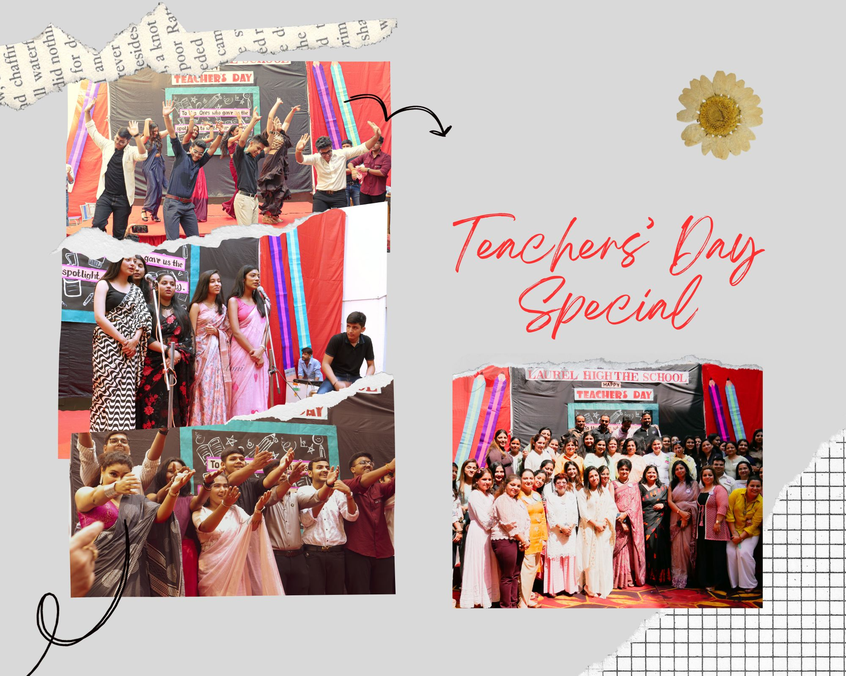
THE HORIZON
Sept’ 23 - Oct ‘ 23
“The
influence
of a
TEACHER
can
never
be
erased.”
Advisor
Ms. Urvashi Choudhary
Chief Editor
Ms. Sangeeta Goel
Hindi Editor
Ms. Bhavna Sharma
English Editor
Ms. Tanvi Chitkara
Computer Graphics
Ms. Bhavna Malik

Slide 2
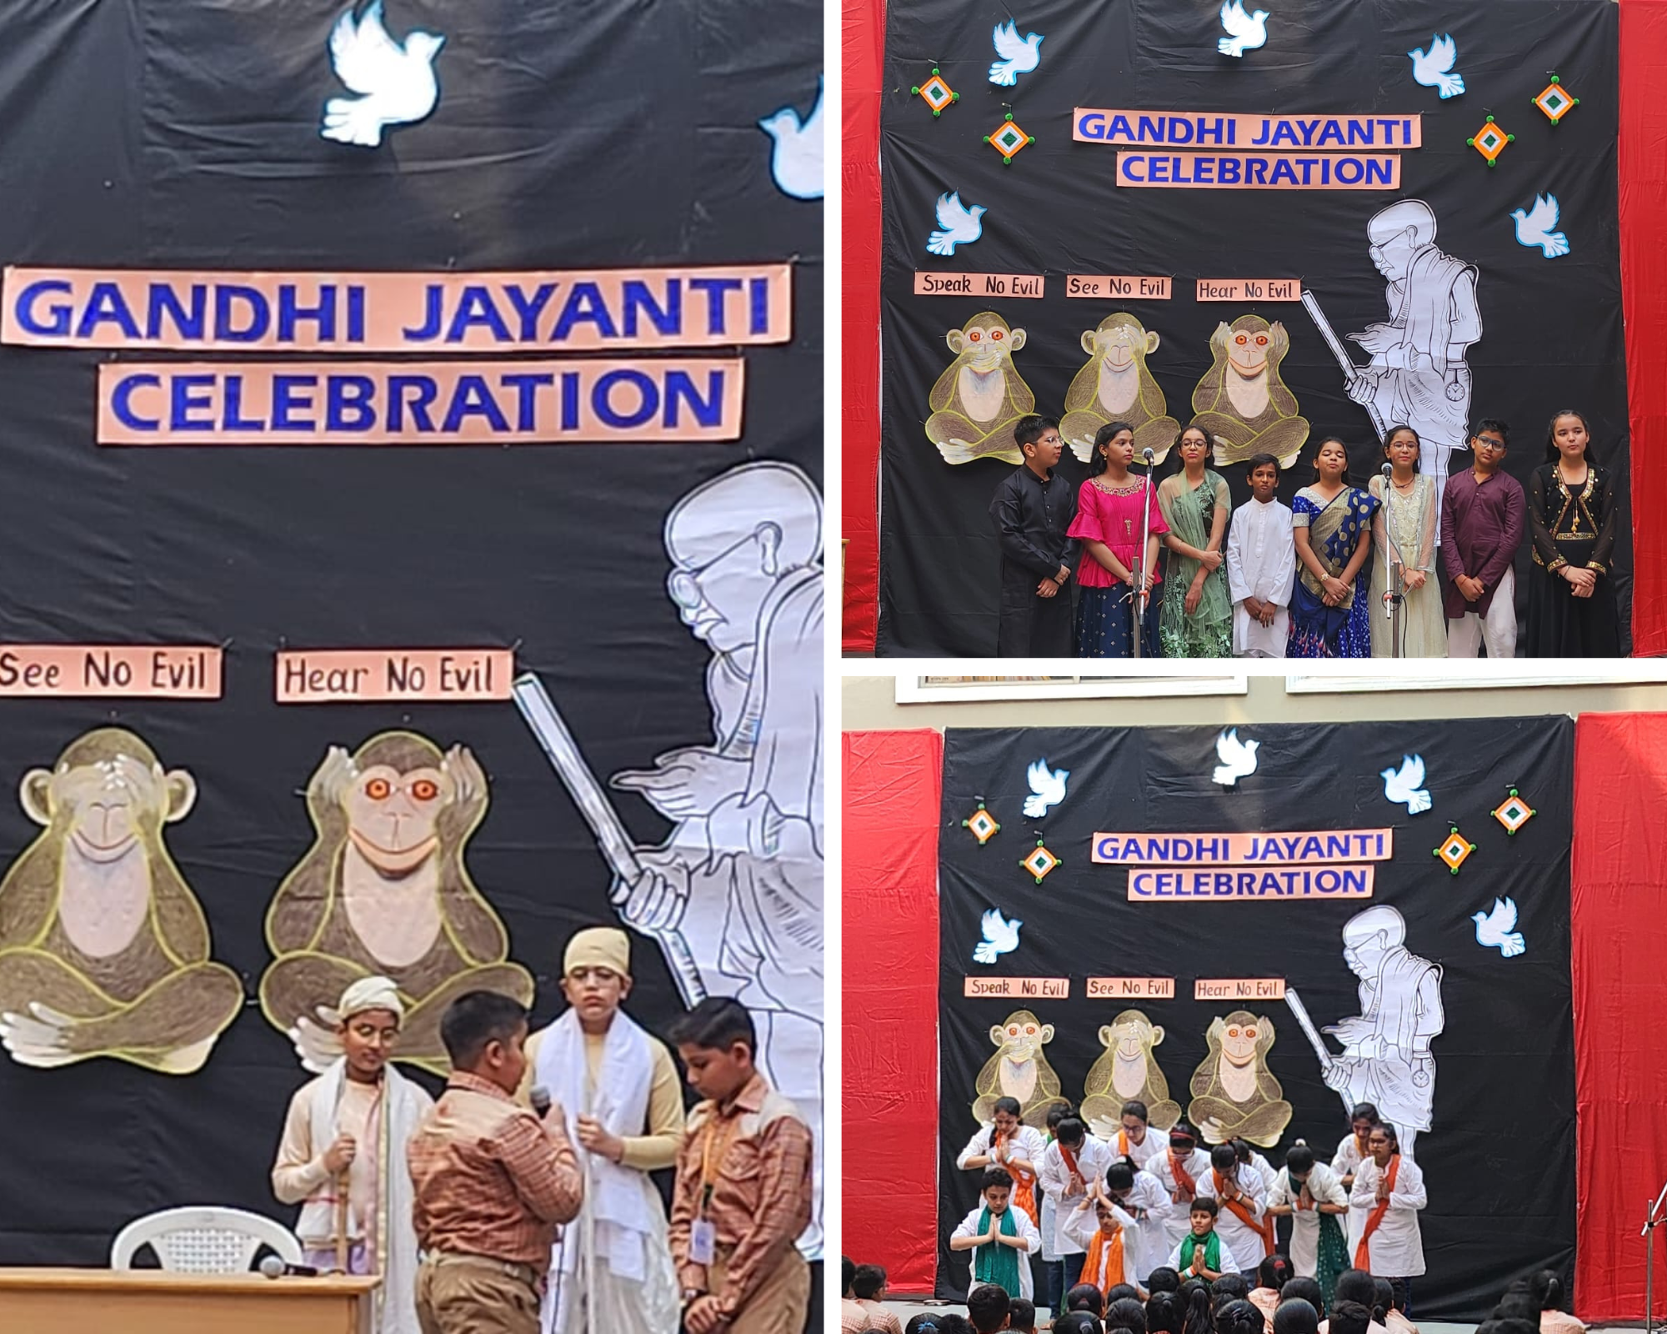
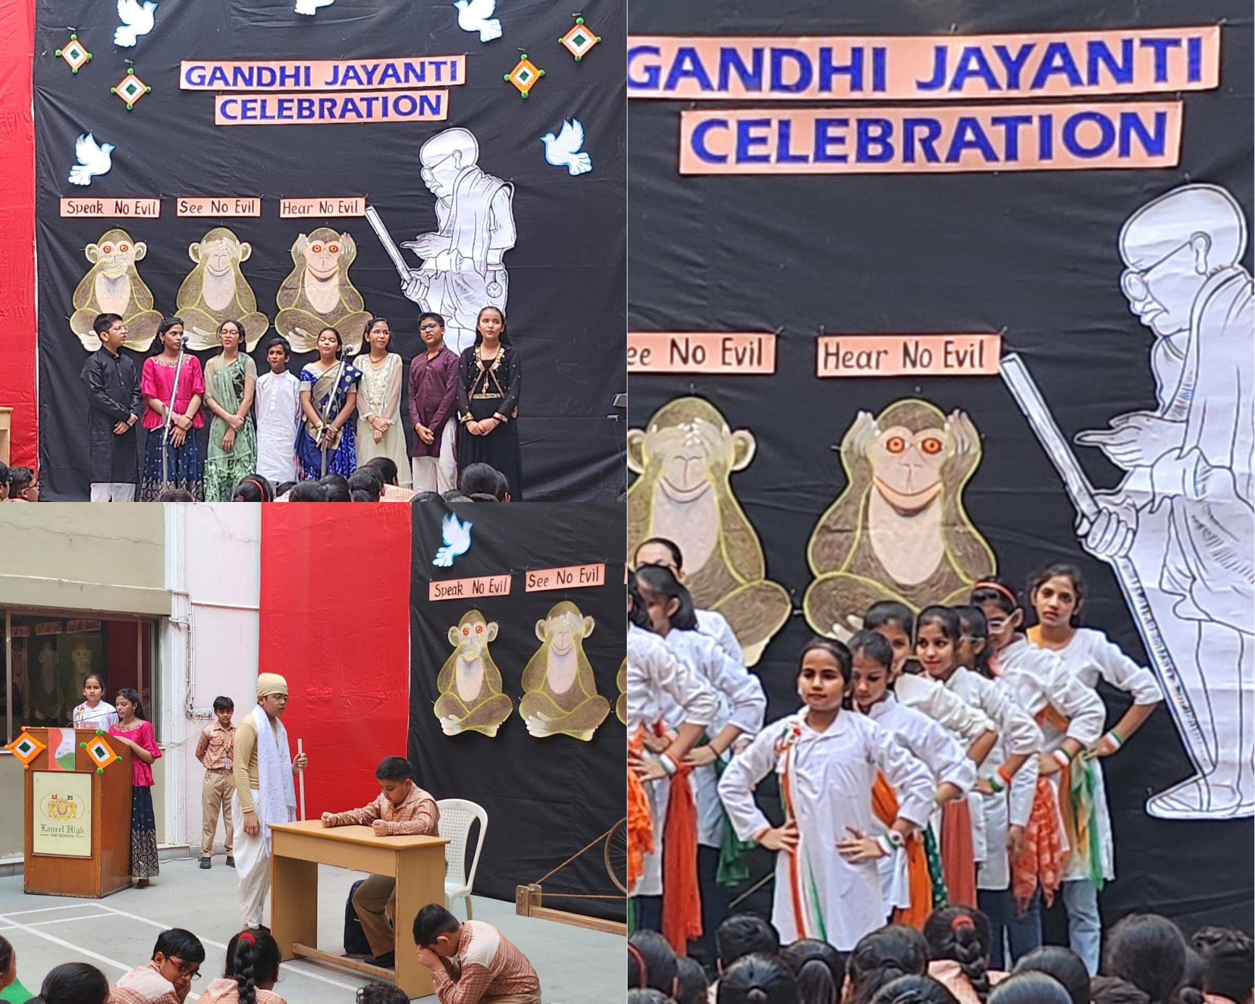
GANDHI JAYANTI CELEBRATION
To give a special tribute to our ‘Father of the Nation’, on Gandhi Jayanti, the special assembly was presented by the students of Class VI B. It emphasized on the importance of the values preached by Gandhi Ji with the help of a short skit bringing into light the key role of truth and non- violence. The ambience was filled with a feeling of patriotism for our country by the performance on a beautiful song ‘Bapu ki baaton ka hai bas itna saar.’ Decked in a plethora of vibrant colours and reverberating beats, the dancers delivered an energetic performance winning accolades from the Head of School.

Slide 3
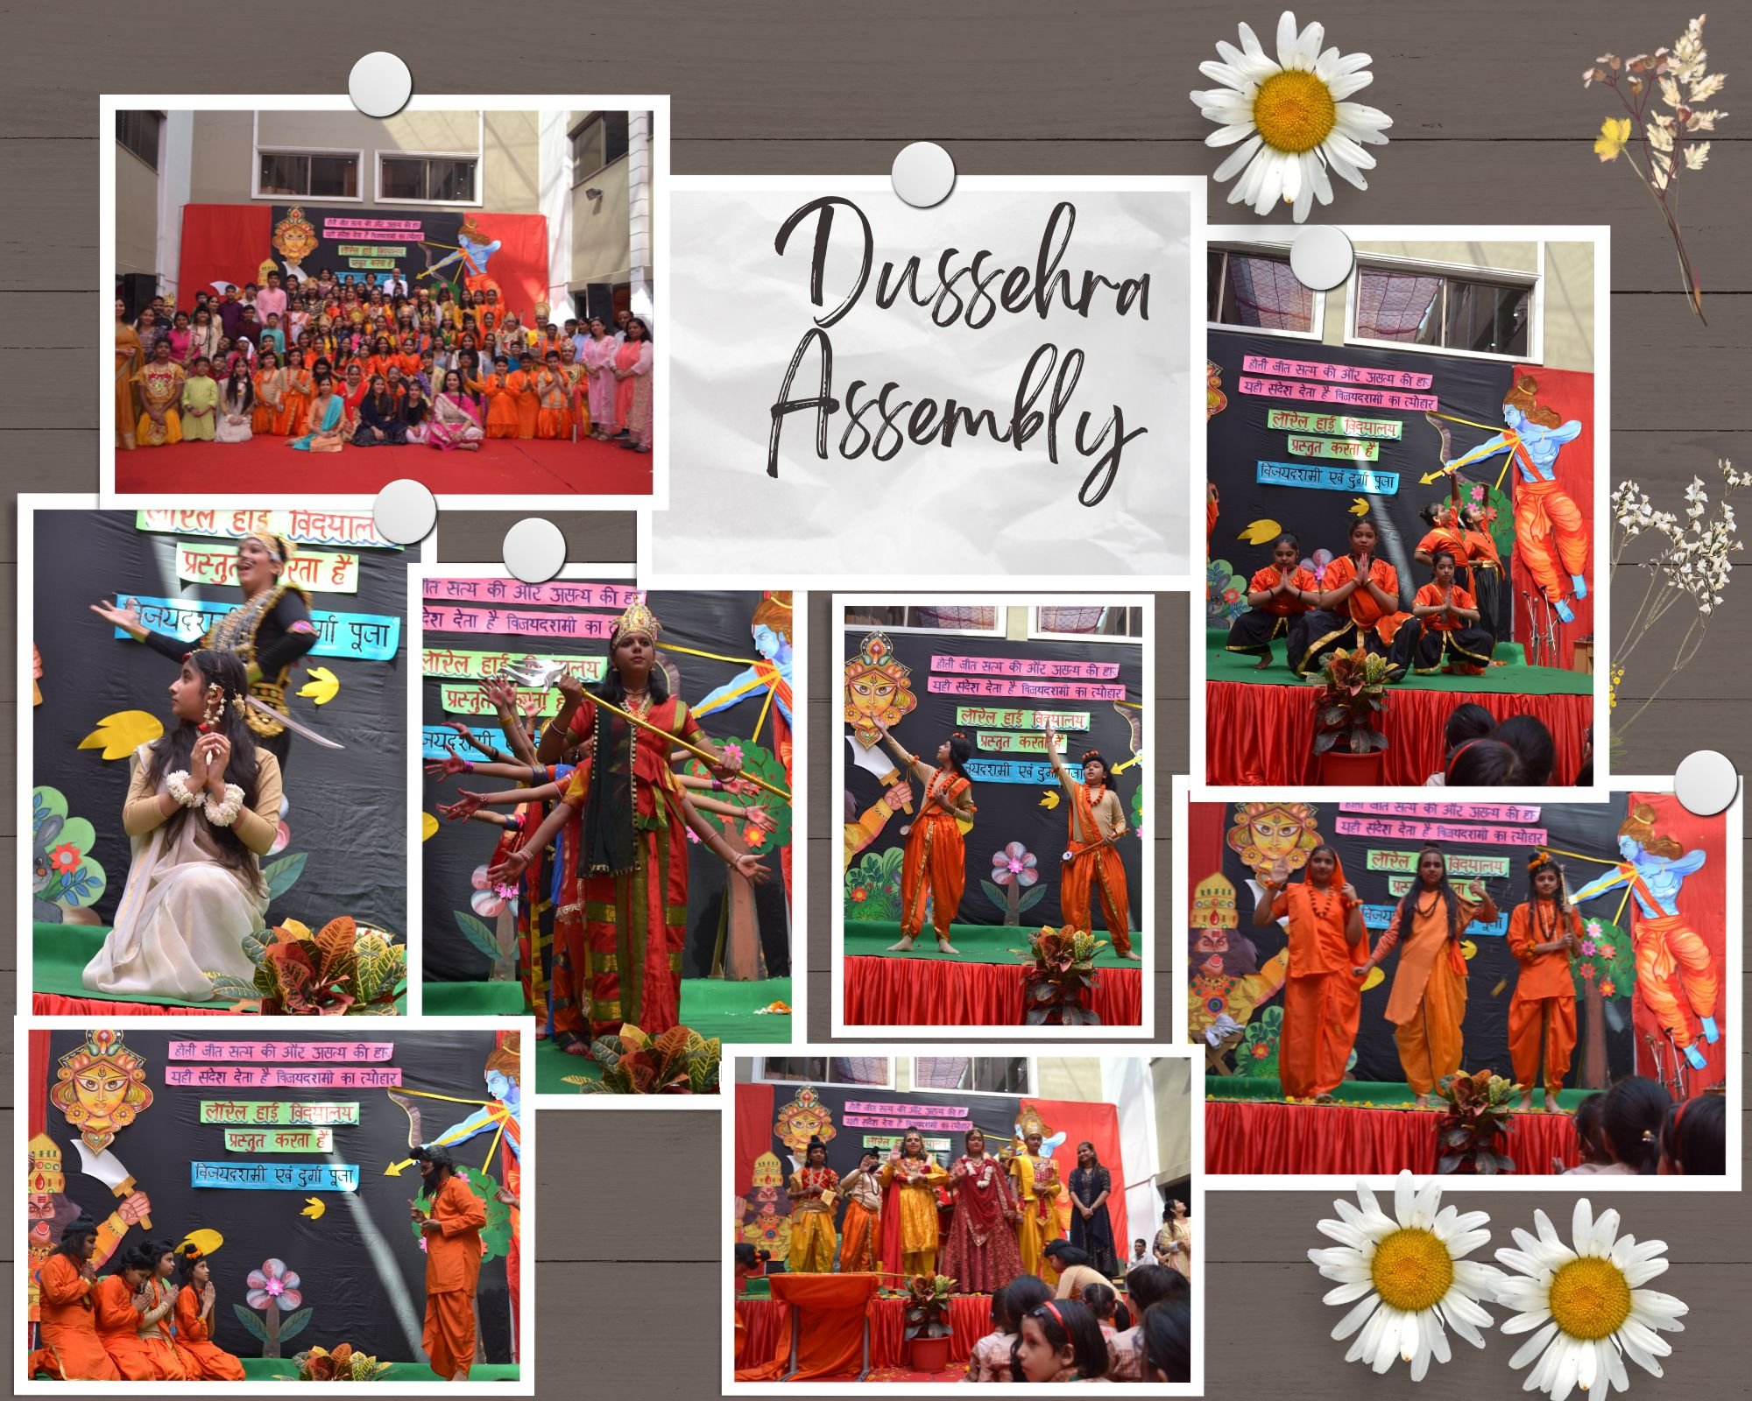
DUSSEHRA CELEBRATION
असत्य पर सत्य के सिद्धांत को दर्शाता दशहरा व शक्ति को दर्शाती माँ दुर्गा का पर्व विद्यालय के प्रांगण में भव्य रूप से मनाया गया l विद्यालय में बच्चों ने विजय दशमी पर्व से संबंधित मनमोहक लघु नृत्य प्रस्तुत किया, जिसमें दर्शाया गया कि किस प्रकार मां दुर्गा ने महिषासुर नामक राक्षस का वध करके दुष्टों का संहार किया। इस अवसर पर मर्यादा पुरुषोत्तम श्रीराम, सीता, लक्ष्मण आदि के परिवेश में छात्र सभी के मन को मोह रहे थे। छात्रों ने संगीत के माध्यम से मर्यादा पुरोषत्तम राम के आने का उत्सव मनाया। लव कुश के द्वारा रामायण की संपूर्ण कथा की सुंदर प्रस्तुति प्रस्तुत की गई। अंत में शास्त्रीय नृत्य के द्वारा श्री राम जी के द्वारा रावण का वध दिखाया गया। विद्यालय के सभापति जी ने कहा कि भारतीय संस्कृति वीरता की पूजक और शौर्य की उपासक है तथा सभी छात्रों को दशहरे की शुभकामनाएं दी। सभी अतिथियों के द्वारा उन विद्यार्थियों को सम्मानित किया गया जिन्होंने जोनल प्रतियोगिता में सफलता प्राप्त कर अपना कीर्तिमान स्थापित किया।✨

Slide 4
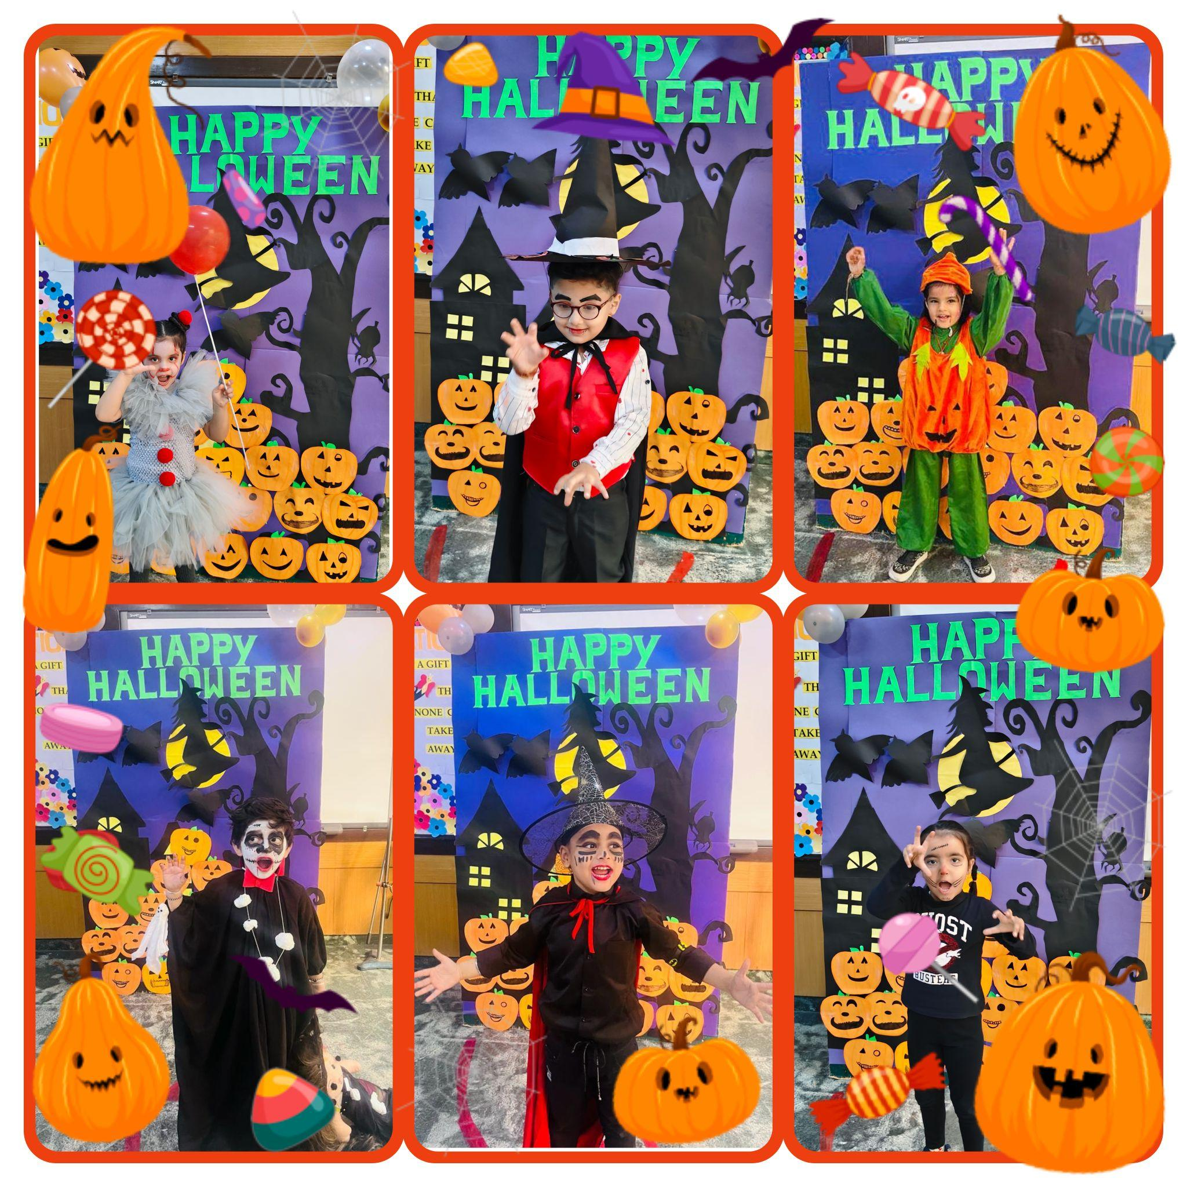
Halloween Celebration
Students of Springboard Class came dressed as witches, ghosts, and vampires for the celebration of Halloween Day on October 31, 2023. They had great fun scaring everyone during the ramp walk. Our students at Laurel High Montessori embraced the spooktacular vibes of Halloween with great zeal.

Slide 5
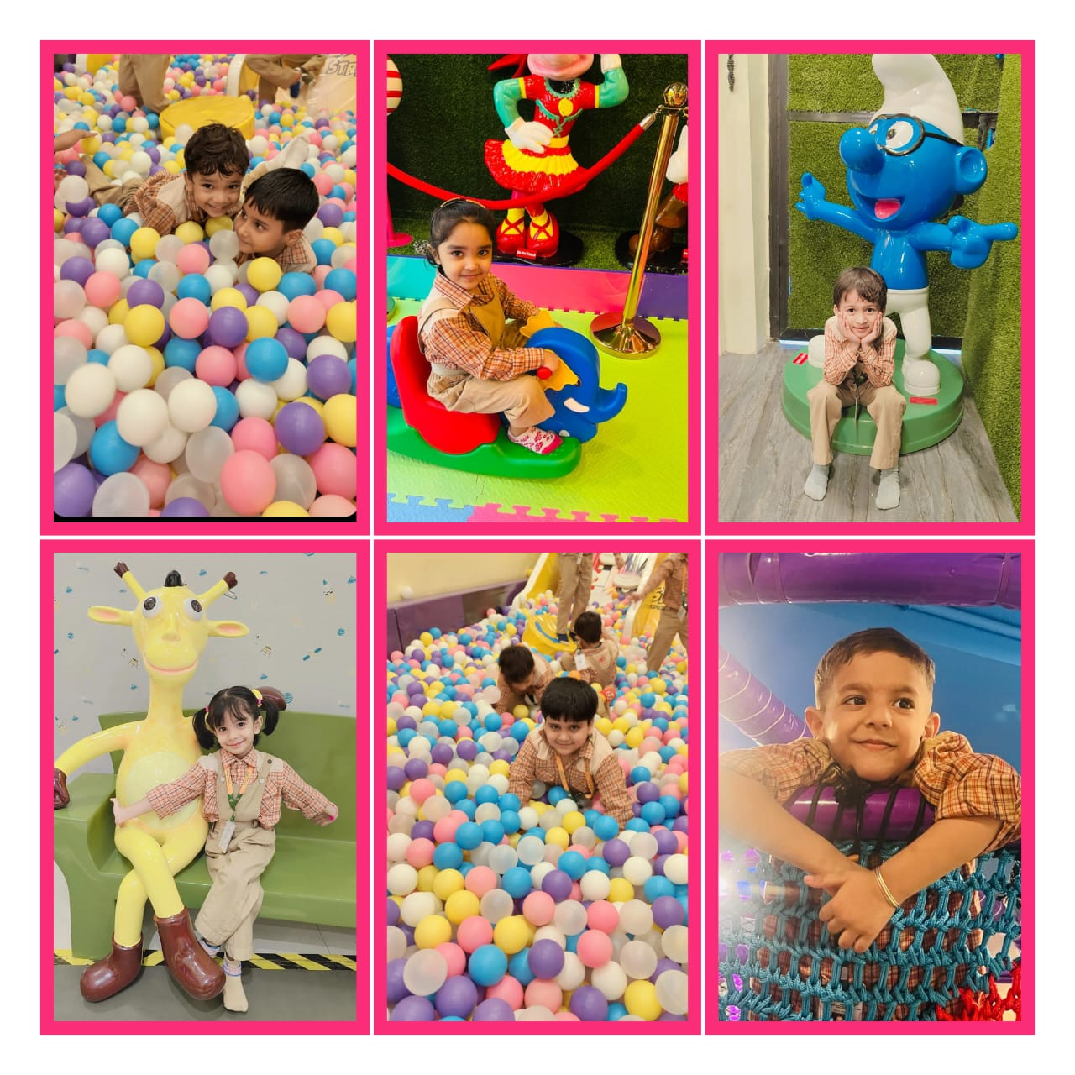
Trip to Bouncing Pouncing
"Indoor play areas are safe places where kids develop socio - emotional and imaginative skills which are necessary to attain self-confidence, improve coordination, and advance critical thinking". Keeping this in mind, Laurel High Montessori
organised a fun -filled trip to BOUNCING POUNCING where the tiny-tots enjoyed themselves to the fullest. They were served with scrumptious food🍔🍟.
The day was full
of fun😊.

Slide 6
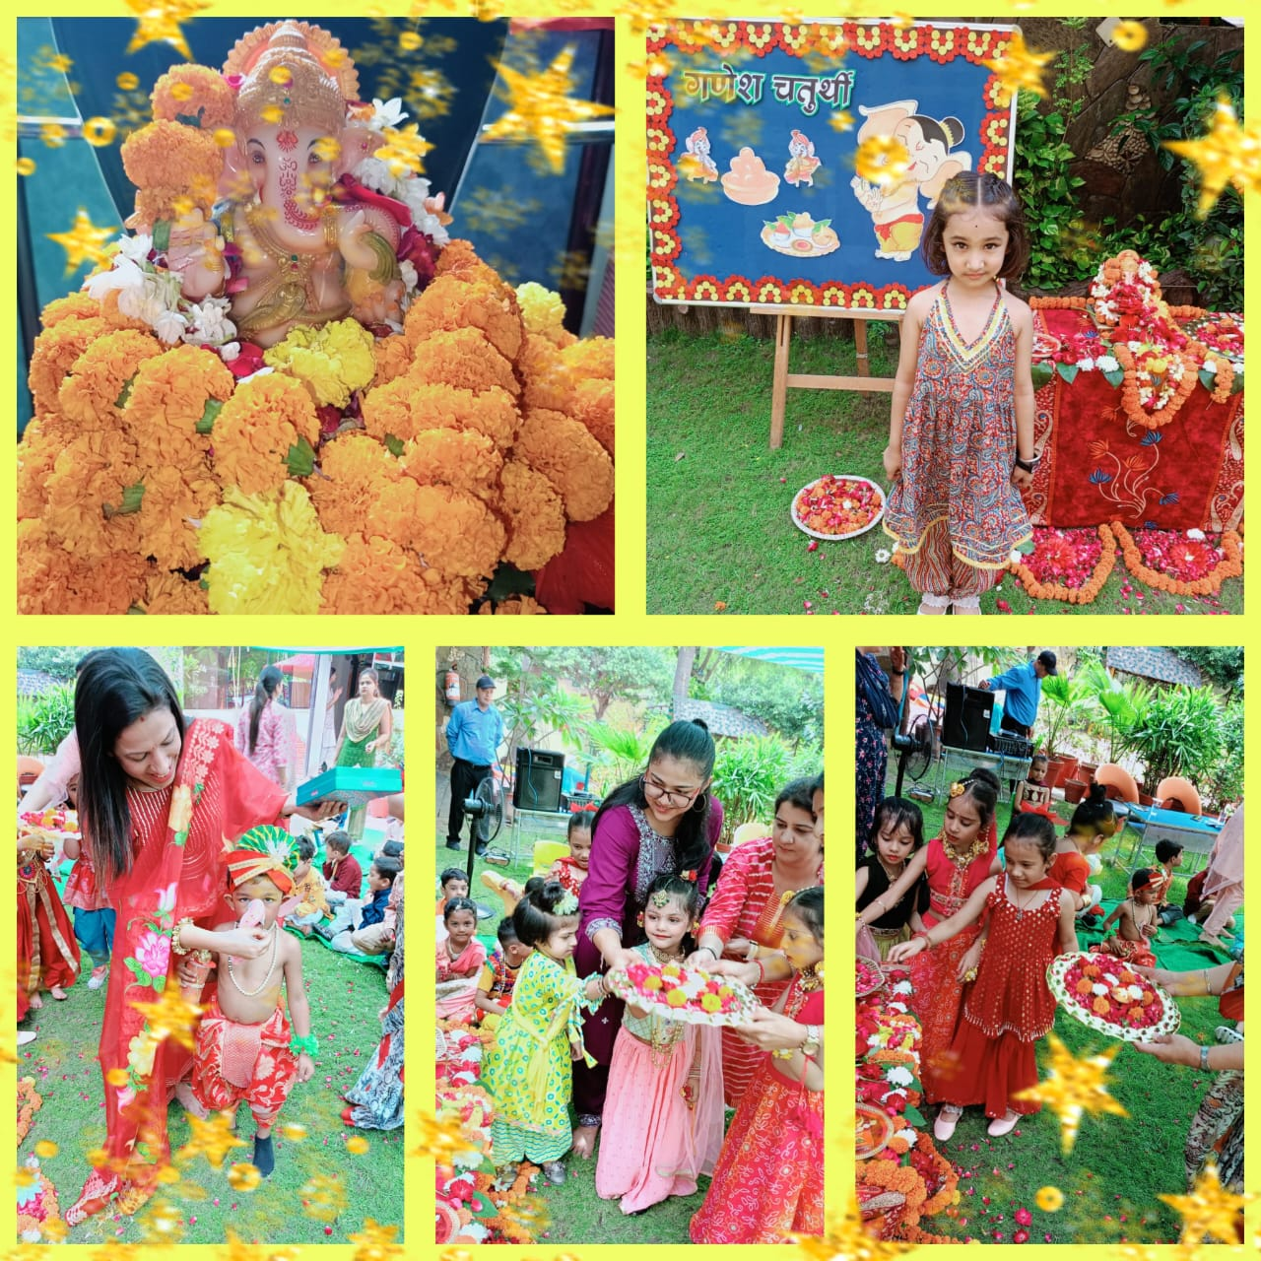
Ganesh Chaturthi Celebration
Echoing the festive spirit and to seek the blessings of Lord Ganesha, Ganesh Chaturthi was celebrated in the school.
Students of Laurel High Montessori delved into the artistic and creative aspects of this beloved festival. The students presented beautiful dance performances.
On this Ganesh Chaturthi, may Lord Ganesha clear the obstacles and pave the way for us to move forward in life.

Slide 7
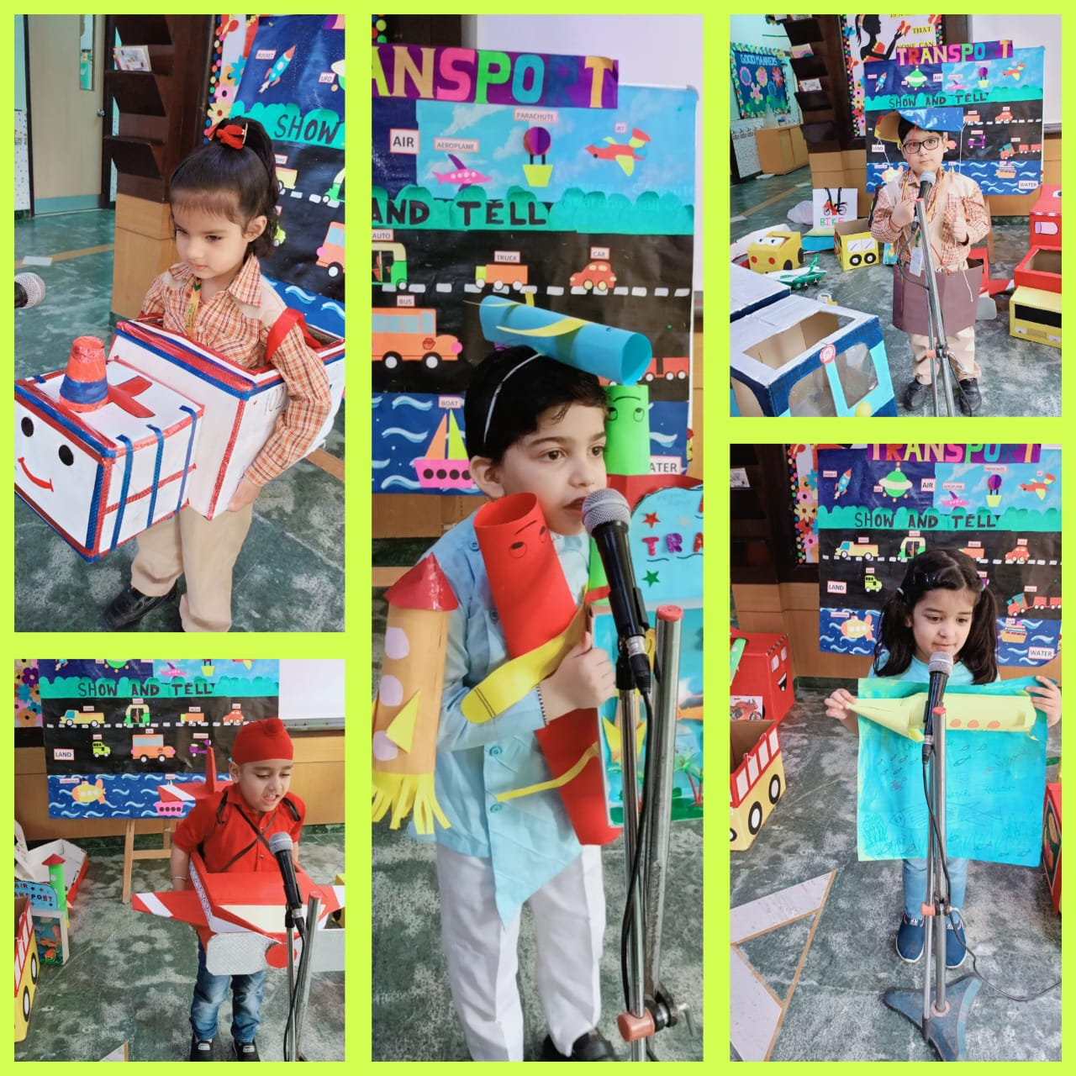
Mike Gladiators on Transport
Exploring wheels, water, and wings with our powerpuff kiddos. To generate awareness of different modes of transport, a Mike Gladiator activity on Transport was conducted. The expressive toddlers of Springboard Class delivered their presentations beautifully through creative props. They learnt “Start Early, Drive Slowly, Reach Early”

Slide 8
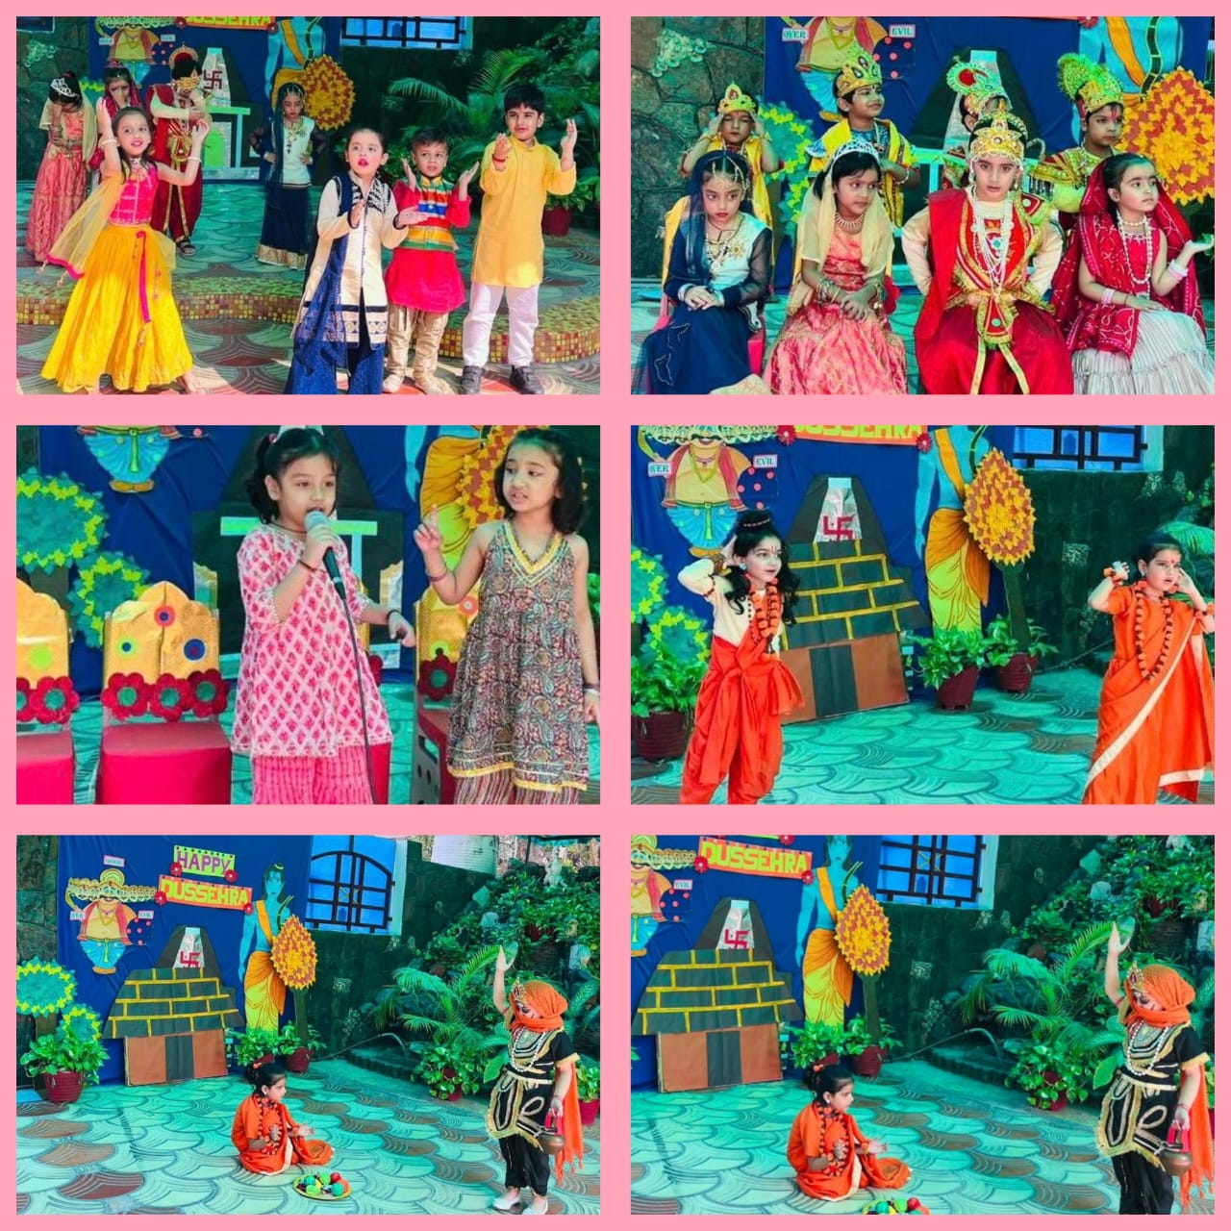
Dusshera Celebration
Lighting up the festive spirit, a special assembly on Dussehra was conducted by Springboard Class on 20 October, 2023.
The young Laurelites celebrated the victory of good over evil through creative enactment of scenes from The Ramayana, recitals and dance performances. Their innocent presentations won several hearts.

Slide 9
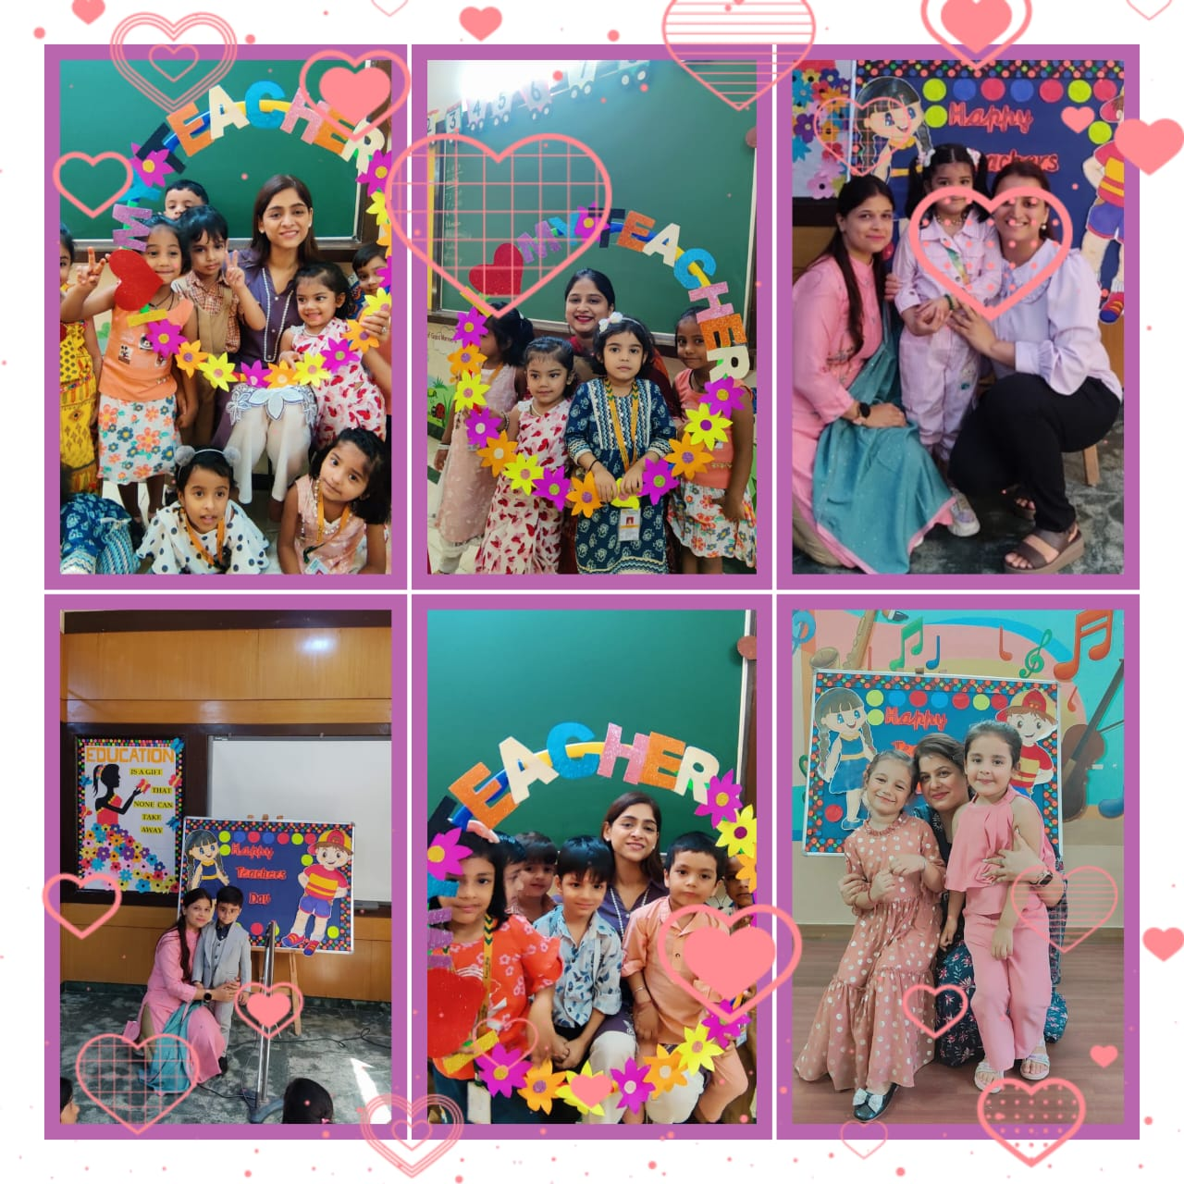
Teacher’s Day Celebration
Laurel High Montessori celebrated Teachers’ day with great gusto and gaiety on 5 September 2023. Students performed a scintillating cultural show to denote their love, respect, and acknowledgement of the hard work put in by the teachers towards their growth and development.

Slide 10
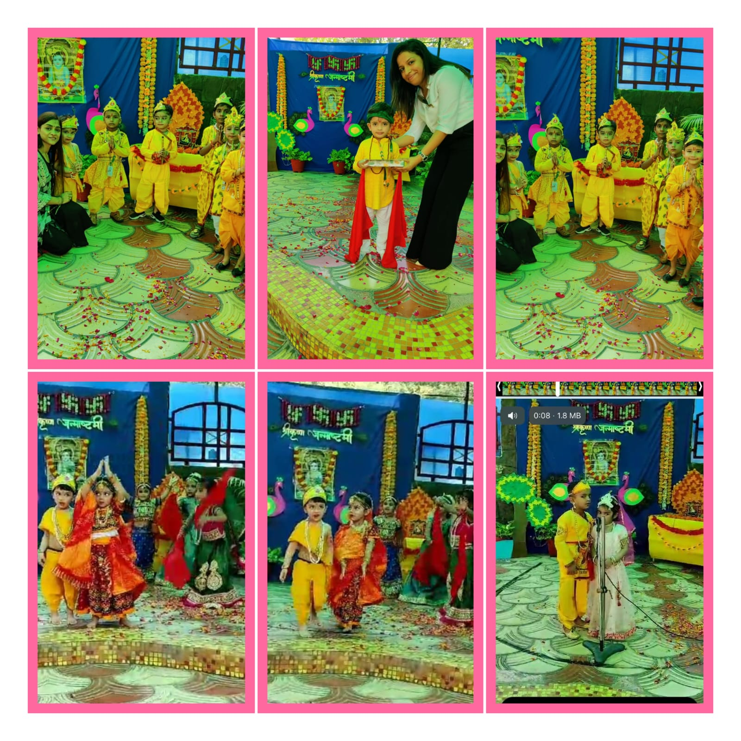
Janmashtami Celebration
Janmashtami is also known as Krishnashtami, a day of great significance all over the world.To cherish the beauty of this festival, a special assembly was organised at Laurel High Montessori by Blueprint babies.

Slide 11
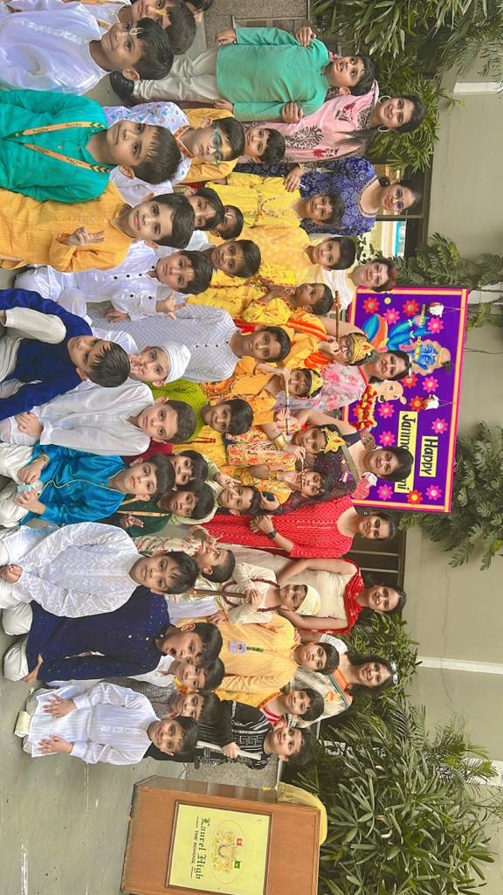
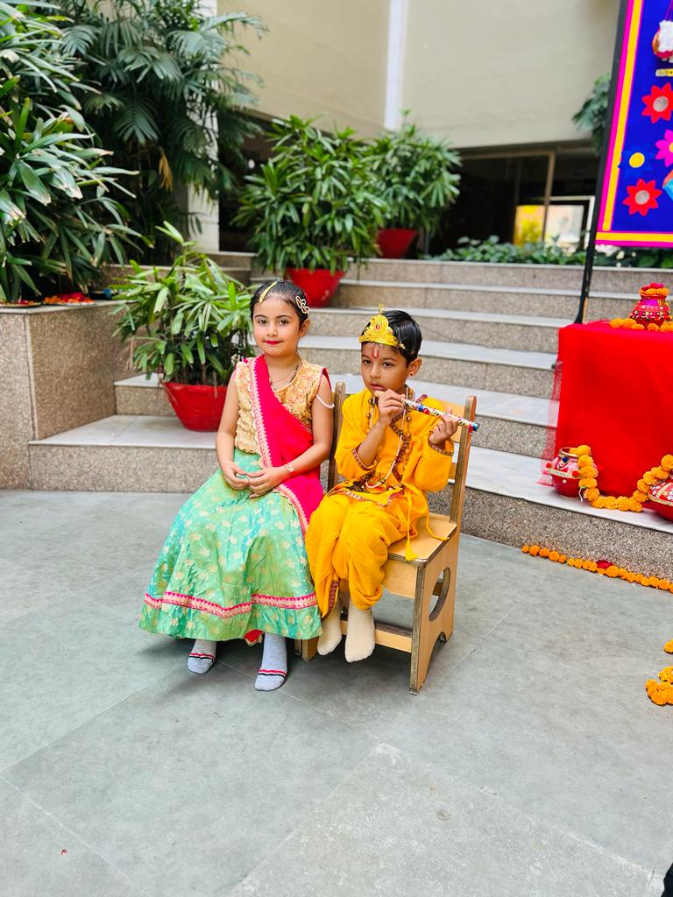
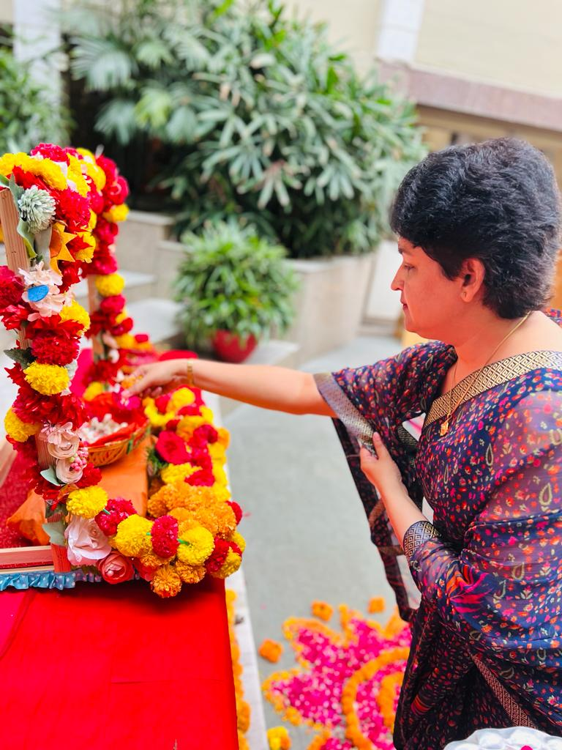
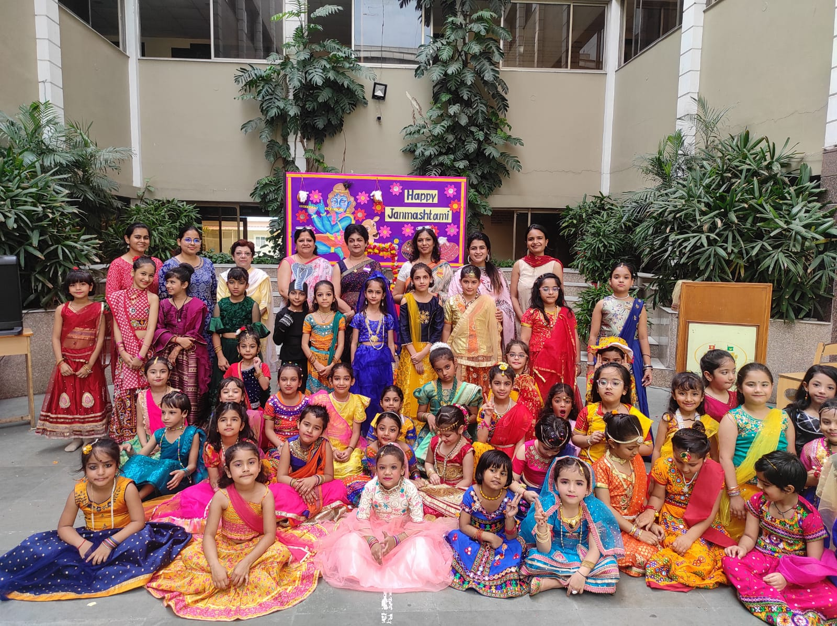
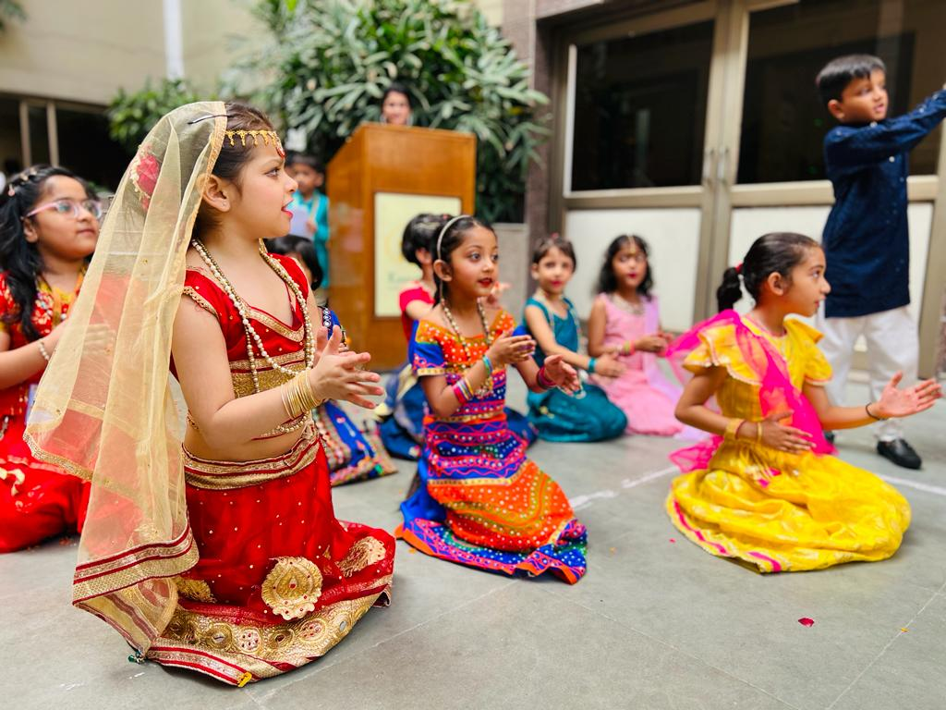
JANMASHTAMI CELEBRATION
Class I
Students of class 1 presented a beautiful assembly on this auspicious occasion. Dressed in traditional attires, the students overwhelmed everyone with their mature performances. The highlight of the assembly- cent percent participation of the students made everyone proud. May Bal Gopal always keep showing us the righteous path.

Slide 12
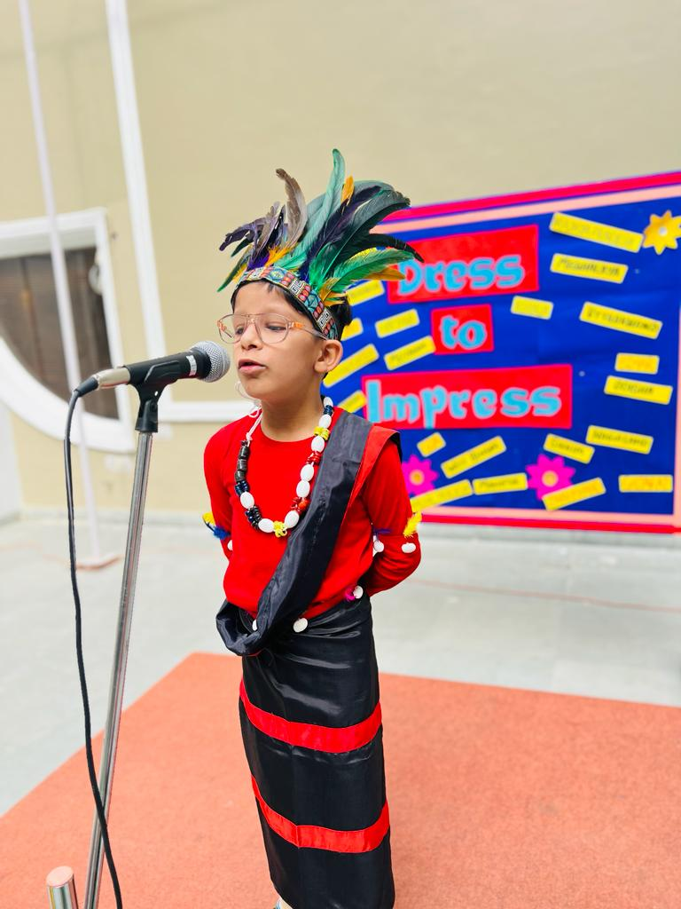
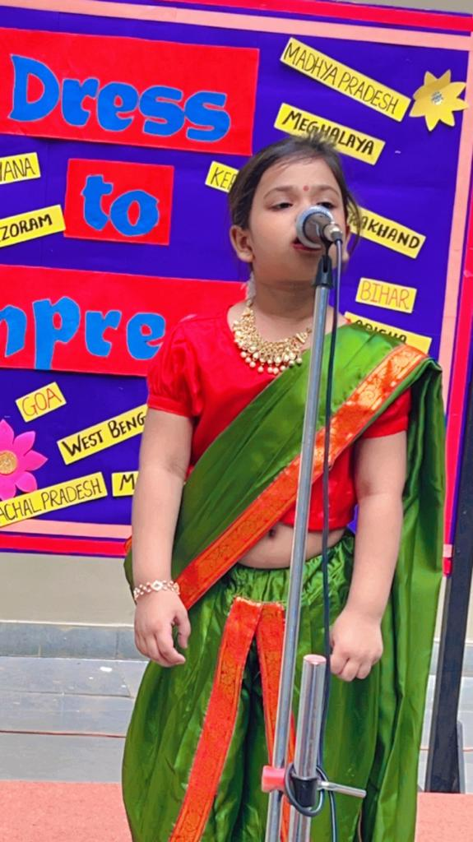
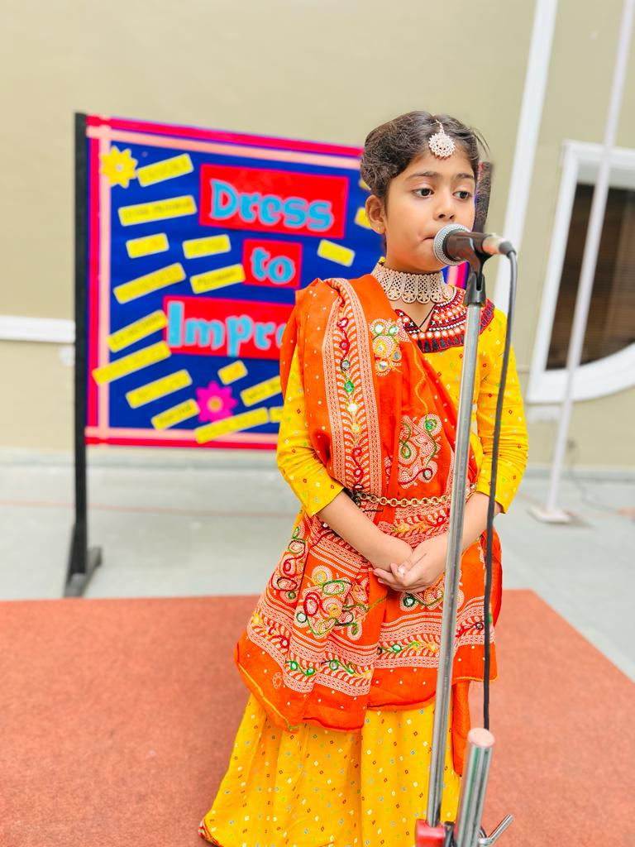
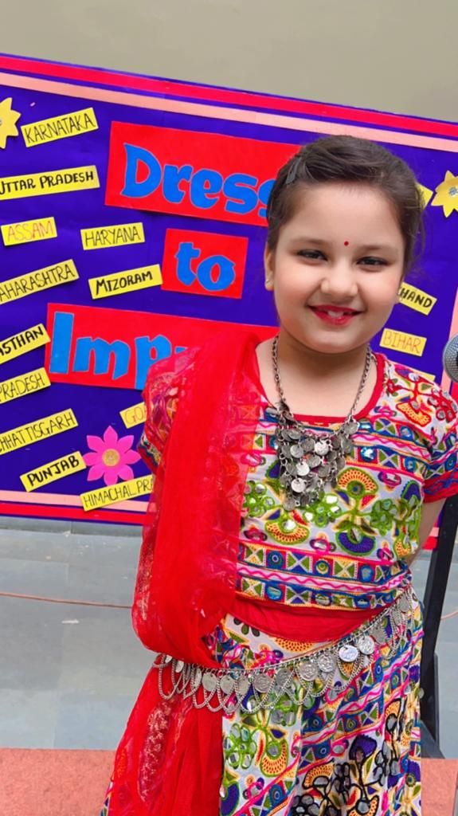
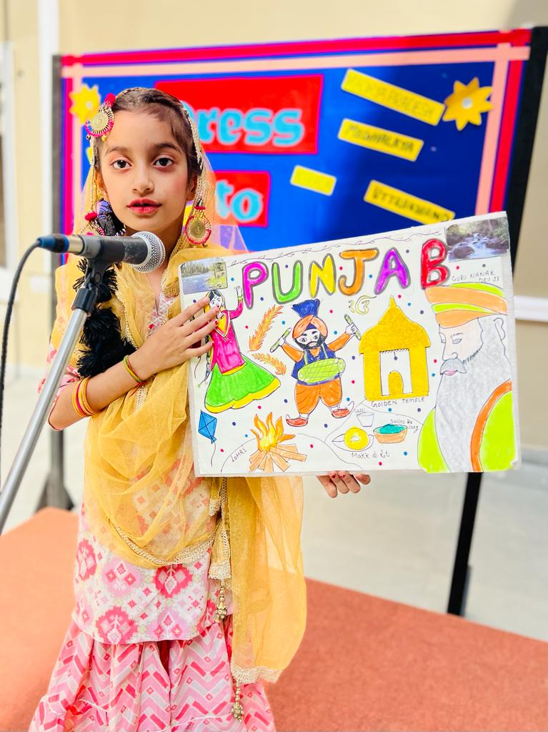
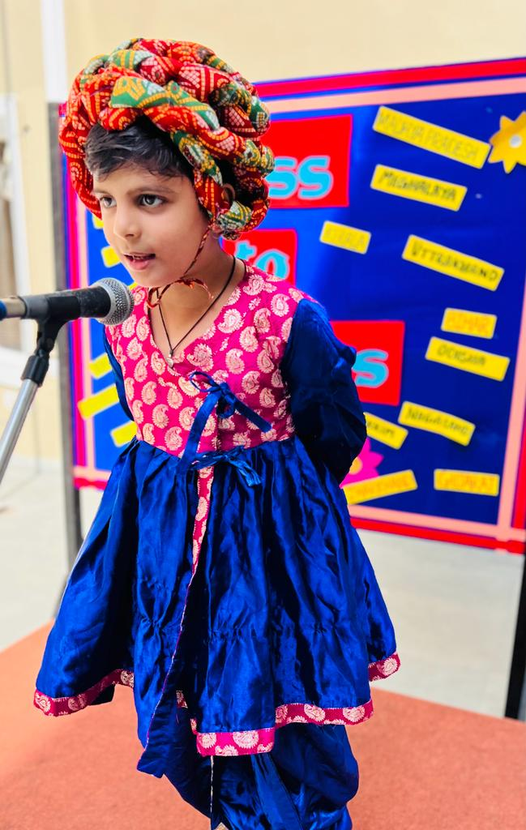
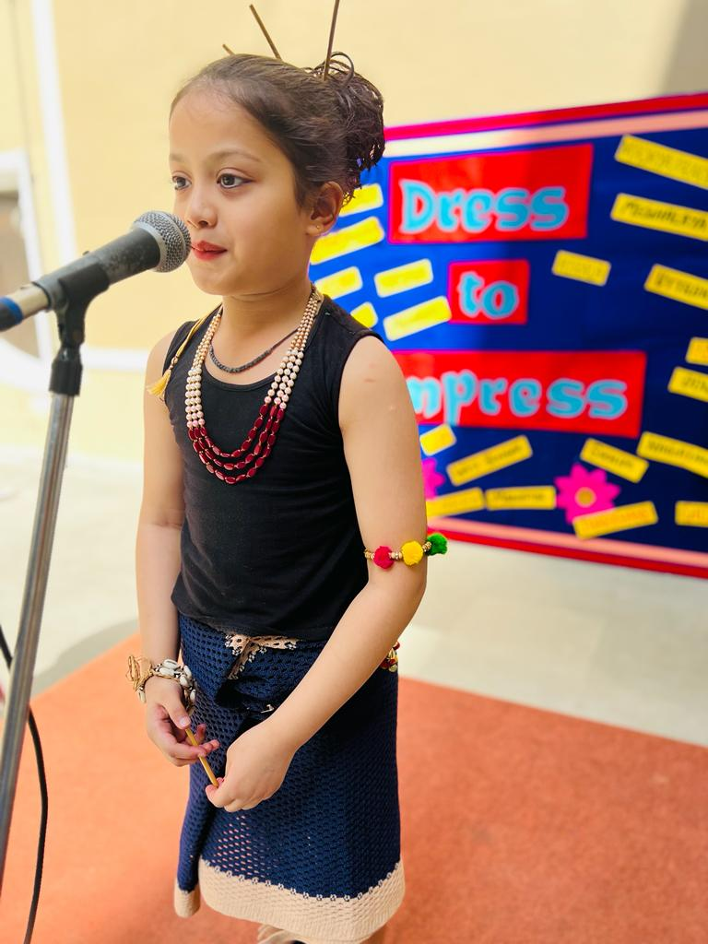
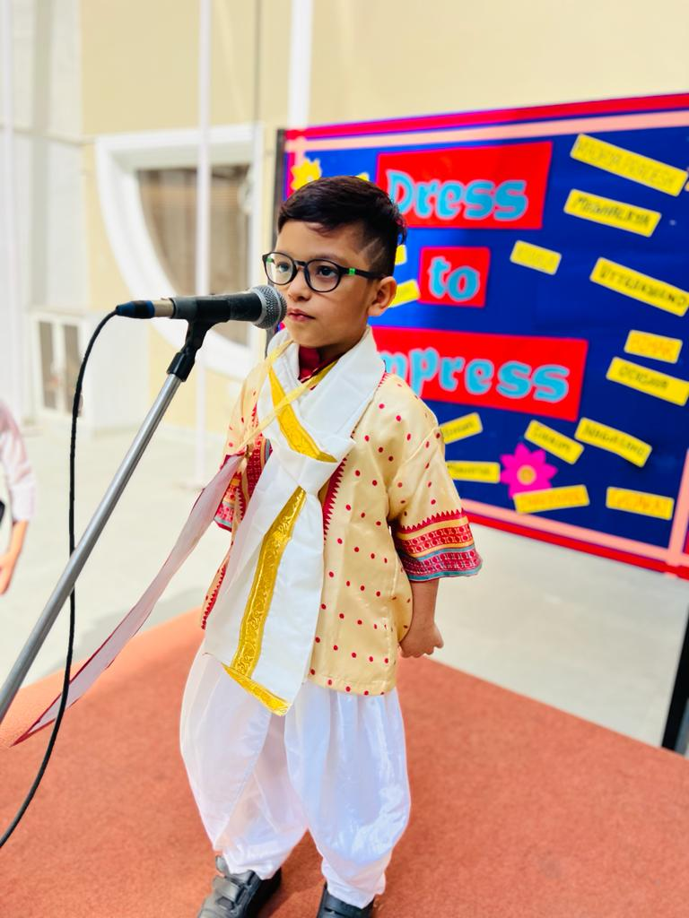
DRESS TO IMPRESS
Class II
An activity of ‘Dress to Impress’ was conducted by Class II students. Dressed in beautiful traditional dresses of different states of India, they spoke on the allotted state . The activity aimed to enhance cultural awareness and inclusivity.

Slide 13
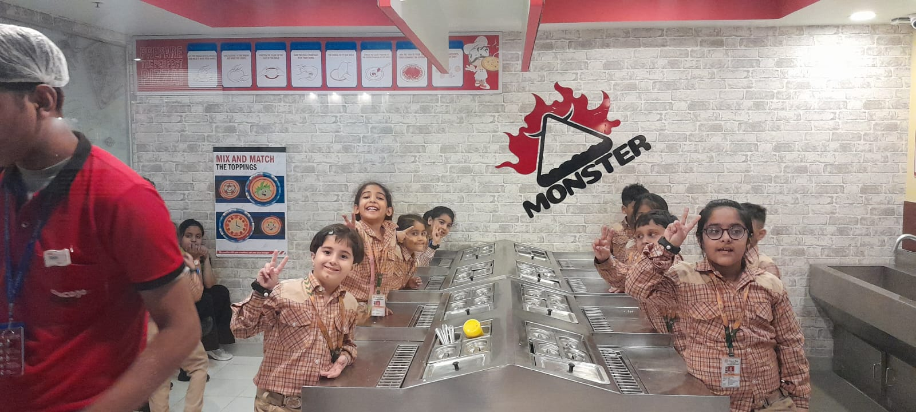
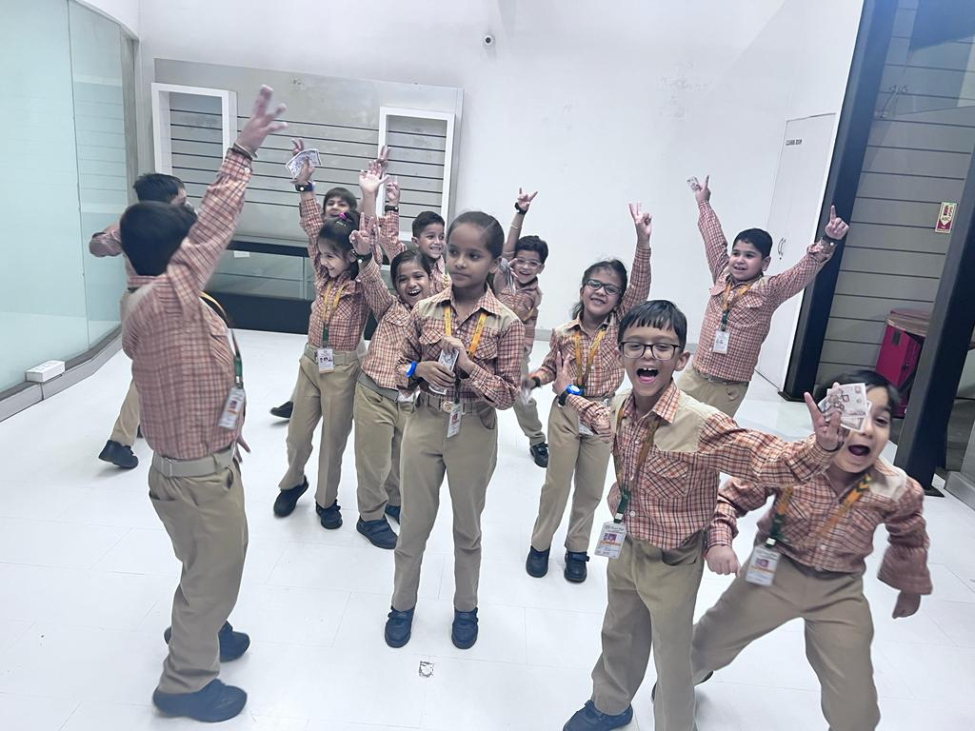
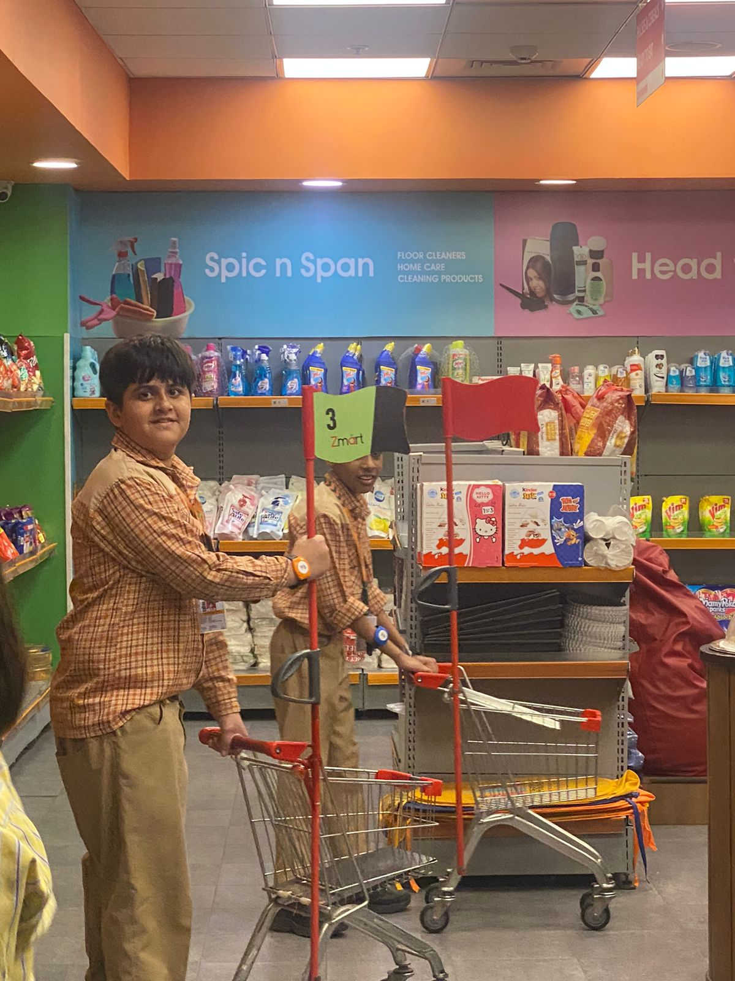
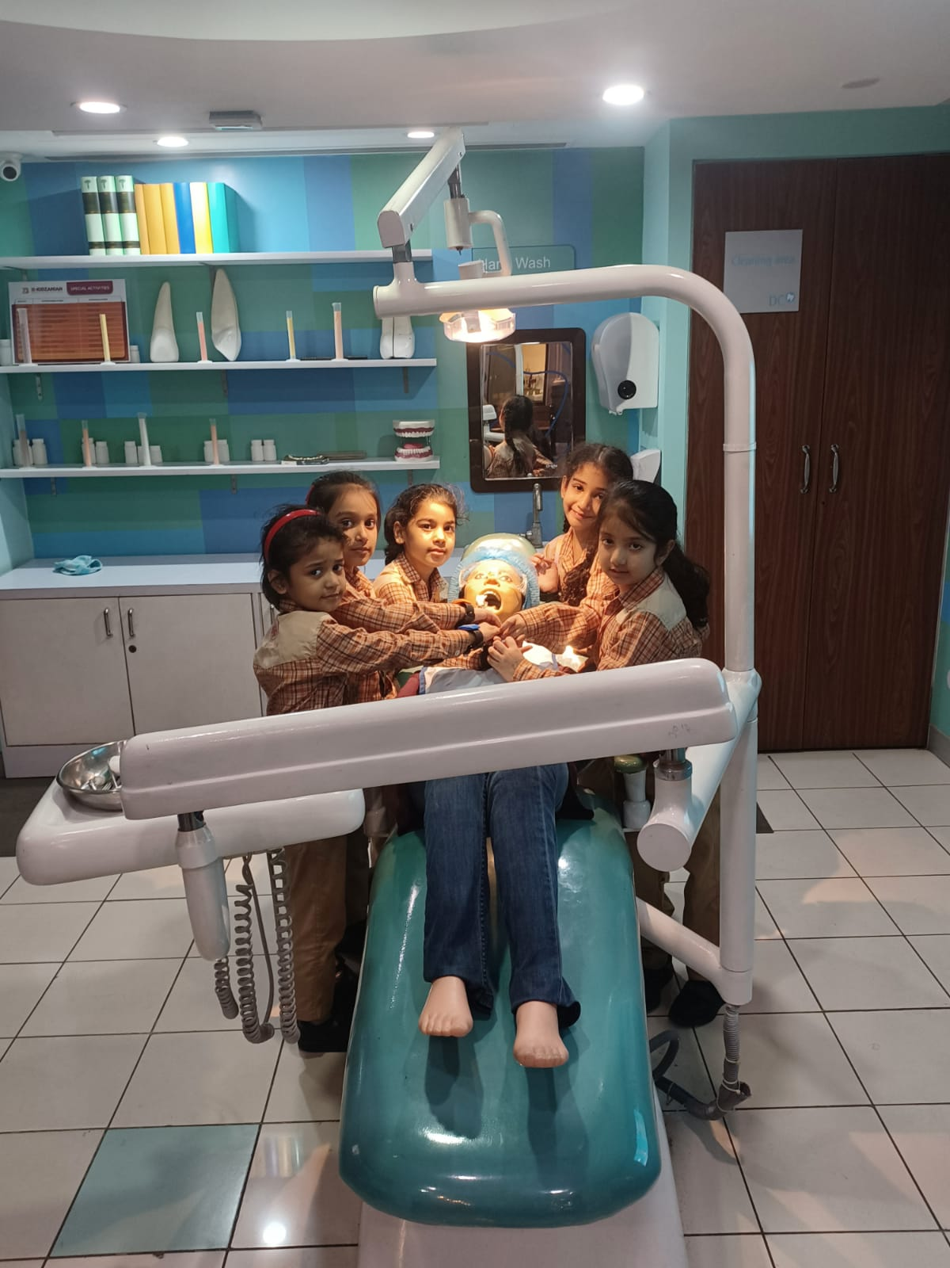
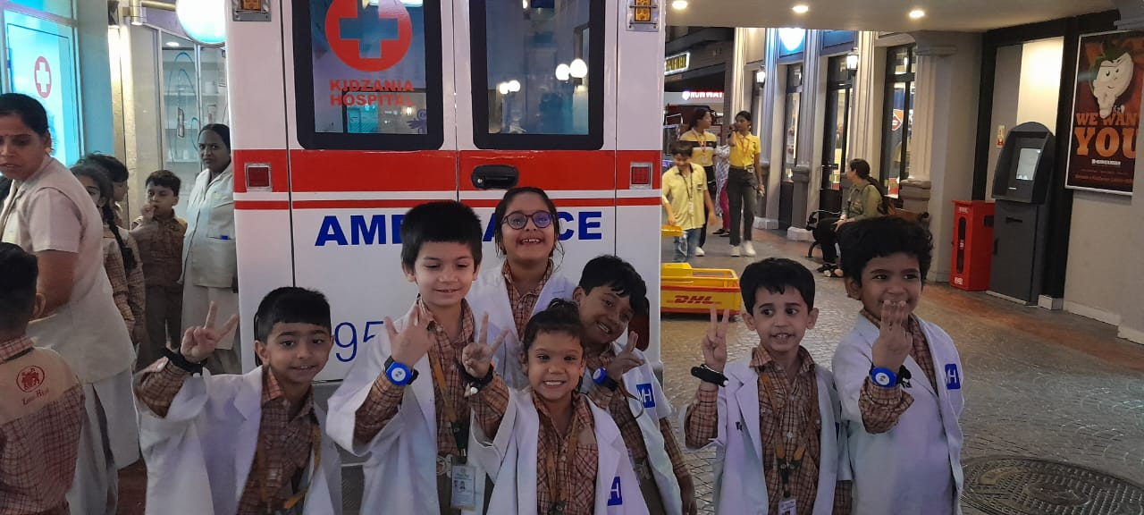
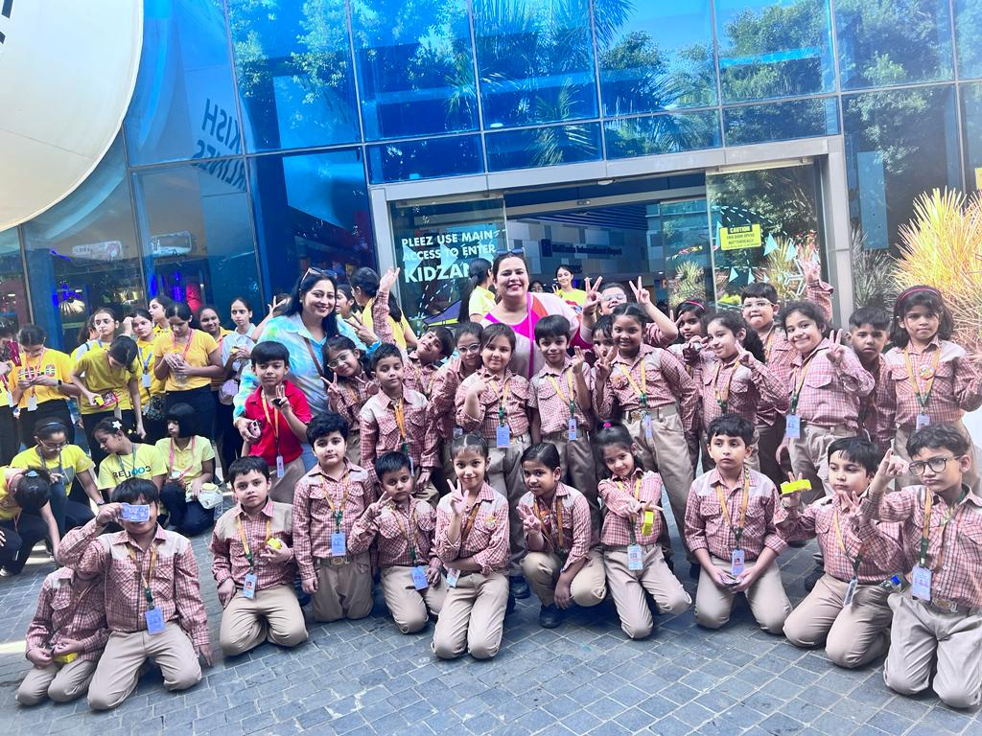
A DAY OUT TO KIDZANIA
Class II
Students of Class II had a great time at Kidzania playing their favourite real-world adult roles.

Slide 14
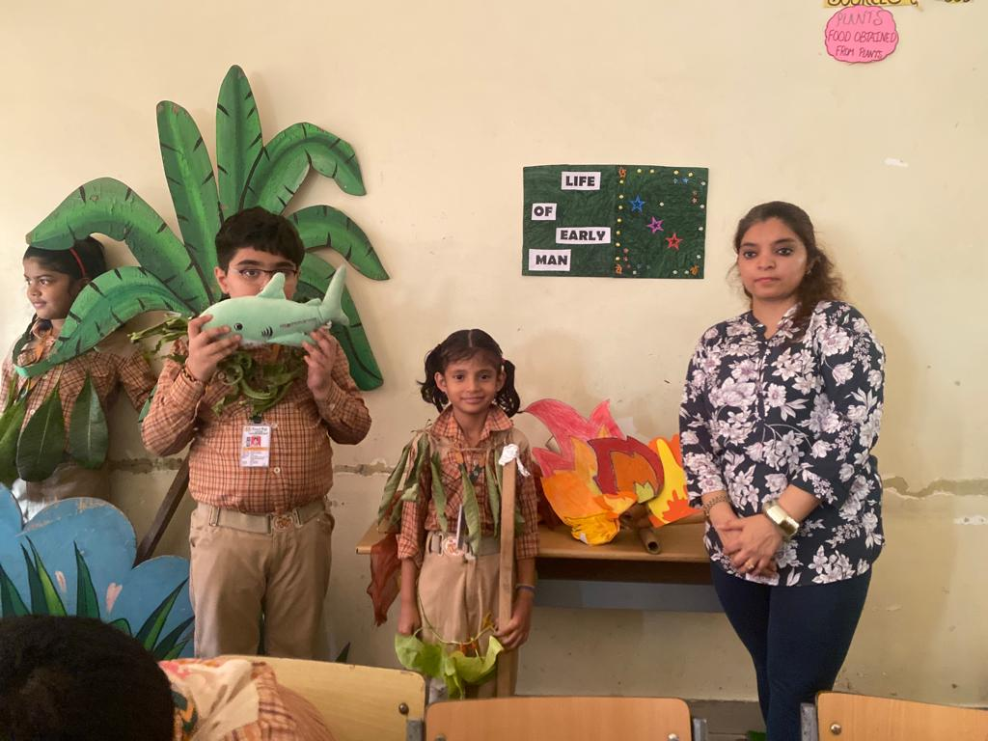
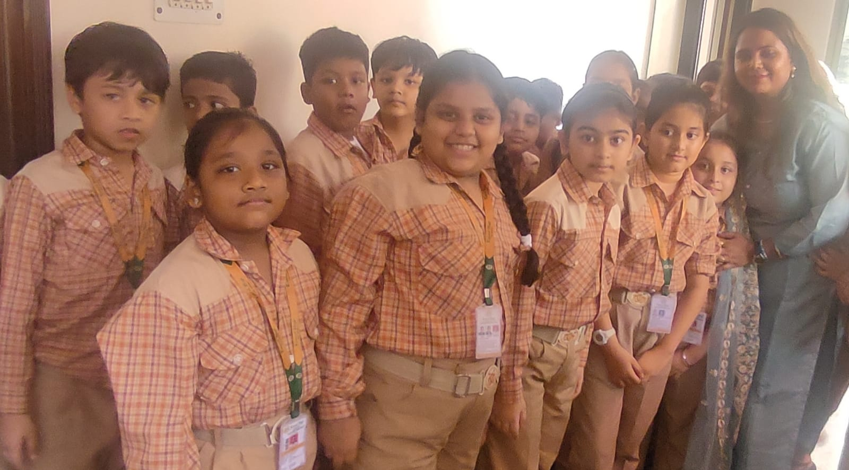
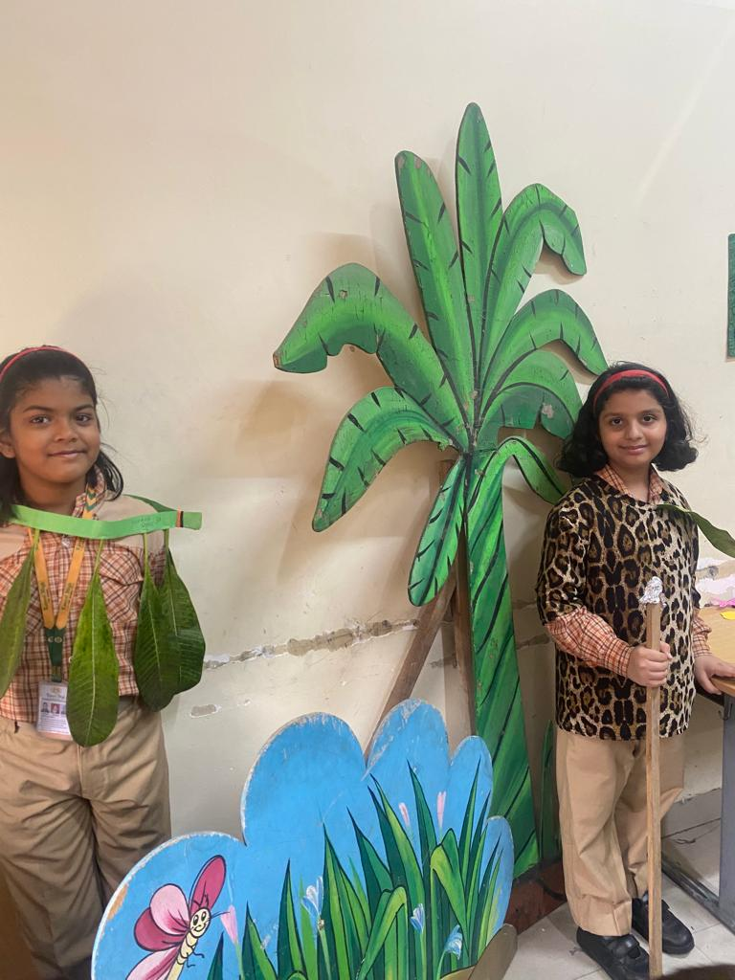
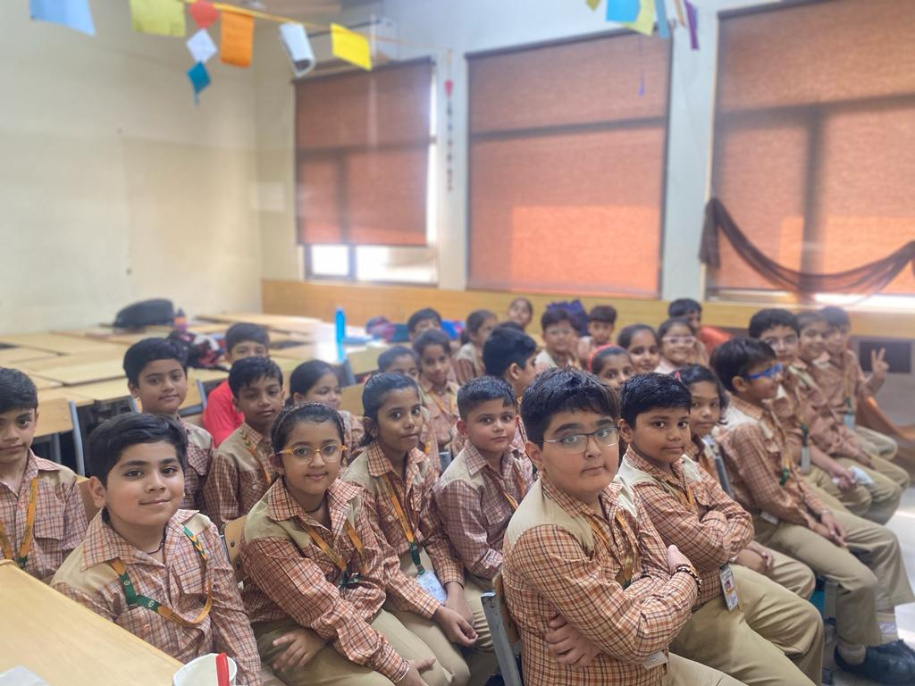
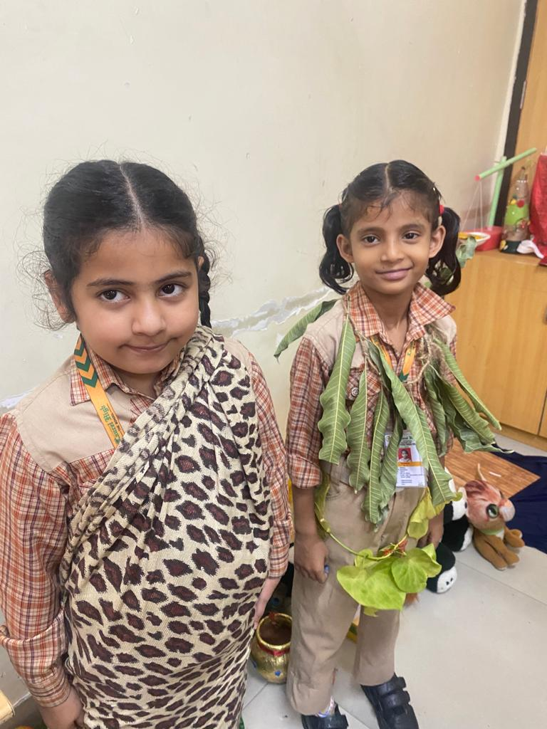
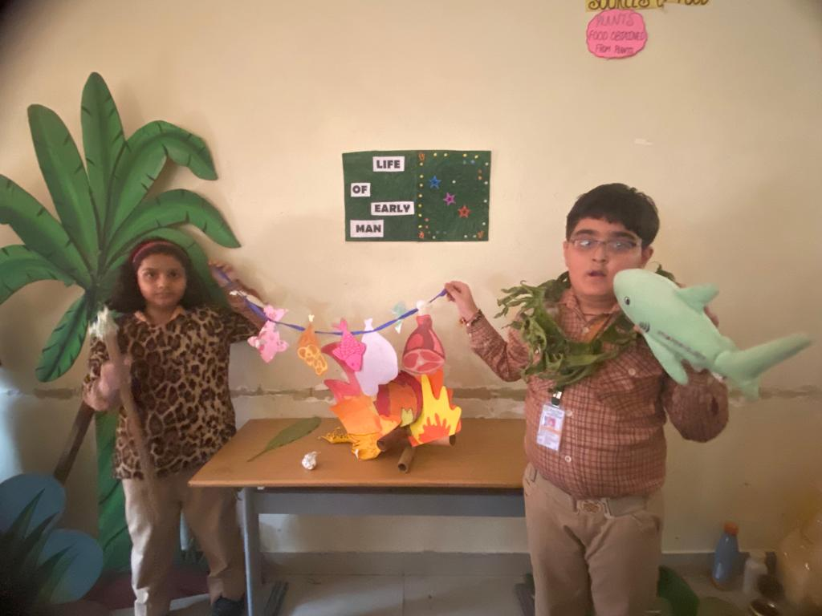
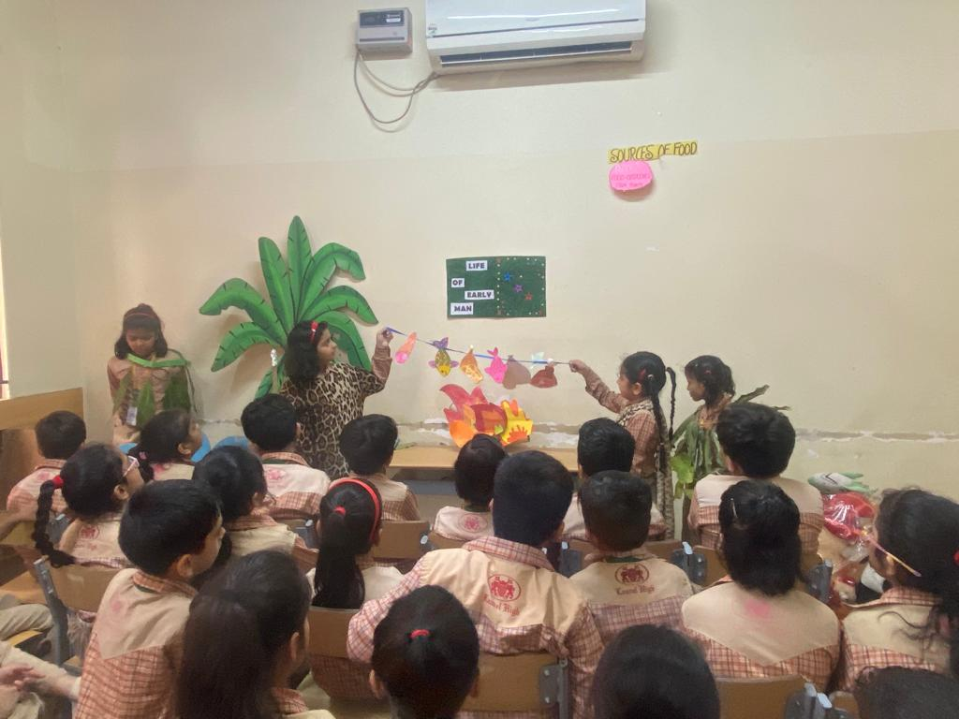
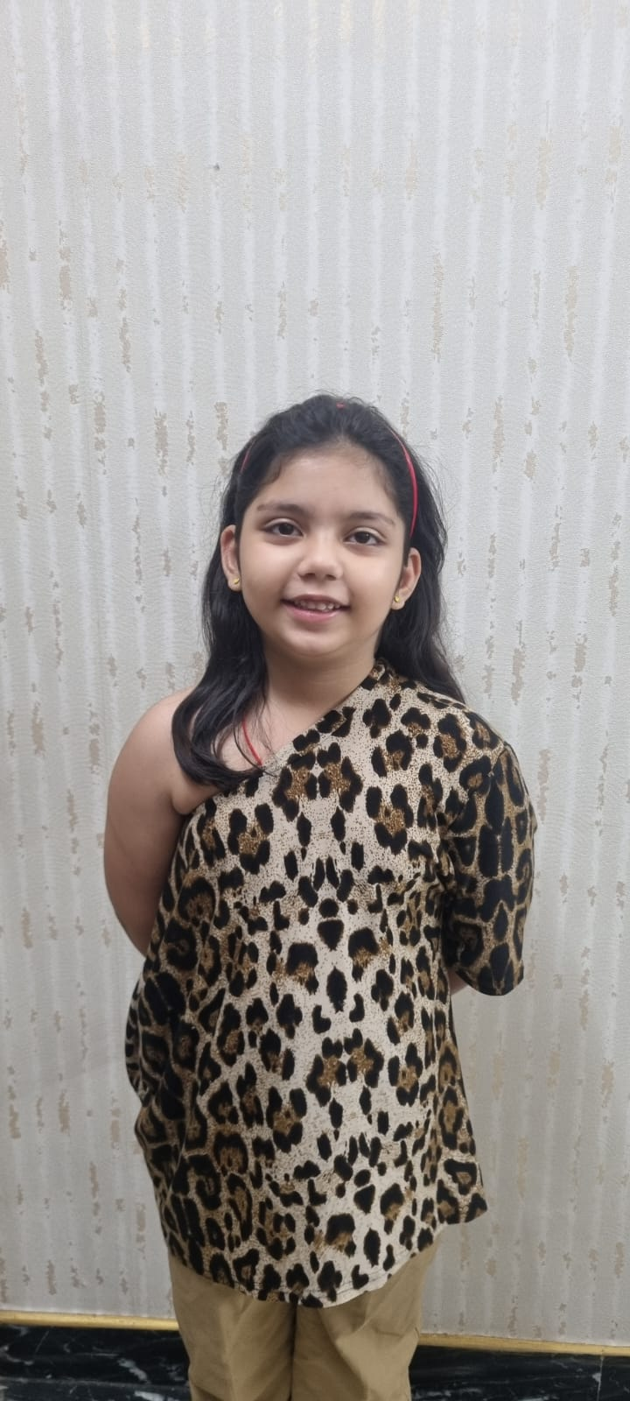
Class III
‘Story Dramatisation’ by the eloquent and creative students of Class III, showcased glimpses from the lives of early humans. Their talent convincingly took the onlookers to that era.

Slide 15
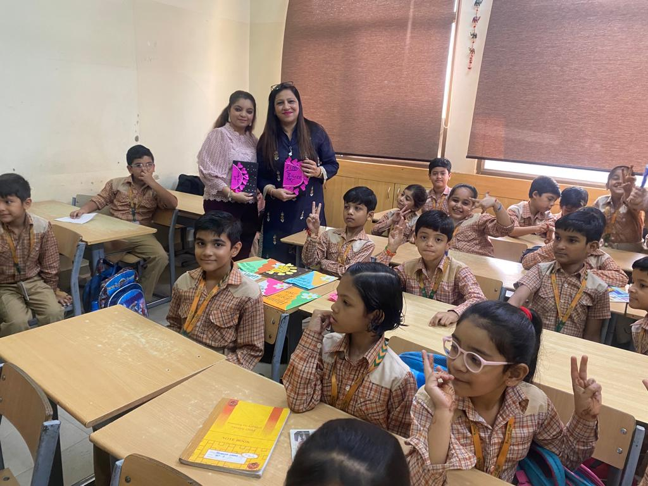
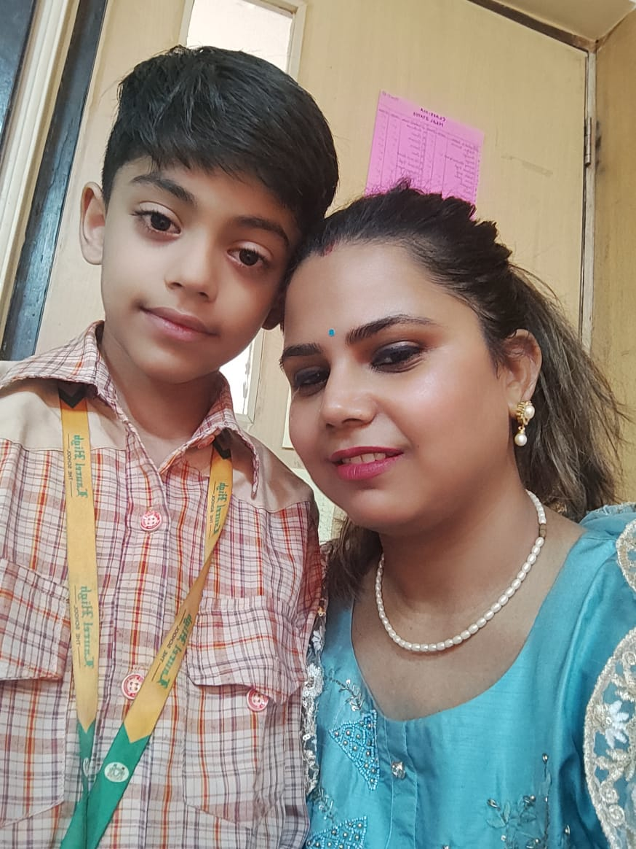
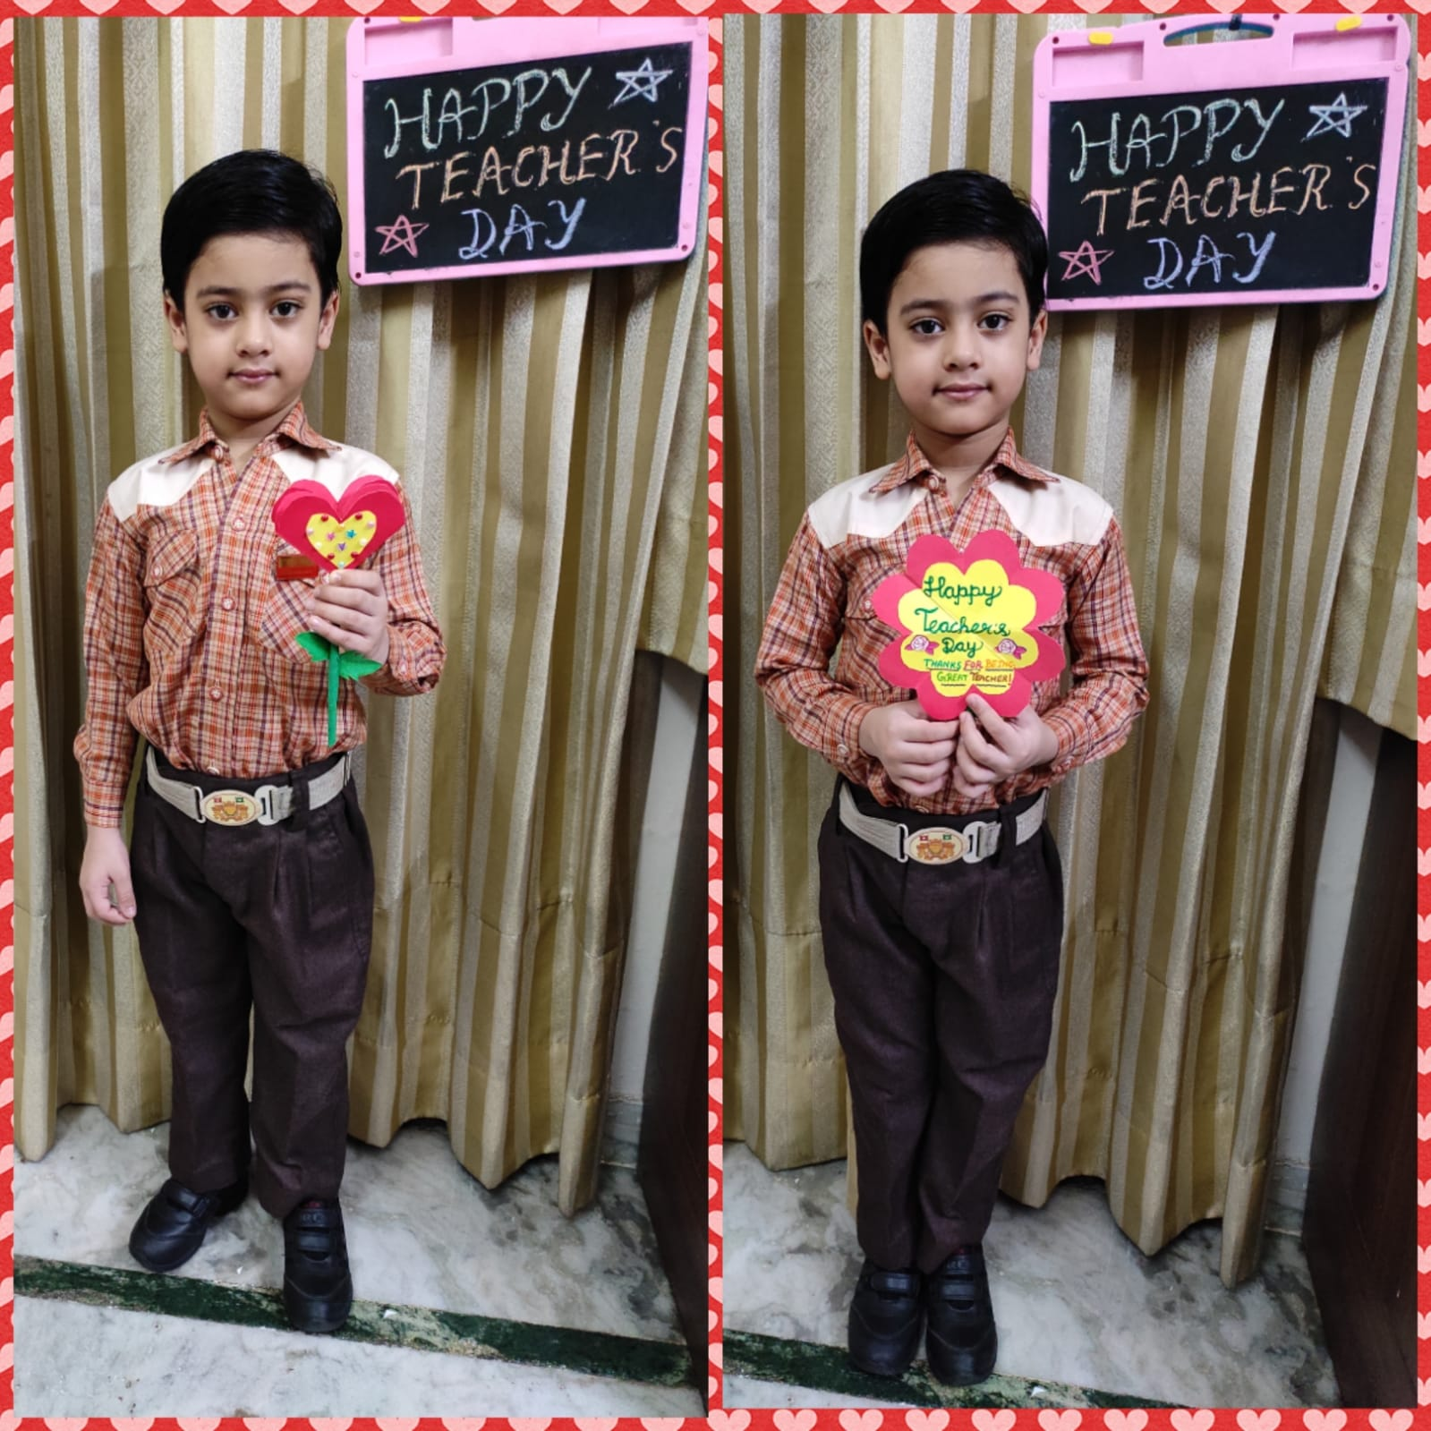
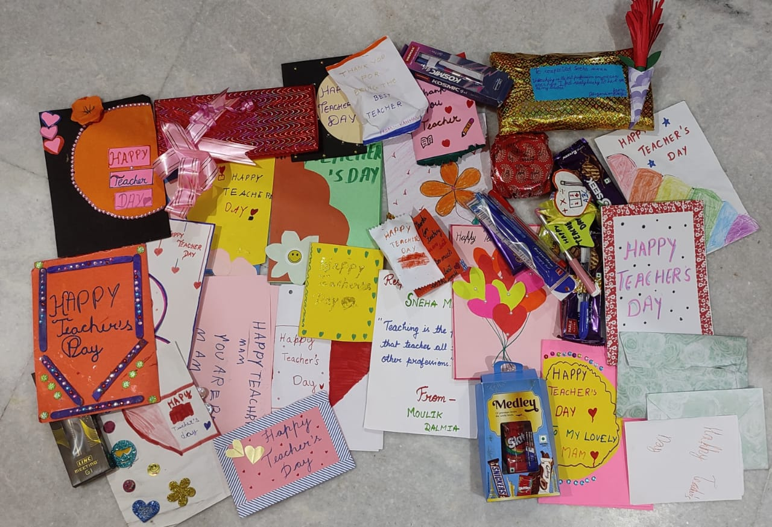
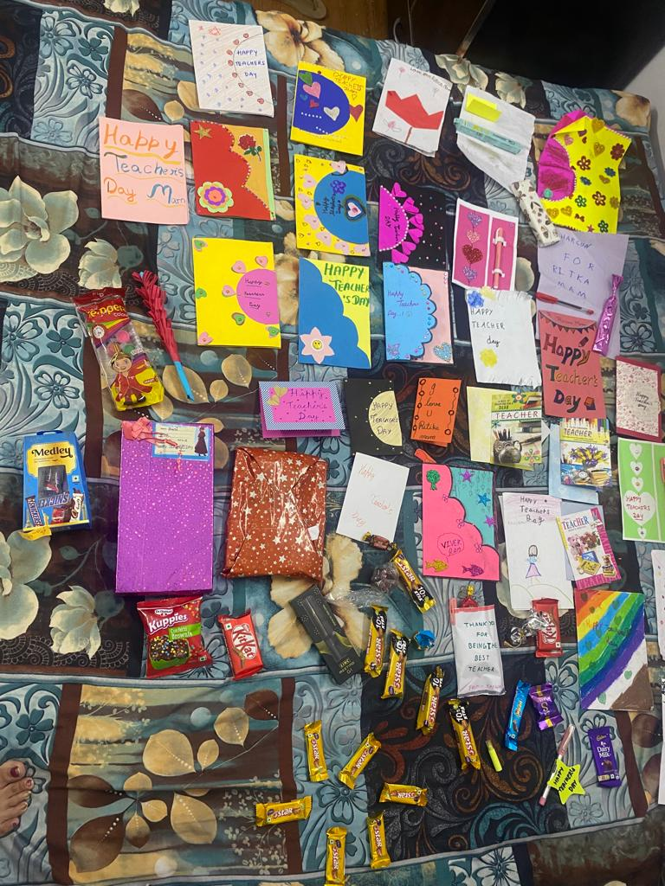
TEACHER’S DAY - A DAY OF LOVE & GRATITUDE
Class III
“A good teacher is like a candle- it consumes itself to light the way for others”

Slide 16
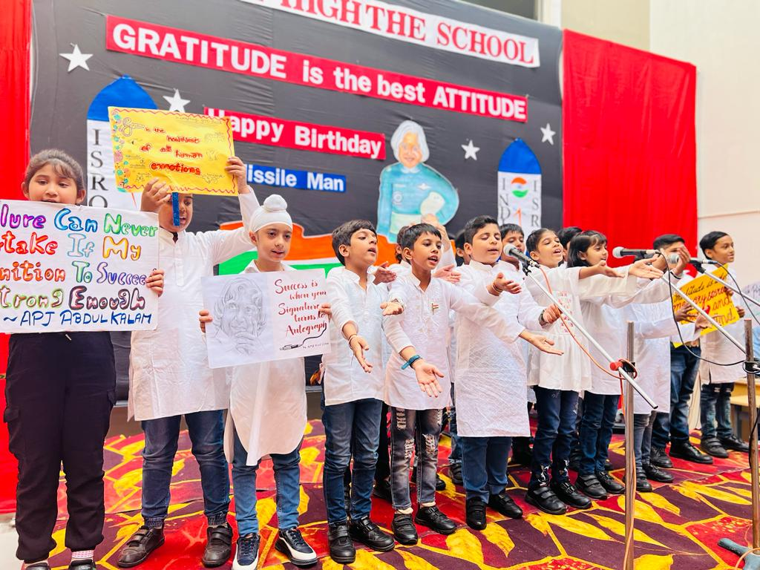
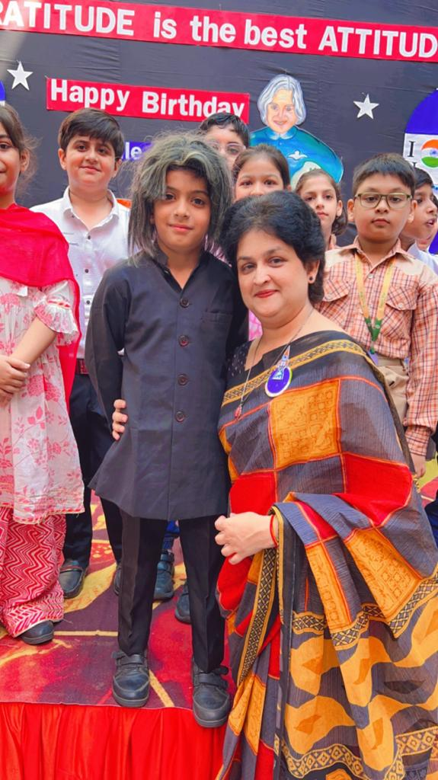
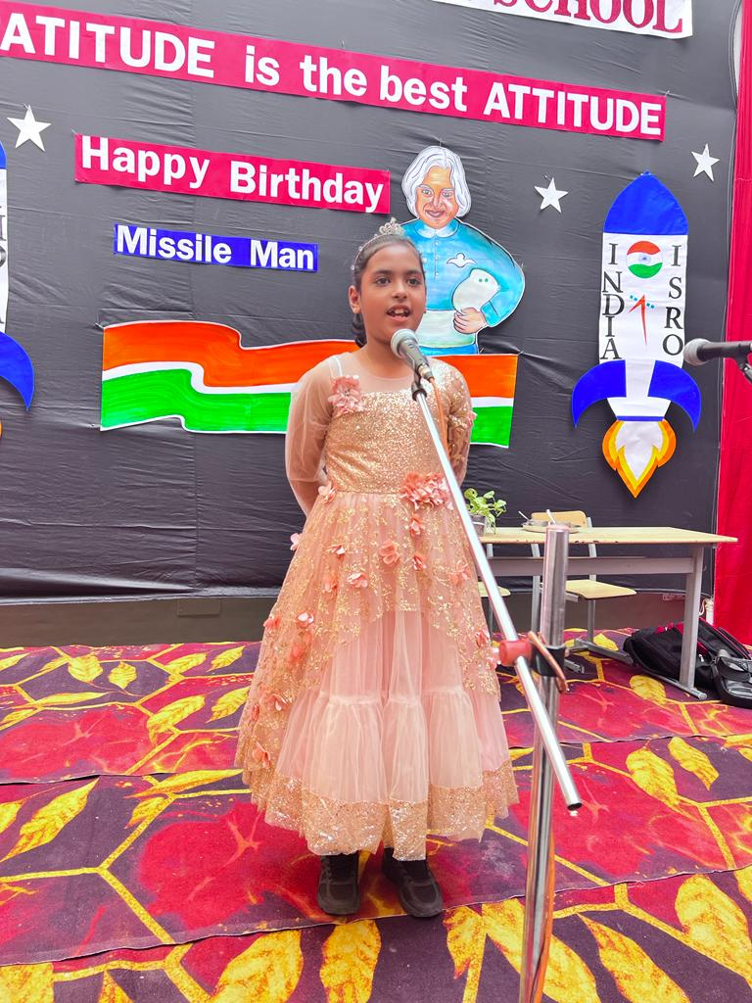
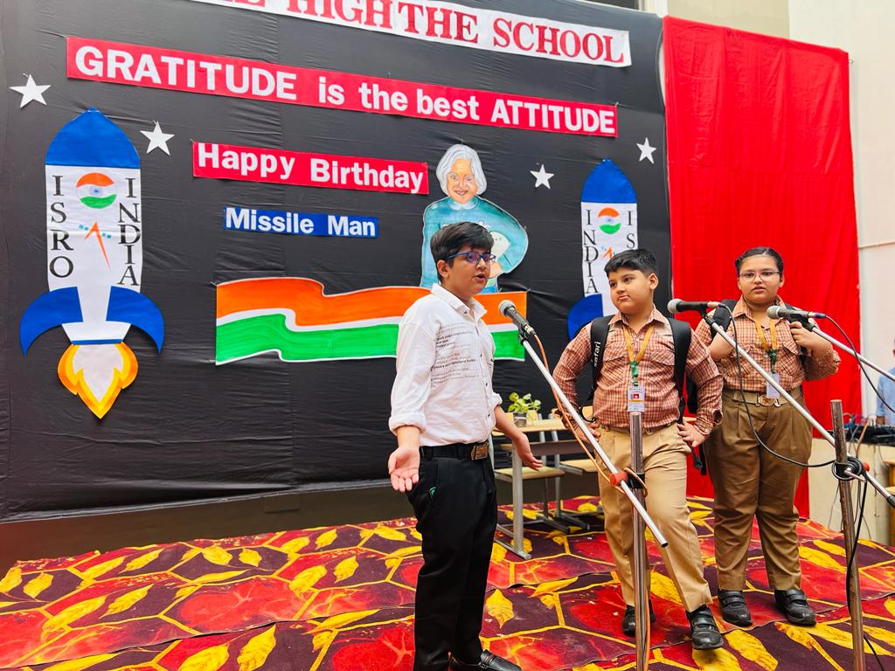
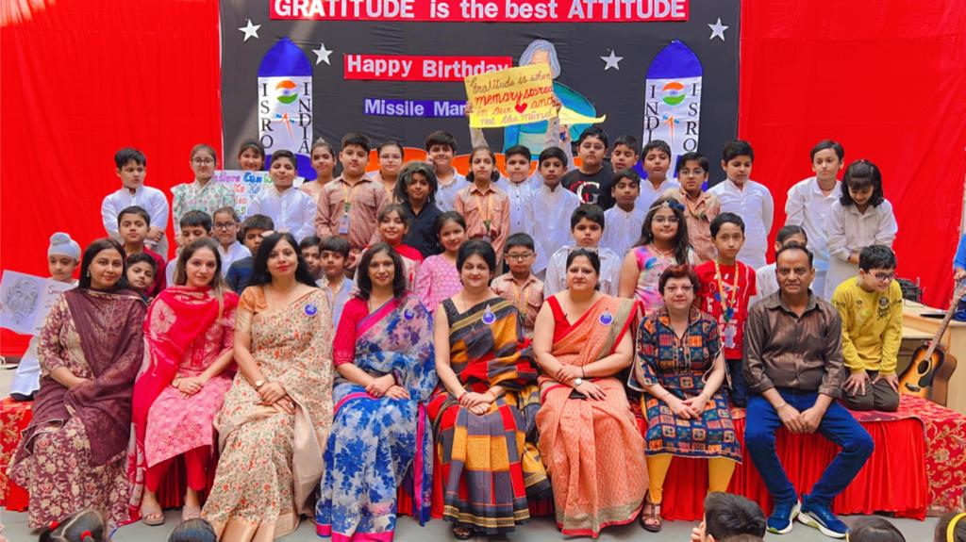
SPECIAL ASSEMBLY ON GRATITUDE
“Living in a state of Gratitude is the gateway to Grace.”
Class IV-B conducted a special assembly to pay heartfelt gratitude to Dr A.P.J Abdul Kalam on his birthday.
Class IV

Slide 17
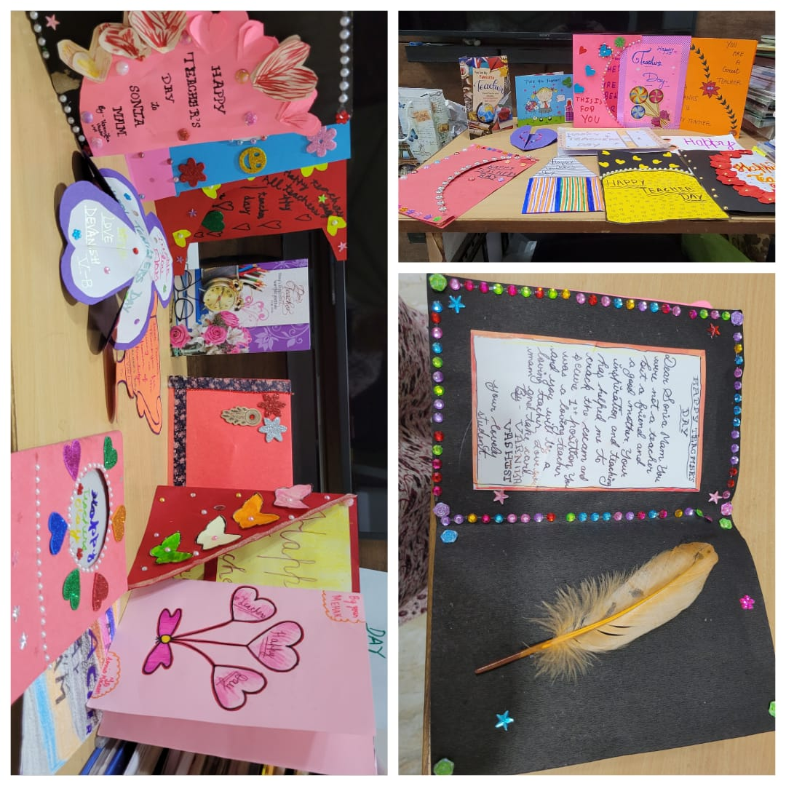
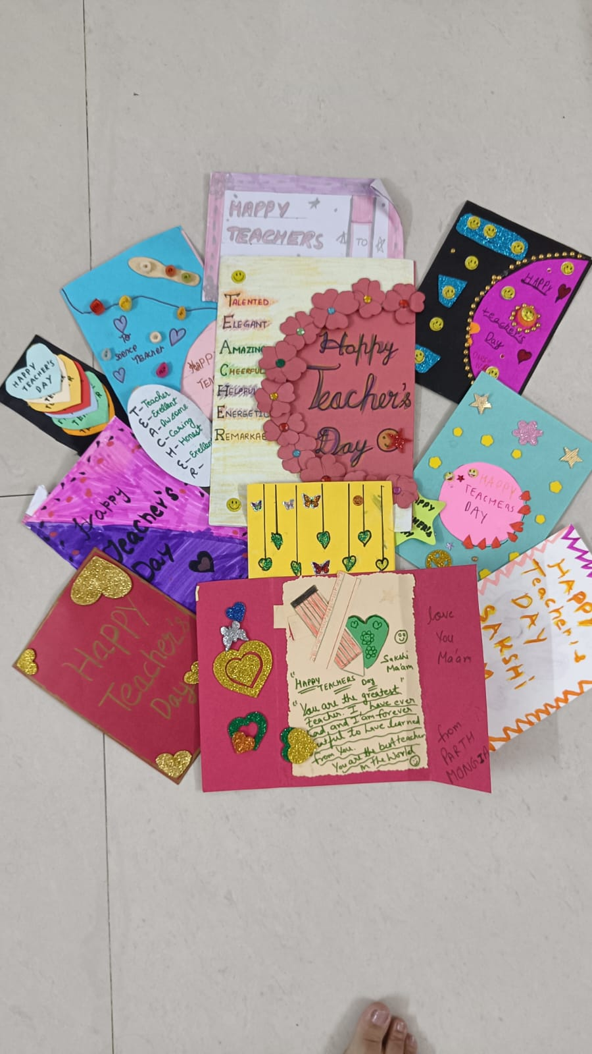


Class IV
CREATIVE HANDS
AT
WORK
“Creativity is intelligence
having fun.”.
It is the supreme art of the teacher to awake joy in creative expression and knowledge.

Slide 18







Class V
RECITATION OF VERSES FROM RAMAYANA
The students of Class V mesmerised the listeners by their recital of verses from the epic Ramayana in proper tempo and rhythm. Through this activity the students got motivated to imbibe the principles of Lord Rama in their lives. Their performances filled the air with peace and divinity.

Slide 19






ARTISTIC MINDS AT WORK
Class V
“Art Education helps children to introspect and become a better version of themselves instead of more like anyone else.”
Art washes away from the soul the dust of
everyday life.
MAANVIKA
AADVANSHI
GARVIT GOYAL
JIVAL MADAN
TANISH KAMRA
DEVAM BANIWAL
VARNIKA VASHIST

Slide 20




EVERY WORK OF ART IS A LESSON
IN INSPIRATION
Class VI
Teacher’s Day Celebration
AARAV GUPTA
Shanaya Goel

Slide 21
Class VI
SERVICE
My mother always taught me to be kind,
She says, people value a beautiful heart more than a sharp mind.
When time comes, you will see,
Helping people makes you happy.
Our Gods have taught us,
To be fair, true and just.
Always be up to provide service,
Help others and you’ll reach to heaven, that’s how you earn it.
In school teachers always say,
Making someone smile can make your day.
So donate money, food, books and toys
Serve the needy, always bring joy.
No matter where you are or who you see,
By helping others you can be happy as me.
Do it for peace, if not for heaven,
Get your service mode and help them.
Swara Sarabhai (VI B)

Slide 22
Class VI
MISSION- MPH
In a mission, “MPH” they stand with pride,
Three cousins, Mehul, Poorvi and Hridyansh side by side.
They want to save dogs from harm and strife,
Make sure they have a better life.
No more searching through garbage for food,
They rescue dogs, and that’s so good!
They give them love, a safe place to stay,
In their mission, they brighten each dog’s day.
Rain or shine, they never back down,
In their mission to save dogs all over town.
Heroes of compassion, with hearts so grand,
In DSM’s mission, they lend a helping hand.
Hridyansh Jain (VI A)

Slide 23



Creative Minds at Work
WHY ARE YOU AFRAID?
Why are you afraid?
Why do you consider life a trade?
Is it solace, or peace that you crave?
I know what yoU have been wanting,
I understand big steps can be daunting!
Being unique and different is not bad,
though it may make the people around you sad!
Calm yourself and say “Who Cares”’
you are different but special,
and the first one who dares!
So when life tells you to stop,
take my advice, listen to the idea,
and image should be cropped!
Vedika Jaiswal
VII - B
Class VII

Slide 24
Class VII
A Journey Through Imagination
Books are like windows to distant lands,
Where adventures await and dreams expand.
With every turn of a page, a story unfolds,
Filling our hearts with tales yet unfold.
From fantasy realms to historical lore,
Books take us on journeys we can’t ignore.
They transport us to places far and near,
Where imagination knows no bounds, my dear.
So let your mind wander through each line,
Discovering treasures that are truly divine.
For in the world of books, the magic lies,
Where stories come alive before our very eyes. Pari Mittal
VII A
Discipline
The call to follow a direction,
Where few would go by choice,
Where all will hear your voice.
It’s not without some sacrifice, or trade of sweat and toll,
Will you do what’s needed?
If we are to reach our goal.
Muskan Garg
VII A

Slide 25


Class VIII
Hope is Something that Brings
Hope is something that brings
So much of peace in your life
When things don’t work the way
You want them to work for you
When you expect a lot
And you are left with only few
It is hope that rekindles the faith
It is hope that takes you ahead with life
Do not lose hope in this way of life
Where you will find yourself
In the midst of things, you want to find
And things that are meant for you
Just keep your hope alive!
Sanchi Poddar (VIII A)
VIII A

Slide 26


An Evening in Snow
The house is still and I am too,
outside the street, lamps grow
and I’m warm tucked in my bed,
watching the snow in the evening.
It covers all the roofs and roads,
till everything’s made white,
and quiet all that it befalls.
On this cold winter’s night.
Navya Bhutani
VIII B
Class VIII
LOVE YOU, DAD
You gave me the world dad, with your love and care,
Your strength and wisdom, always there,
You showed me how to stand tall and be brave,
To be kind and compassionate.
Through thick and thin, you were always my guide,
Your love and support, I cannot hide,
Dad, I’m grateful for all that you do,
I LOVE YOU SO MUCH…..
Dhanya Sharma
VIII B

Slide 27


CREATIVITY UNLIMITED
Class IX
DAKSH DAMBLANI
(IX-B)
RADHA KRISHNA
—---DEVANSHI (IX-B)

Slide 28
STREET CRIME
“We should be tough on crime and tough on the causes of crime.”
As you all know that street crime is increasing rapidly all over the world. A crime committed by the people on public places is termed as a street crime. It is a type of crime that occurs on the street. The most common of them are robbery, pickpocketing, theft, harassment, kidnapping etc. That can happen to anyone. Mostly young people are at a risk because they are mostly outside the home doing many things such as going for studying, jobs and performing many other tasks. These crimes can happen anywhere - at school, at home, in parks etc. The major causes are unemployment, lack of education, poverty, greediness, revenge and some are compelled to commit crimes because of other reasons. We can work to control street crimes in certain ways such as government should make available jobs for young people, providing facilities for doing our own business, reducing the cost of education for people, install CCTV, improve street lighting, honest policemen should be employed by the government etc. These are some of the ways in which street crime can be reduced. On the other hand, we should also help the government by making our efforts and make people stop doing these crimes. By doing all these things we can make the world free of street crimes and live without worrying for our children.
“Crime prevention saves lives and money.”
Kush Bhola (IX-A)
Class IX

Slide 29




“There is No Must in Art because ART is FREE.”
Class X
BHAVYA NAYAK
(X- A)

Slide 30
Timeless benefits of Reading Newspapers
“ Reading newspapers is not just about staying informed , It’s about satisfying your curiosity, expanding your horizons and fostering a deeper understanding of the world.”
In today’s digital age where information flows through screens and social media feeds , the practice of reading newspapers remains as relevant as ever, offering a unique and invaluable source of information , insight and cognitive stimulation. There are enduring advantages of picking up a physical newspaper or browsing through a digital one. So, let’s delve into the benefits of reading newspapers.
One key advantage of reading newspapers is their ability to provide in-depth coverage of news stories. Unlike brief, and often sensationalist headlines of social media. Established newspapers have a reputation for credibility and reliability. Journalist and editors adhere to ethical standards, ensuring that information presented is accurate and trustworthy. In a world where misinformation Is rampant, newspapers serve as a reliable source of news. Regular newspaper reading contributes to vocabulary enrichment and literacy. Articles often introduce readers to new words and concepts, expanding their language skills. This is particularly beneficial for students and individuals looking to enhance their language proficiency.
In conclusion, while digital media has transformed the way we consume news, the benefits of reading newspapers persist. They offer a reliable, comprehensive, and diverse source of information that fosters critical thinking, community engagement, and an appreciation for history.
“Informed readers ,empowered minds ;
unleash the power of newspapers”
AMAIRA BHASKAR (X-A)
Class X

Slide 31
Class X
A PERFECT SURPRISE
It was a beautiful sunny afternoon when Inaya left for her home after playing with her friends for
hours. On her way back, she saw a huge gathering round her house. She was puzzled and at
the same time quite frightened. A thousand negative thoughts crossed her mind which she
pushed aside and started running towards her house.
She squeezed in through the crowd and finally reached her house gate. What she saw was truly a
shock for her! She could not believe her eyes. Her idol was standing right there in front of her. It
was none other than the renowned author J.K. Rowling. She opened her mouth to speak but no
words left her mouth. She was overjoyed. 'Come inside dear. She's here for you only.' her mother said. She happily
entered banging the door behind leaving the people outside dumbstruck.
'Umm... Hello ma'am.' Inaya stuttered, unable to understand how to begin the conversation. J.K.
Rowling laughed merrily at her cuteness. 'Hello little kid' . Daughter, we will be publishing her
upcoming series of Adventure Stories', her father said. Inaya was on cloud nine. She could not
believe her ears. Her father was going to publish her favorite author's books! ' Oh my god, dad'
Inaya exclaimed. 'Can I get your autograph, ma'am ?' Inaya asked nervously. 'Sure kid... Your
mom showed me your self-written stories. They are marvellous. You'll become a great author
some day.' 'Thank you so much ma'am. I really need more motivation right now.' 'Dear, your only
motivation should be you. But you have done commendable work. It's quite appreciable. ' Had
she been alone, Inaya would have screamed right now.
She was being appreciated by her idol!
After a lot of discussion, J.K. Rowling stood up. ' I am afraid , I've to leave now. Uh.. By the way
Inaya I got a gift for you.' She said and took out a brown envelope. 'This is the first copy of my
next book, it has got my signature. A small gift for you.' 'Thank you so much ma'am, I'm
seriously out of words right now.' said Inaya who was unable to express her gratitude.
That night Inaya went on thinking of the events that happened that day and she couldn't stop smiling.
Vanya ( X B)

Slide 32




TEAM BUILDING
Class XI
(Group Activity)
AIM: To be effective at communication, team building, leadership and spontaneity.
The entire class participated and were engaged in fun activity.
Poem Composed by
Purvi Gupta (XI-A)

Slide 33

THAT NIGHT 🌉
I could still hear those voices
Every late night
But no one understood
what was my plight.
I wish I could tell what happened
What was the story of "her " that night.
Cuz it was just the start and not the end
About something that disguised herself A "FRIEND "
I could feel her presence
And hear her crawl
I felt weird as if someone was there.
Behind the wall.
Staring at me with those brilliant bloodthirsty eyes
Who had a chilling cackle and bloodcurdling cries.
Had shaggy hair and tangled locks
Which grew and caught me as she walked
I suddenly froze and could not walk
Class XI
Her looks were eerie
More horrifying than anyone ever talked
Yes she was the BLOODY MARY.
I begged her to SPARE me
Begged her to let me be free
But on hearing her words
turned me to a stone
When she said
" I'll always follow you till grave stone.“
Paavani Jetli
(XI- B)
XI B

Slide 34

TEACHERS’ DAY CELEBRATION
Class XII
Students of Class XII presented a special assembly as a mark of gratitude and respect for all the teachers on 5 September. It was
a memorable day for everyone.The event was a wonderful amalgamation of song, dance, skit , self composed poem and heartfelt expressions of students. They felicitated the Head of School, Incharges and all the teachers with beautiful Mementoes. It was a day of mixed feelings both for the teachers and students. Teachers bestowed their blessings on the students and prayed for their bright future.

Slide 35
वो दिन भी क्या दिन थे !
Class XII
सुबह मम्मी उठाती आवाज़ लगाकर, स्कूल के लिए देर नहीं हो रही lउस ठंडी हवा में बस का इंतजार करते और
खुद से ही पूछते आज ज़्यादा ही ठंड नहीं हो रही।
कॉरिडोर में शोर मचाते हुए टीचर्स से छुपना छुपाना l किसी के अधूरे प्रोजेक्ट वर्क को चलती क्लास में ही पूरा करते जाना।
ब्लेज़र डाल के सिर पर किसी के बेमतलब ही उसकी कुटाई हो जाती थी l वह सीन भी किसी मूवी से काम थोड़ी ना होता था,जब स्कूल में किसी की लड़ाई हो जाती थी।
हम सारे दोस्त तब एक परिवार-सा हुआ करते थे l स्कूल जाने का मतलब दोस्तों से मिलना ही तो था, बेतुकी बातों पर भी
बेहिसाब हँसते थेl अब जिसको आज याद करके हँसते हैं, वह स्कूल ही तो था l
एक-एक करके गॉसिप सुनना और सुनाना, वह उलझी हुई सी जिंदगी बेफ़िक्र से जीते थे, हम एक बार फिर से उस ग्राउंड में पड़ती धूप सेंकते थेl अच्छे थे यार वह दिन भी जब स्कूल में थे हम l
याद है वह स्कूल का आखिरी ऑफिशियल दिन जब आखिरी बार हम स्कूल में एज़ ए स्टूडेंट गए थे l आखिरी बार अपने क्लास में बैठे, आखिरी बार टीचर को लेक्चर देते हुए सुन रहे थे l उस वक्त पता थोड़ी ना था कि यह दिन भी इतनी याद आएँगे l
अपनी मेन्यू की चाउमीन का टेस्ट , हम कहीं ओर ढूँढ ही नहीं पाएँगे l लंच में की हुई छीना झपटी भी उन खास पलों में से एक होगीl टीचर्स के ताने और डाँट भी क्या पता था इन यादों के लिए एक भेंट होगी।
वॉशरूम भी दोस्त सारे ग्रुप में जाया करते थे , वहीं से फिर बंक मारने का प्लान बनाया करते थेl अपनी डेस्क को किसी ओर के बैग से साफ करने में सुकून मिलता था, क्लास के टाइम कॉपी पर लिख लिखकर बातें करना फन लगता था।
आज भी कोई पूछता है कि स्कूल याद आता है , क्या मैं कहती हूँ नहीं पर स्कूल के वह लोग याद आते हैं l बिल्कुल वैसा ही रिश्ता तो उन सब से अब रहा नहीं, पर जिनसे रह गया वह जिंदगी भर के लिए अपने हो जाते हैं | आशी बेलान( XII B)

Slide 36

BOOK REVIEW
“The Girl of Ink and Stars”
“The Girl of Ink and Stars” by Kiran Millwood Hargrave is a gripping tale of grit, resilience, myth and magic for young readers.
Little Isabella is a budding cartographer who sets out to hunt for her lost friend with only an ancient map and deceit as her tools. Her rollercoaster ride is a daring combination of not only courage and compassion but also loss and discovery. She travels in the most unlikely company facing unseen monsters through hell, heaven, fires, forests and forbidden territories. Strongly recommended for all age groups, especially readers on the lookout for a heartwarming fantasy tale.
By Ms. Sangeeta Goel
(Sr. Academic Coordinator)

